Slide 1
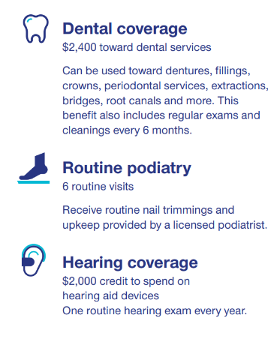
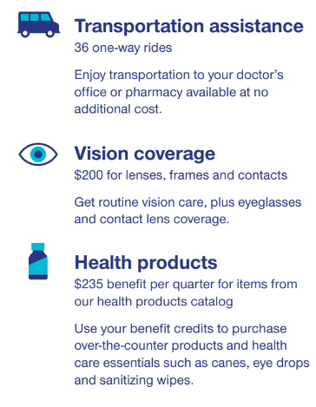
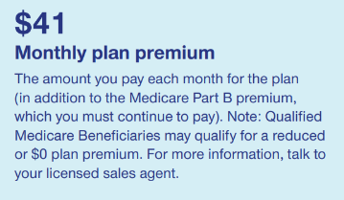
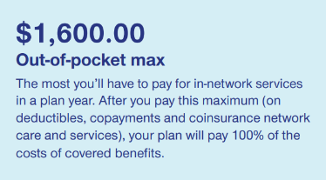
ALABAMA 2024
BALDWIN
JEFFERSON
MADISON
MOBILE
MONTGOMERY
SHELBY
H0710-070-000
PPO - IESNP

Slide 2
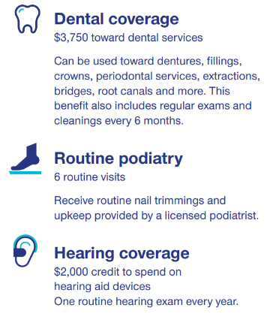
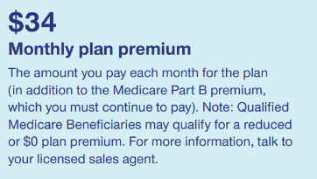
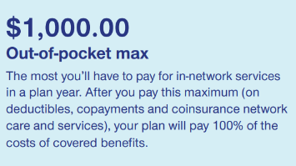
COLORADO 2024
ADAMS
ARAPAHOE
BOULDER
DENVER
DOUGLAS
EL PASO
FREMONT
JEFFERSON
LARIMER
PUEBLO
WELD
H0710-008-000
PPO - IESNP

Slide 3
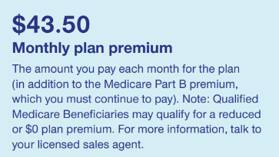
Connecticut 2024
FAIRFIELD
HARTFORD
H0710-009-000
PPO - IESNP

Slide 4
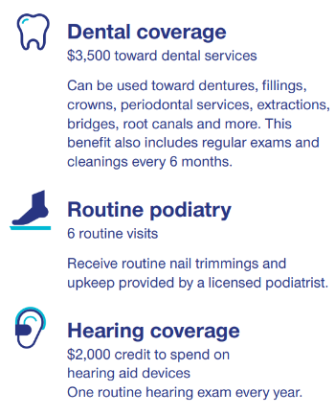
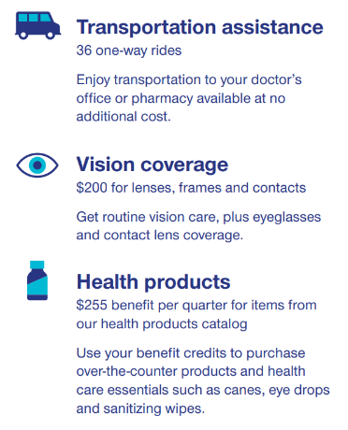
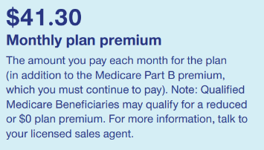
DC 2024
WASHINGTON DC
H0710-059-000
PPO - IESNP

Slide 5
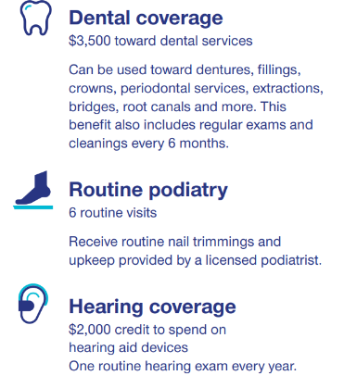
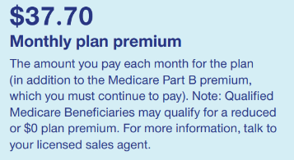
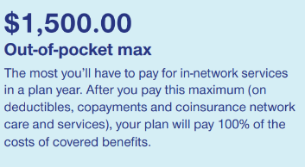
FLORIDA 2024
ALACHUA | MARION
BREVARD | MARTIN
BROWARD | NASSAU
CHARLOTTE | OKALOOSA
CITRUS | ORANGE
CLAY | OSCEOLA
COLLIER | PALM BEACH
DADE | PASCO
DUVAL | PINELLAS
ESCAMBIA | POLK
HERNANDO | SANTA ROSA
HILLSBOROUGH | SARASOTA
INDIAN RIVER | SEMINOLE
LAKE | ST LUCIE
LEE | SUMTER
MANATEE | VOLUSIA
H0710-012-000
PPO IE-SNP

Slide 6
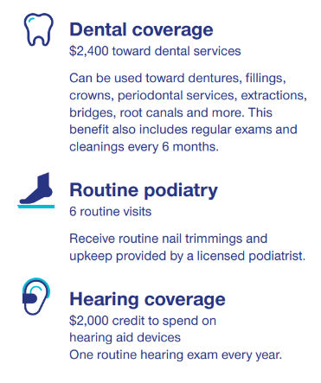
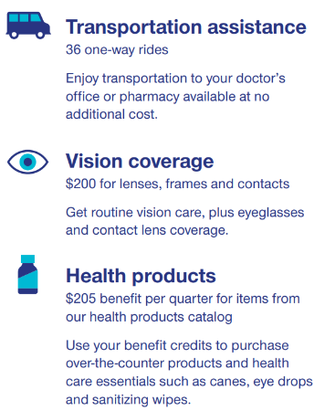
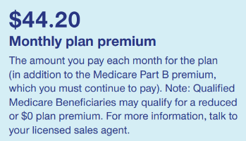
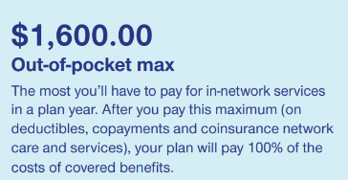
GEORGIA 2024
CHATHAM
CHEROKEE
CLAYTON
COBB
COLUMBIA
DE KALB
DOUGLAS
FAYETTE
FLOYD
FORSYTH
FULTON
GWINNETT
HALL
HENRY
MUSCOGEE
RICHMOND
ROCKDALE
H0710-054-000
PPO - IESNP

Slide 7
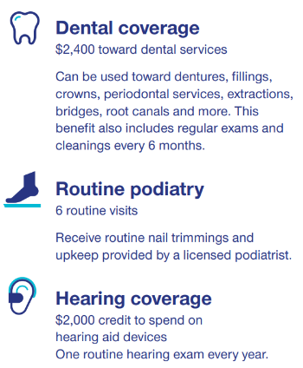
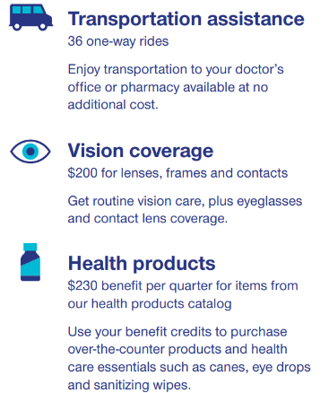
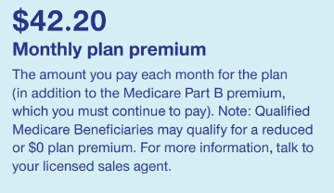
IOWA 2024
BLACK HAWK
CLINTON
LINN
POLK
SCOTT
H0710-060-000
PPO - IESNP

Slide 8
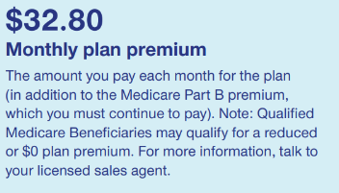
ILLNOIS 2024
COOK
DU PAGE
LAKE
H0710-055-000
PPO - IESNP

Slide 9
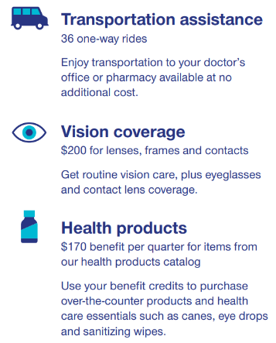
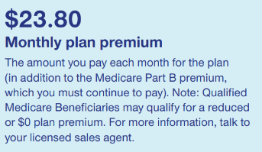
INDIANA 2024
ALLEN
GRANT
HAMILTON
HENDRICKS
JOHNSON
LAKE
MADISON
MARION
MONROE
PORTER
ST JOSEPH
TIPPECANOE
H0710-061-000
PPO - IESNP

Slide 10
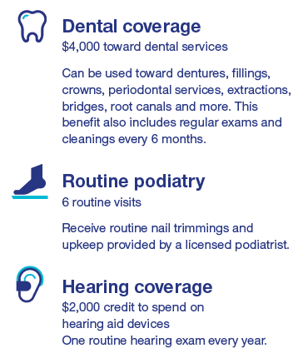
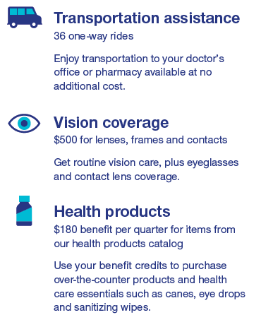
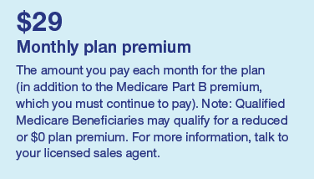
KANSAS 2024
JOHNSON
H0710-062-000
PPO - IESNP

Slide 11
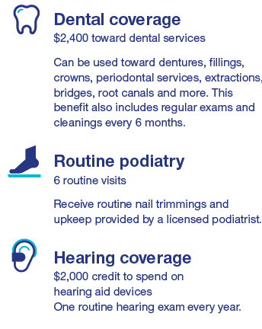
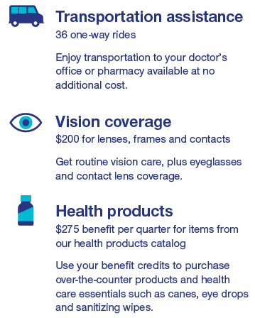
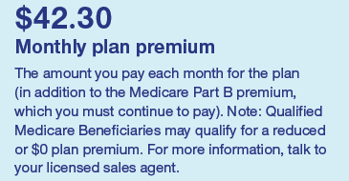
KENTUCKY 2024
BOONE
CAMPBELL
DAVIESS
FAYETTE
JEFFERSON
KENTON
H0710-071-000
PPO - IESNP

Slide 12
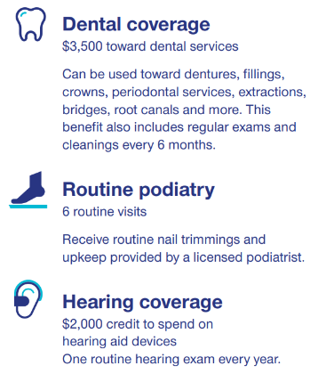
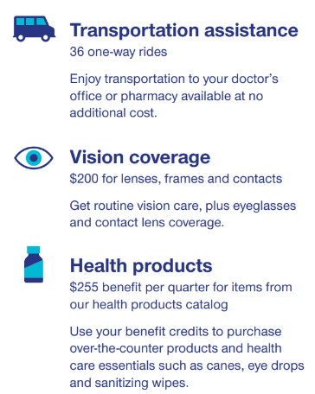
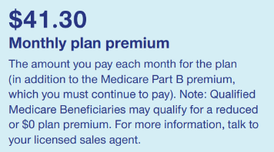
MARYLAND 2024
ANNE ARUNDEL
BALTIMORE
BALTIMORE CITY
CARROLL
FREDERICK
HOWARD
MONTGOMERY
PRINCE GEORGES
H0710-059-000
PPO - IESNP

Slide 13
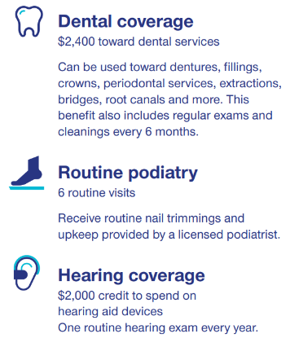
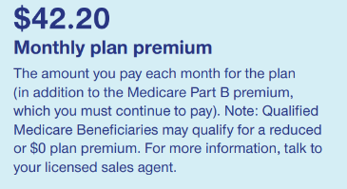
MINNESOTA 2024
ANOKA
CARVER
DAKOTA
HENNEPIN
RAMSEY
SCOTT
ST LOUIS
WASHINGTON
H0710-047-000
PPO - IESNP

Slide 14
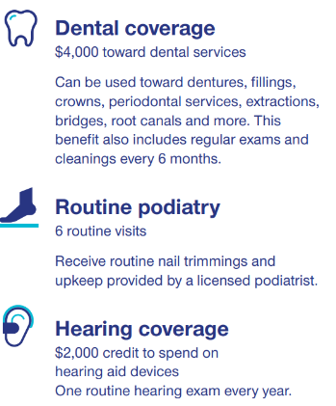
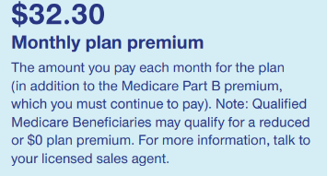
MISSOURI 2024
JACKSON
JASPER
JEFFERSON
ST CHARLES
ST LOUIS
H0710-066-000
PPO - IESNP

Slide 15
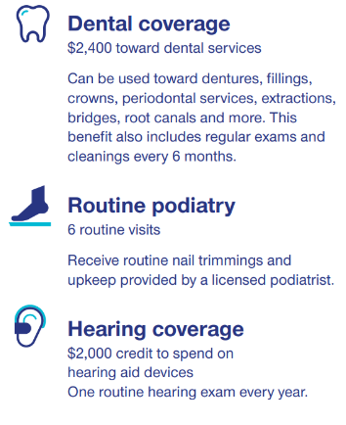
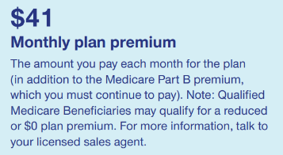
MISSISSIPPI 2024
HARRISON
HINDS
LEE
RANKIN
H0710-070-000
PPO - IESNP

Slide 16
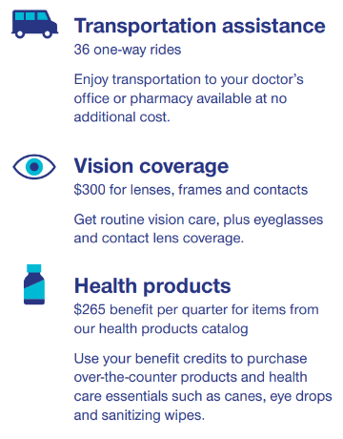
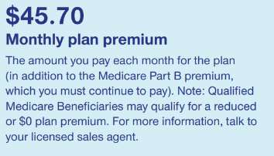
NORTH CAROLINA 2024
ALAMANCE
BUNCOMBE
CABARRUS
CATAWBA
CUMBERLAND
DAVIDSON
DURHAM
FORSYTH
GASTON
GUILFORD
HENDERSON
JOHNSTON
MECKLENBURG
ORANGE
RANDOLPH
ROCKINGHAM
ROWAN
RUTHERFORD
STANLY
WAKE
WILSON
H0710-068-000
PPO IE-ISNP

Slide 17
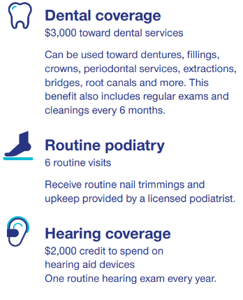
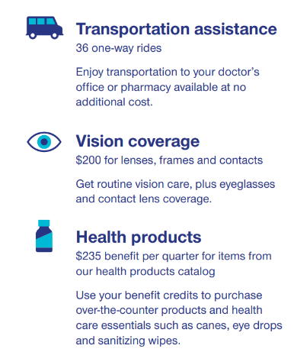
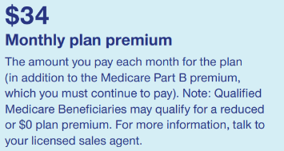
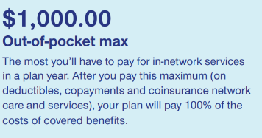
NEW JERSEY 2024
BERGEN
BURLINGTON
CAMDEN
ESSEX
MERCER
MIDDLESEX
MONMOUTH
MORRIS
OCEAN
PASSAIC
SOMERSET
UNION
H0710-056-000
PPO IE-ISNP

Slide 18
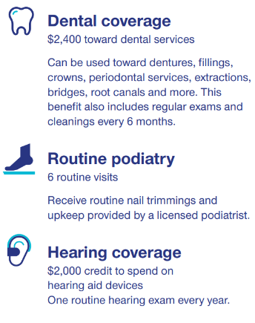
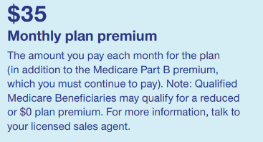
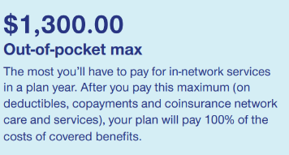
NEW YORK 2024
BRONX
CHAUTAUQUA
ERIE
KINGS
MONROE
NASSAU
NEW YORK
NIAGARA
ONEIDA
ONONDAGA
QUEENS
RICHMOND
ROCKLAND
SCHENECTADY
SUFFOLK
WESTCHESTER
H2292-003-000
PPO IE-ISNP

Slide 19
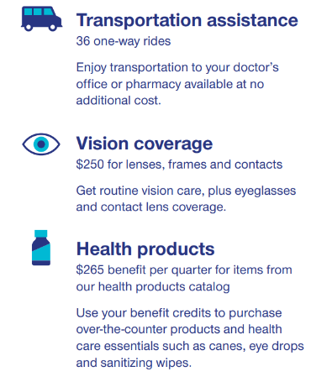
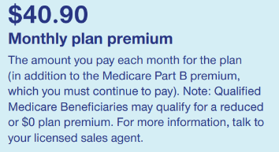
OHIO 2024
BUTLER
CUYAHOGA
FRANKLIN
HAMILTON
LAKE
LORAIN
MIAMI
MONTGOMERY
STARK
SUMMIT
WARREN
H0710-057-000
PPO IE-ISNP

Slide 20
OKLAHOMA 2024
OKLAHOMA
TULSA
H0710-058-000
PPO IE-ISNP

Slide 21
OREGON 2024
BENTON
CLACKAMAS
JACKSON
JOSEPHINE
LANE
LANE
LINN
MARION
MULTNOMAH
POLK
WASHINGTON
YAMHILL
H0710-037-000
PPO IE-ISNP

Slide 22
PENNSYLVANIA 2024
ALLEGHENY
BERKS
BUCKS
CAMBRIA
CHESTER
DELAWARE
ERIE
FRANKLIN
INDIANA
LANCASTER
LEHIGH
LUZERNE
MONTGOMERY
NORTHAMPTON
NORTHUMBERLAND
PHILADELPHIA
H0710-067-000
PPO IE-ISNP

Slide 23
Rhode Island 2024
KENT
PROVIDENCE
WASHINGTON
H0710-050-000
PPO IE-ISNP

Slide 24
SOUTH CAROLINA 2024
ANDERSON
BEAUFORT
CHARLESTON
GREENVILLE
HORRY
LEXINGTON
ORANGEBURG
PICKENS
RICHLAND
SPARTANBURG
SUMTER
YORK
H0710-068-000
PPO IE-ISNP

Slide 25
Tennessee 2024
DAVIDSON
HAMILTON
RUTHERFORD
SHELBY
SUMNER
WILLIAMSON
H0710-070-000
PPO - IESNP

Slide 26
TEXAS 2024
BELL
BEXAR
COLLIN
DALLAS
DENTON
HARRIS
MC LENNAN
TARRANT
TRAVIS
H0710-058-000
PPO IE-ISNP

Slide 27
Utah 2024
BOX ELDER
CACHE
DAVIS
IRON
SALT LAKE
TOOELE
UTAH
WASHINGTON
WEBER
H0710-069-000
PPO - IESNP

Slide 28
Virginia 2024
ALEXANDRIA CITY
ARLINGTON
CHESTERFIELD
FAIRFAX
HENRICO
JAMES CITY CO
LOUDOUN
NEWPORT NEWS CITY
H0710-059-000
PPO - IESNP

Slide 29
Washington 2024
BENTON
CLARK
COWLITZ
FRANKLIN
KING
KITSAP
LEWIS
MASON
PIERCE
SKAGIT
SNOHOMISH
SPOKANE
THURSTON
WHATCOM
YAKIMA
H0710-030-000
PPO - IESNP

Slide 30
Wisconsin 2024
BROWN
DANE
DODGE
DOUGLAS
FOND DU LAC
JEFFERSON
KENOSHA
MANITOWOC
MILWAUKEE
OUTAGAMIE
OZAUKEE
POLK
RACINE
ROCK
SHEBOYGAN
ST CROIX
WALWORTH
WASHINGTON
WAUKESHA
WAUPACA
WINNEBAGO
H5253-064-000
PPO - IESNP

