Slide 1
2024
Shane White – National Distribution Director

Slide 2
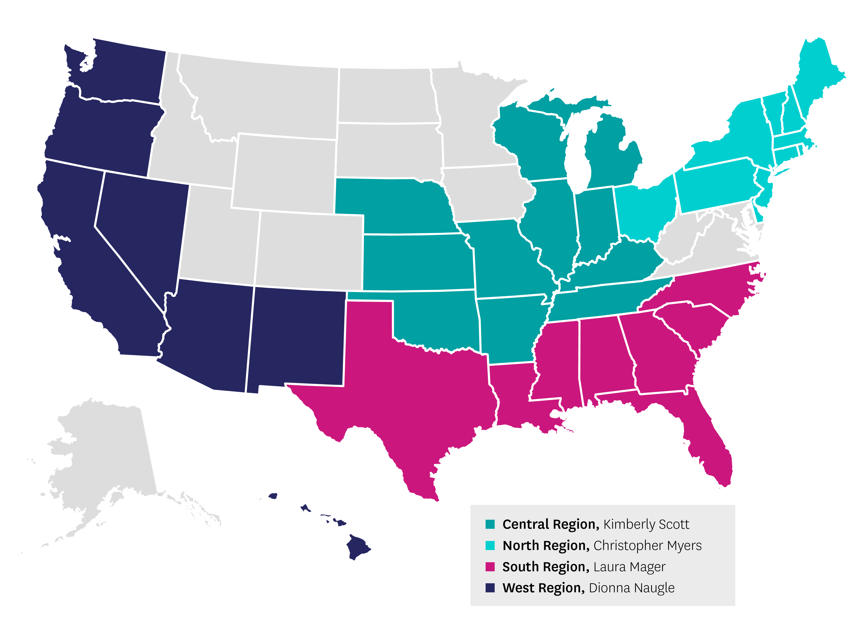
Field Sales Regions
*Update - June 2023

Slide 3
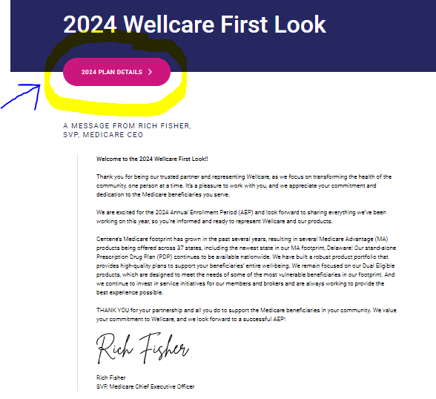
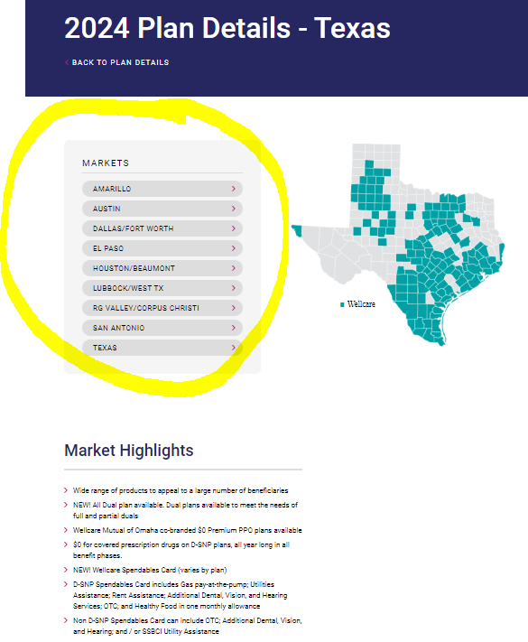
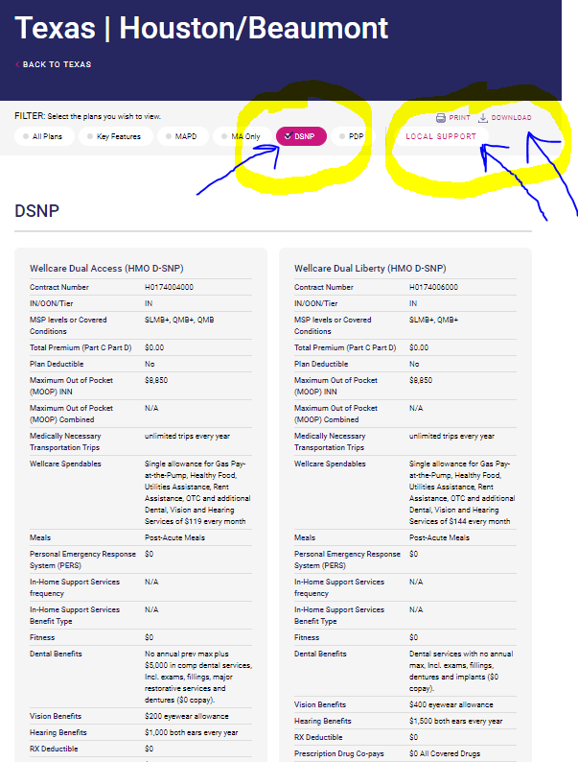
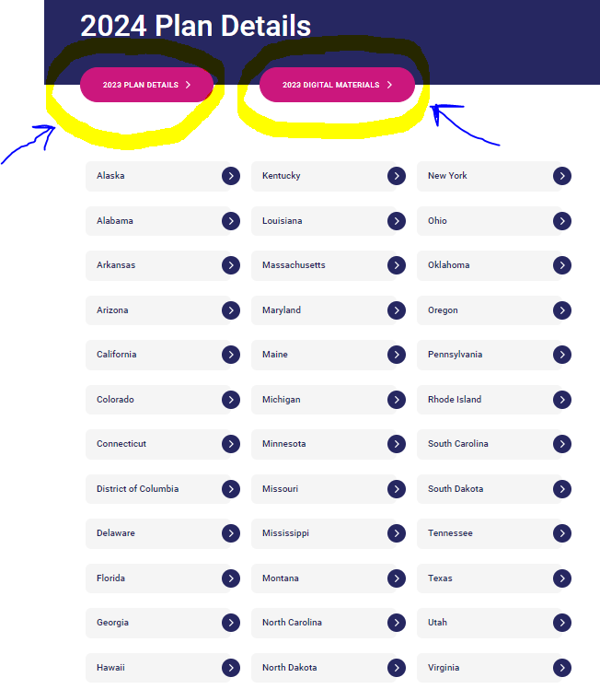
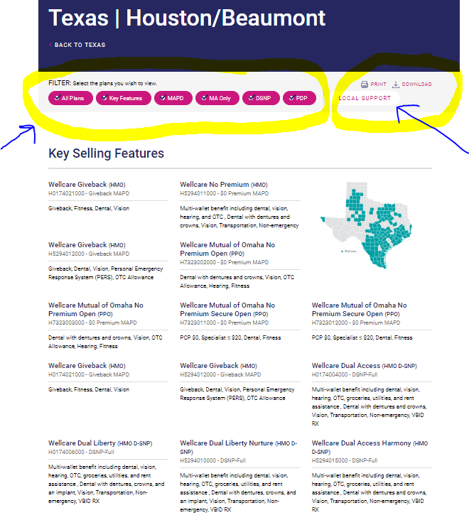
link to Wellcare First Look which has quick access to PAAGs (overviews) of every state and plan we have. (www.wellcarefirstlook.com) Wellcare First Look
5 screenshots to help.
1 - Home Page of First Look, 2 - 2024 Plan Details Tab, 3 - 2023 Plan Details – TX (example, 4 & 5 - 2024 PAAG – Houston, TX (example) – Plan Type Customizable

Slide 4
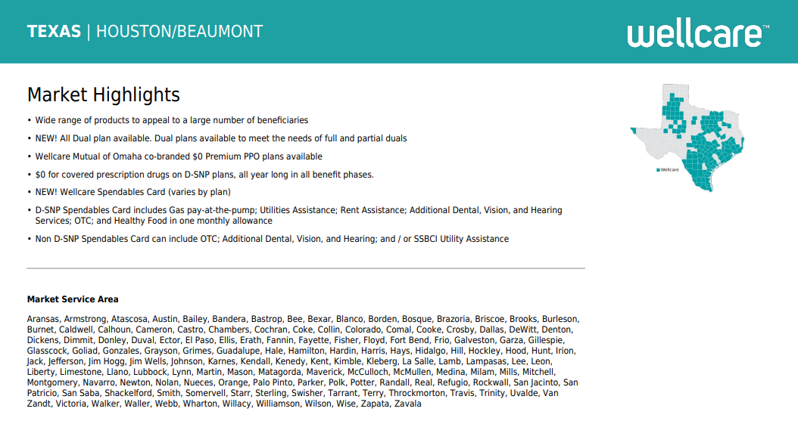
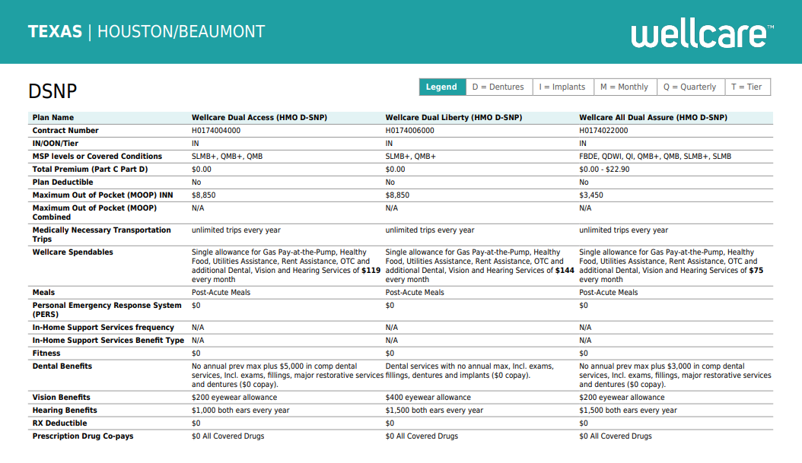
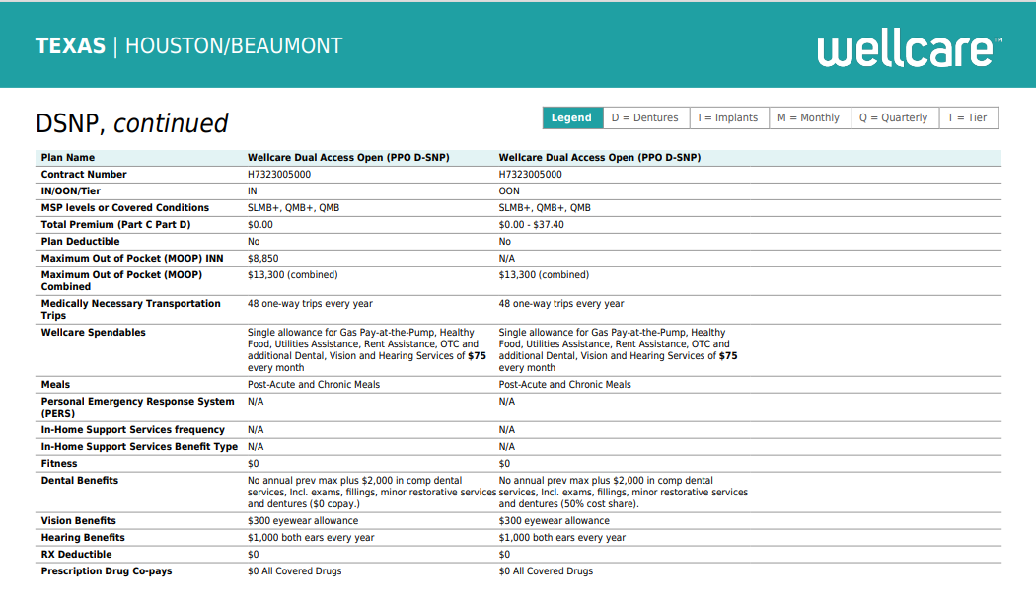
Custom PAAGs Portfolio at a Glance D-SNP Example

Slide 5
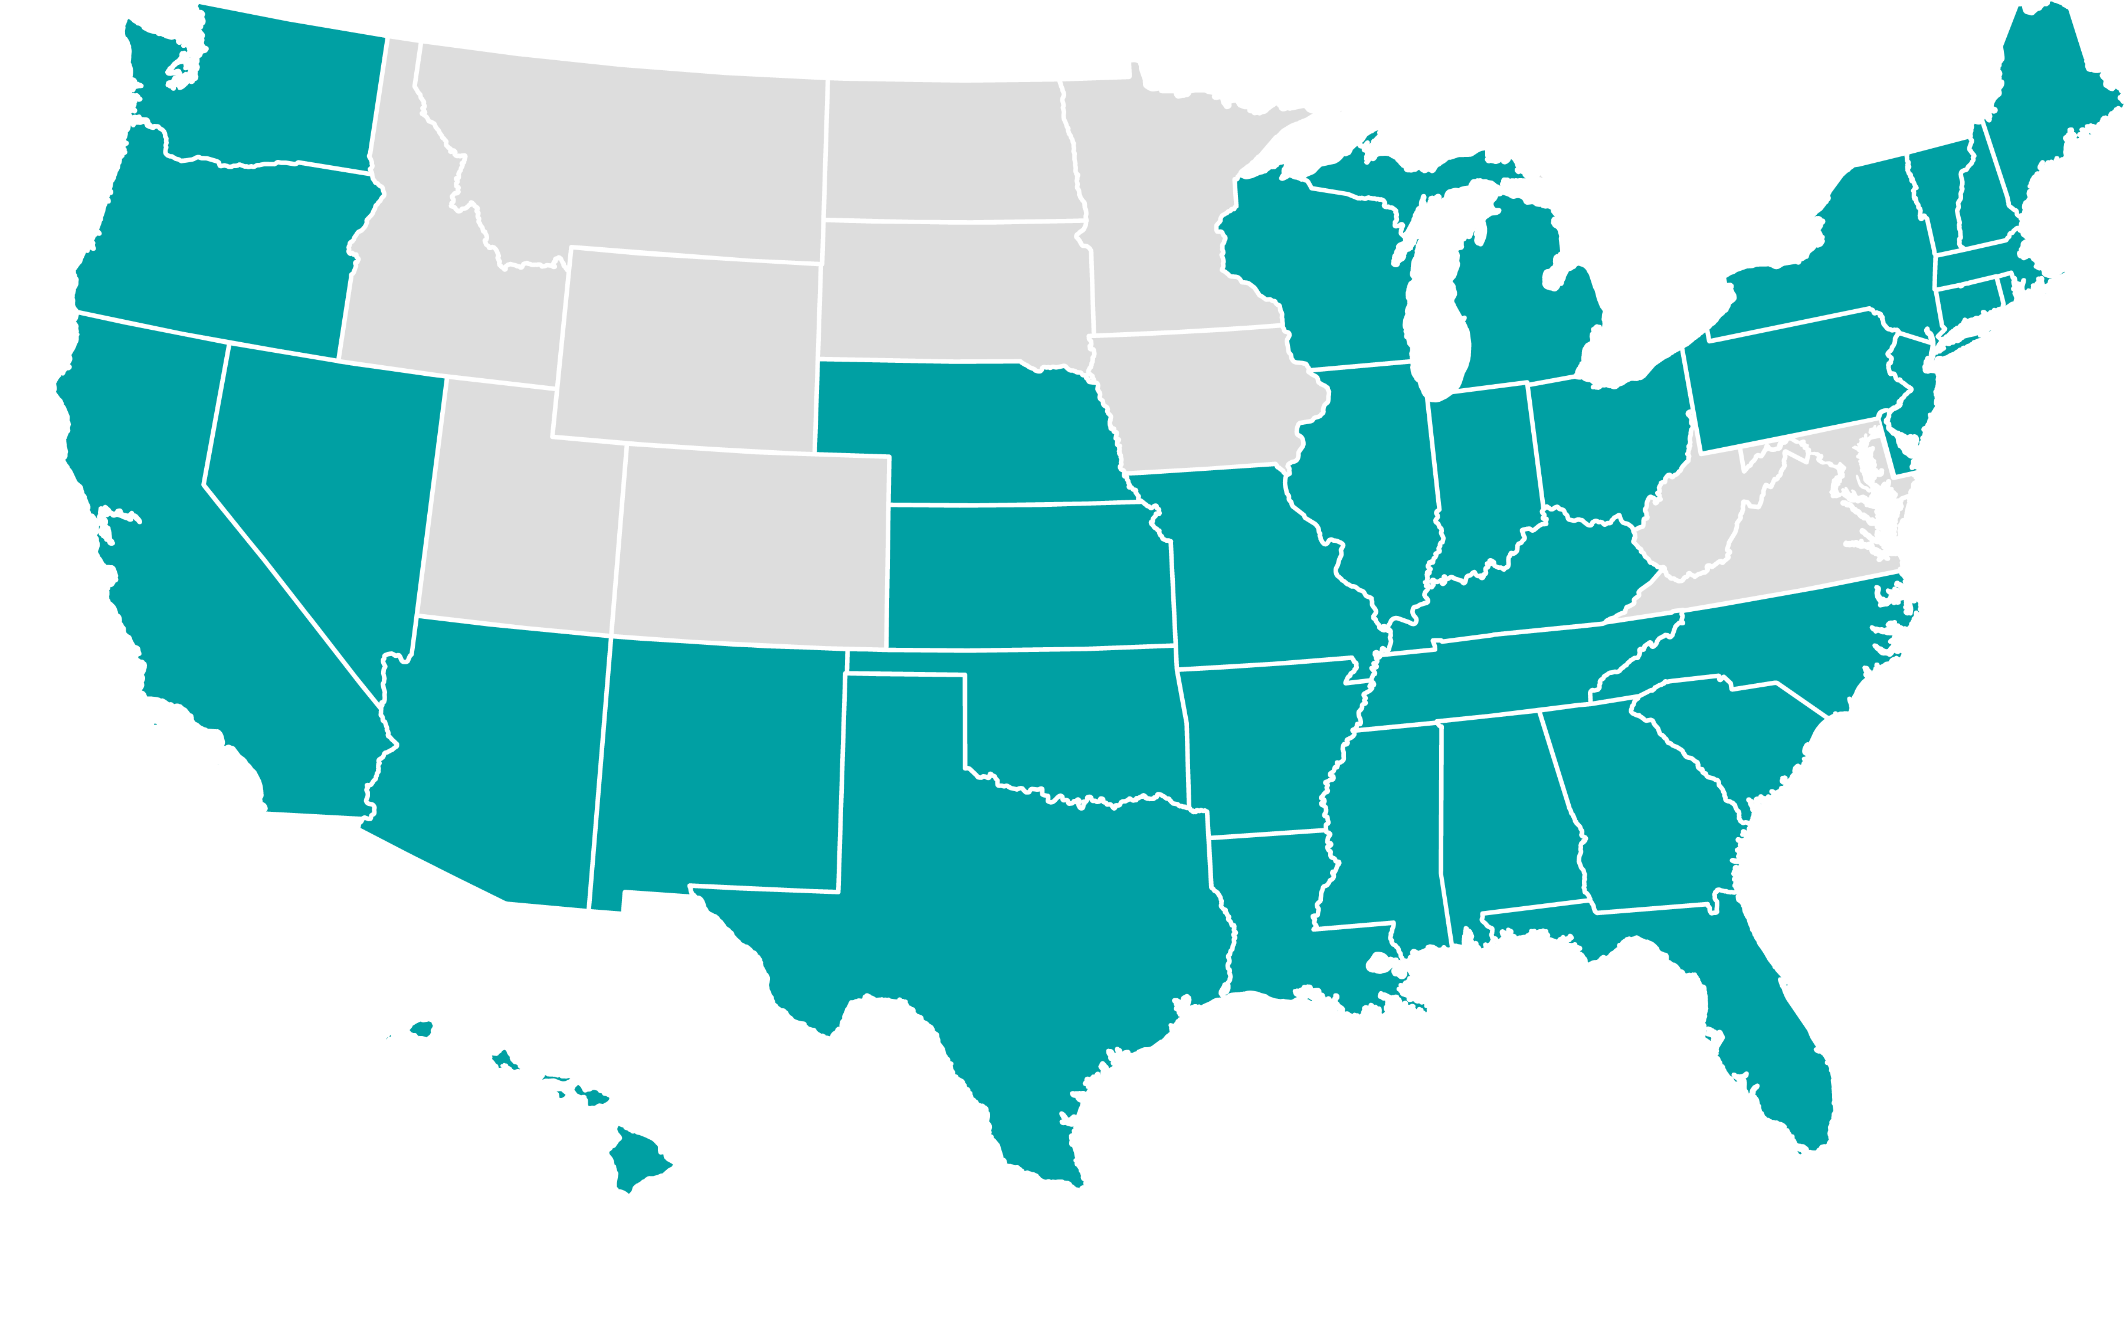
Geographic Expansion
New for 2024
New state: Delaware
21 new counties across four markets
Total MAPD Footprint
37 states, 1,808 counties
Access to 52 million MA eligibles (1% YOY increase)
80% of eligible beneficiaries in footprint
County expansion

Slide 6
Service Enhancements
Broker Support
Agent Systems & Resources
Customer Service
90-95% overall service levels maintained YTD
Increased collaboration with Customer Service to reduce transfers
94% of tickets worked within 2 business days
Implemented enhanced service model to assist with D-SNP plans
Real-time Medicare and Medicaid self-service for D-SNP eligibility verification available on Ascend
Expanded go-to-market materials and digital resources
Increased member services agent tenure with over 80% of call center staff with more than 30 days experience
Most calls answered under 10 seconds
Member ID card improvements
Enhanced call listening and insights to improve quality and training

Slide 7
Materials Update

Slide 8
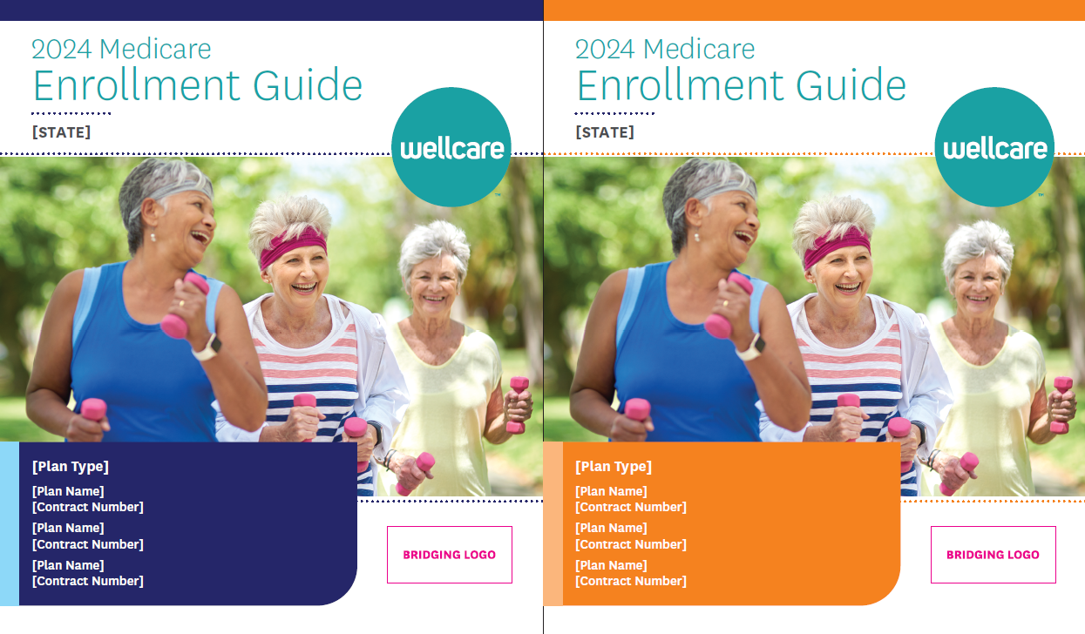
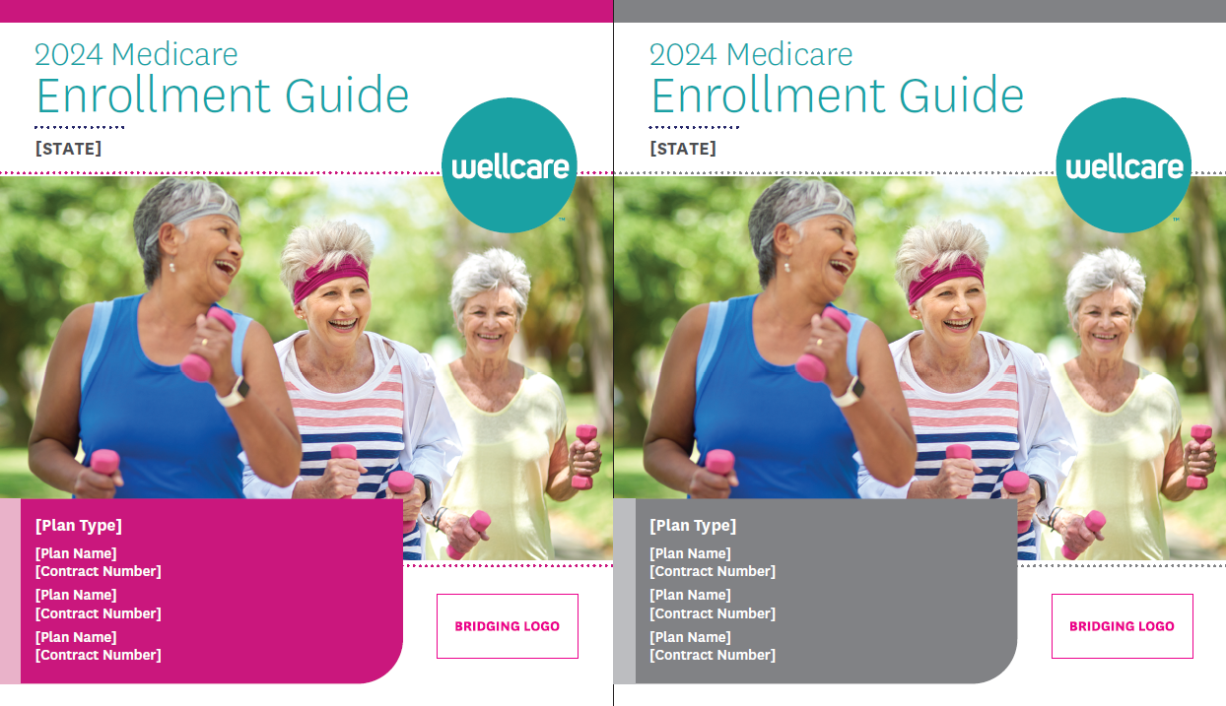
Enrollment Guide: Color Covers by Plan Type with Photo
Enhancements include:
Modern, redesigned look and feel
Added a true Table of Contents
Addition of Plan Benefits-at-a-Glance
Copy-heavy content replaced with infographics
Addition of new Member Portal section

Slide 9
Welcome Kit and Welcome Back Kit: Member-specific; plan name and contract number on covers
Enhancements include:
Kits are now PBP-specific with plan names added to footers
New Spendables flyer
Merged benefit-heavy content into Extra Benefits section
New Vendor Contact flyer
New My New Member Journey page
New Health Awareness Calendar, created in collaboration with Quality and HEDIS teams
New Welcome Back Kit for returning members; 22 pages focusing on CAHPS, Quality, retention, and digital initiatives

Slide 10
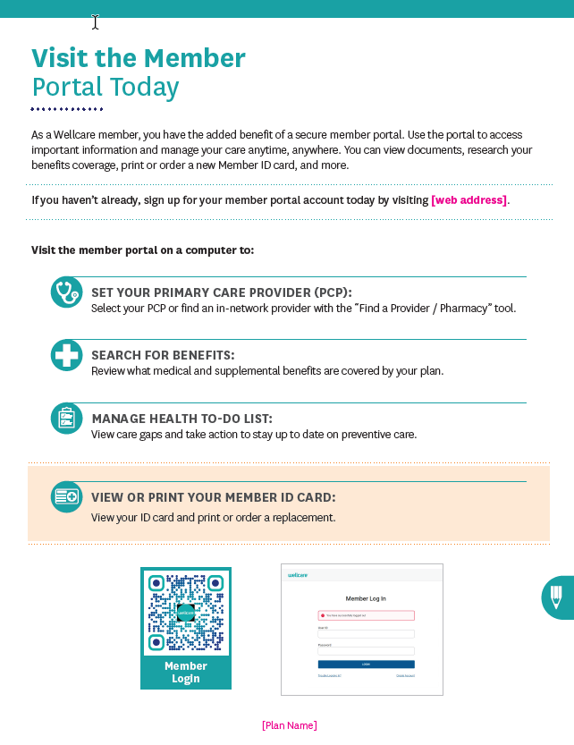
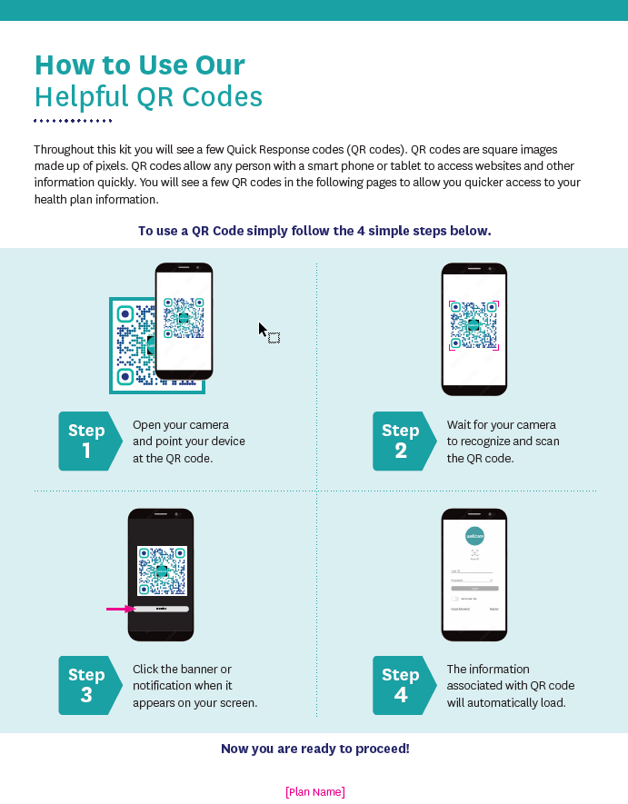
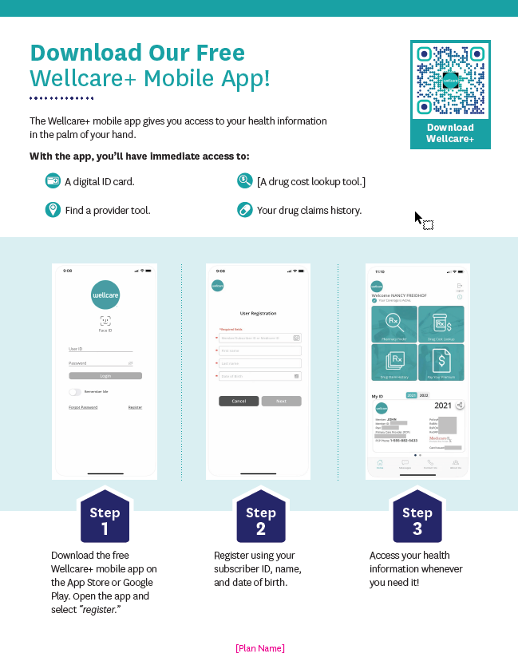
Enrollment Guide, Welcome Kit, and Welcome Back Kit: Expanded Self-Service Tools Section
New feature: QR codes!
Included in Enrollment Guide

Slide 11
Wellcare Brand Bridging Strategy
Member, Provider, and select Field Marketing communications will feature a logo that includes a legacy Medicare brand
All National Marketing campaigns, Sales Operations communications, and Broker Materials will still be under the national Wellcare brand

Slide 12
Service Improvements
People |  | Process |  | Systems
Investment to carry more tenured agents Removal of lower-tier agents Focus on First Person Resolution through improved agent capabilities |  | Overhaul of Broker Support/Customer Service partnership Improved ancillary operating model for reduced transfers Launched cyclical annual training schedule based on seasonality |  | Migration to Amazon Web Services for improved self-service Alignment of CRM tool best practices and features Enhanced call listening and insights through Qualtrics

Slide 13
Portfolio Approach

Slide 14
Product Portfolio Highlights
New D-SNP All Duals plans AL, AR, FL, GA, KY, LA, MI, MS, NC, NM, OH, OK, TX, WI
LIS Plans
In 2024, the partial Part D Low Income Subsidy (LIS) sunsets.
More prospects will be eligible for the full subsidy.
23 New PBPs
$0 and low-premium plans
Dual plans across several markets
$0 plans in 35 states

Slide 15
Portfolio Approach Special Needs Plans
Products | Product Examples | Target Market
Zero Cost-Share D-SNP – Fully Eligible Medicare/Medicaid | Wellcare Dual Liberty | Cost-share protected beneficiaries who qualify for Medicaid cost-sharing protection and full state benefits Member does not pay for Medicare-covered medical benefit cost-shares, but does pay Part D LIS copays
Zero Cost-Share D-SNP – Cost-Share Protected Duals in each state | Wellcare Dual Access | Cost-share protected beneficiaries who qualify for Medicaid cost-sharing protection, but NOT for extra benefits from state Member does not pay for Medicare-covered medical benefit cost-shares, but does pay Part D LIS copays QMB
Non-Zero D-SNP – All MSP Levels allowed in each state | Wellcare All Dual Wellcare All Dual Assure | Members who qualify for partial Medicaid but not Medicare medical cost-share protection Eligibility for Medicare plan is as follows: SLMB, QI, QDWI (potentially other MSP levels depending on state eligibility criteria) Accepts all Duals regardless of MSP level
Non-Zero D-SNP | Wellcare Dual Reserve Wellcare Dual Select | Members who qualify for partial Medicaid but not Medicare medical cost-share protection Eligibility for Medicare plan is as follows: SLMB, QI, QDWI (potentially other MSP levels depending on state eligibility criteria)
NEW

Slide 16
PY2024 D-SNP Portfolio Approach
Dual plans will have a consistent structure of MSP eligibility levels across plans.
STRUCTURE
1
Liberty
Target populations by plan:
Liberty – full dual cost-share protected MSPs
Access – full dual cost-share protected MSPs – specifically QMB
All Dual/All Dual Assure – partial MSPs – SLMB only, QDWI, and QI
MSP Revenue Legend:
QMB+, SLMB+, *and FBDE*: High revenue, full cost-share protection
QMB: Lower revenue, full cost-share protection
SLMB only, QDWI, and QI: Lowest revenue, not cost-share protected
*State nuances may occur – MSP may not be cost-share protected
MSP: QMB+, SLMB+, and FBDE
2
Access
MSP: QMB, QMB+, SLMB+, and FBDE
3
All Dual or All Dual Assure (select markets)
MSP: QMB, QMB+, SLMB+, FBDE+, SLMB only, QDWI, and QI
All information on this slide is subject to change until approved by CMS.
Notes:
_6/14/2023: Refined DSNP Structures for intended audience

Slide 17
PY2024 NEW All Dual Plan Offerings
Dual plans will have a consistent structure of MSP eligibility levels across plans.
STRUCTURE
1
Liberty
3
All Dual/All Dual Assure Plan Design:
Plans will include rich supplemental benefits
New All Dual plans will target partial duals who are not cost-share protected
HMO plans offered
All Dual (20% A/B benefits) select markets or All Dual Assure (copay A/B benefits) select markets
MSP: QMB+, SLMB+, and FBDE
2
Access
MSP: QMB, QMB+, SLMB+, and FBDE
3
All Dual or All Dual Assure
MSP: QMB, QMB+, SLMB+, FBDE+, SLMB only, QDWI, and QI
Plan Offering | States
Wellcare All Dual Assure (HMO D-SNP) | AL H6975, AR H9630, KY H9730, LA H2491, MI H5475, MS H1416, NC H4073, OK H9900, OH H0908, TX H0174, WI H8189
Wellcare All Dual (HMO D-SNP) | FL H1032, GA H1112, NM H2134
All information on this slide is subject to change until approved by CMS.
Notes:
_6/14/2023: Refined DSNP Structures for intended audience

Slide 18
Portfolio Approach Traditional Medicare Advantage
Products | Product Examples | Target Market
Part B Premium Giveback | Wellcare Giveback Wellcare Giveback Open | Value-conscious beneficiaries who are seeking some or all of the Part B premium back, are willing to trade off other benefits for the giveback, and do not qualify for payment of Part B premium by Medicaid HMO, HMO-POS, and LPPO options available
$0 premium | Wellcare No Premium Wellcare No Premium Open Wellcare Complete No Premium Wellcare Mutual of Omaha No Premium | Value-conscious beneficiaries who are seeking predictable copays and extra benefits HMO, HMO-POS, and LPPO options available
Part D Premium (LIS) | Wellcare Assist | Beneficiaries who receive Extra Help on Part D from the federal government but don’t qualify for a zero cost-share D-SNP and are seeking richer benefits than offered on a $0 premium plan Part D premium is paid by the Extra Help they receive HMO, HMO-POS, and LPPO options available

Slide 19
Portfolio Approach Traditional Medicare Advantage
Products | Product Examples | Target Market
Low, Moderate, or Higher Premium | Wellcare Low Premium Wellcare Premium Enhanced Open Wellcare Premium Ultra Wellcare Premium Ultra Open | Beneficiaries who are not receiving Extra Help but are seeking rich medical and extra benefits for a premium between $1-49, $50-$99, $100+ HMO, HMO-POS, LPPO, and PFFS (Wellcare Advantage Premium Enhanced) options available
MA only | Wellcare No Premium Patriot Wellcare Patriot Giveback | Beneficiaries who receive credible Part D coverage through a retiree plan, VA benefits, etc. Some plans also includes giveback of some or all the Part B premium HMO, HMO-POS, and LPPO options available

Slide 20
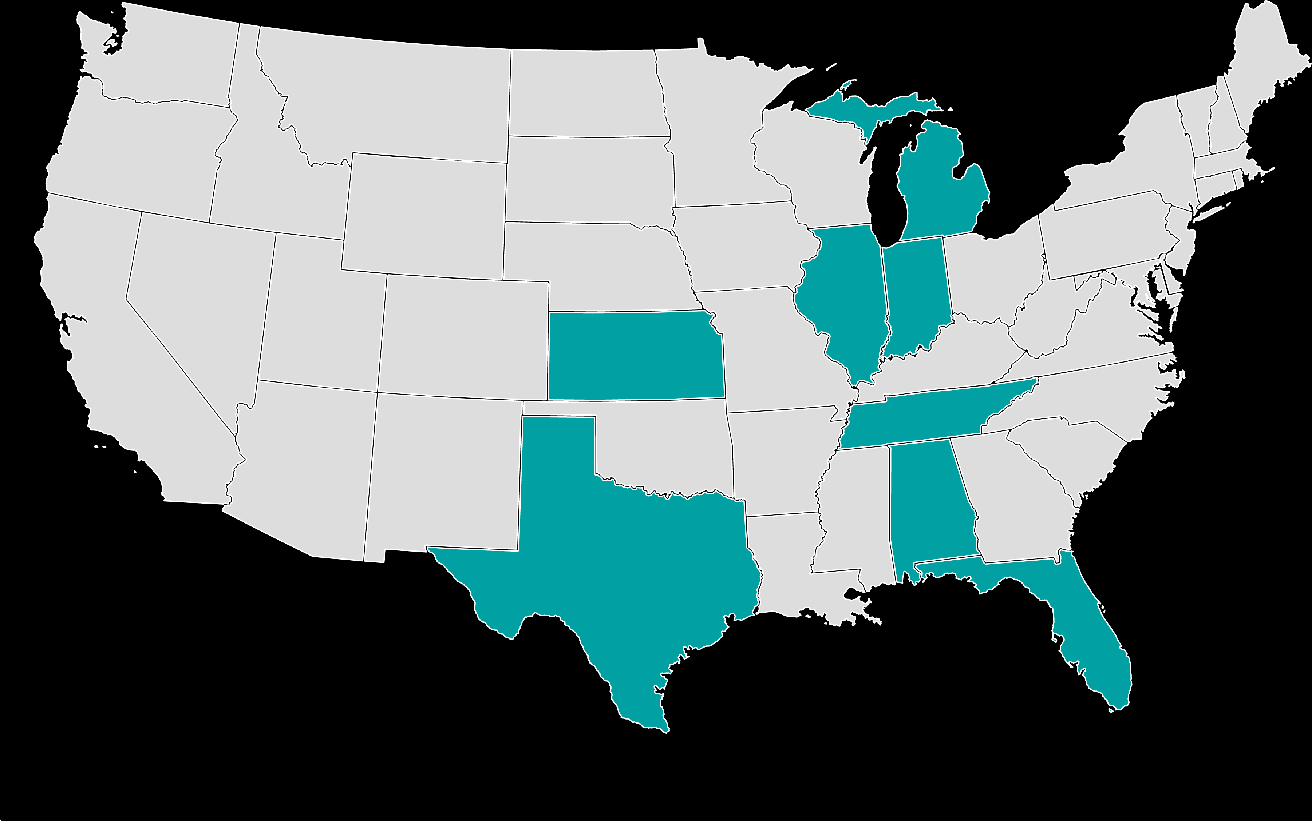
PY2024 Ascension Complete Plan Acquisition
Ascension Complete Joint Venture (ACJV)
Joint venture between Ascension, the second largest Catholic and nonprofit health system in the US, and Centene signed on May 31, 2019, resulting in Ascension Complete owned by both Centene (60%) and Ascension (40%).
This partnership created a provider-endorsed Medicare Advantage (MA) product which delivers integrated, high-quality care and services to seniors.
Purchase agreement for Centene to acquire 100% ownership of the joint venture signed Dec. 23, 2022; effective May 1, 2023.
Licensing agreement (trademarks, logo, name, domain, etc.) with Ascension for the use of the brand ends Dec. 31, 2023. All products will be rebranded under Wellcare By Allwell.
States: Alabama, Florida, Illinois, Indiana, Kansas, Michigan, Tennessee, and Texas
8
States
20K
Members on 1/1/23
All information on this slide is subject to change until bids are submitted and approved by CMS.

Slide 21
PY2024 Ascension Complete Plan Acquisition
 | PY2023: Ascension Complete |  | PY2024: Wellcare Complete
Legal Entity | Centene Venture Company XX |  | Centene Venture Company XX (No change)
DBA (Doing Business As) | Ascension Complete (FL, IL, IN, TN, TX) |  | Wellcare; Wellcare By Allwell; Wellcare Complete (FL, IN, TX)
Brand Name | Ascension Complete |  | Wellcare By Allwell
Plan Name | Ex: Ascension Complete Reward |  | Ex: Wellcare Complete Giveback
Platform | Amisys |  | Amisys (No change)
States & Contracts | Alabama – H4343 Florida – H8225 Illinois – H7399 Indiana – H1774; H7925 | Kansas – H5398; H6830 Michigan – H0482 Tennessee – H2853; H8121 Texas – H6678; H9357 | Alabama – H4343 Florida – H8225 Illinois – H7399 Indiana – H1774; H7925 | Kansas – H5398; H6830 Michigan – H0482 Tennessee – H2853 Texas – H6678; H9357
Logo
Website | ascensioncomplete.com |  | wellcarecomplete.com
All information on this slide is subject to change until bids are submitted and approved by CMS.
Notes:
Updates:
_6/12/23: Updated Brand Name, Logo, and included details surrounding DBA, states and contracts. _4/26/23: Inserted links to Wellcare Brand Details/Guidelines and Logos.

Slide 22
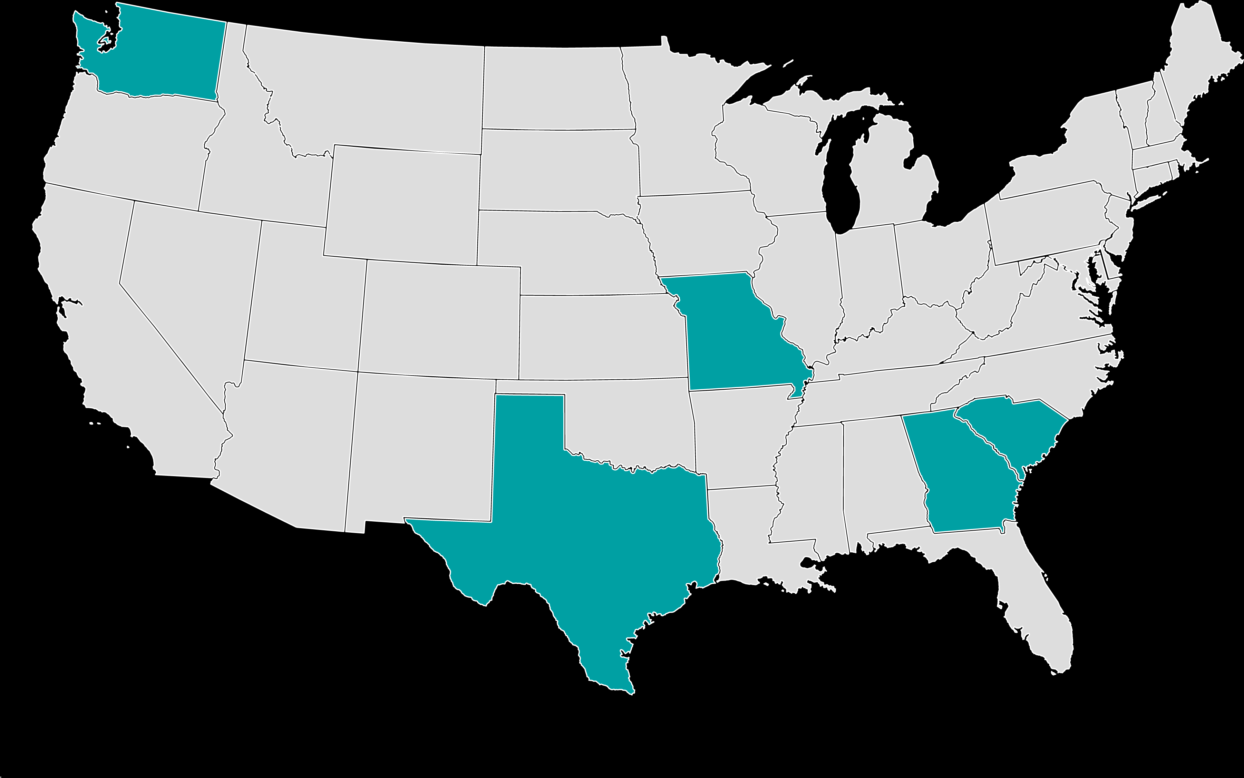
Wellcare and Mutual of Omaha Partnership
Wellcare and Mutual of Omaha are partnering to leverage the highly sophisticated health management capabilities and extensive brand recognition of two industry leaders.
Wellcare provides high-quality, affordable healthcare to more than 1.2 million Medicare Advantage members and 4.1 million PDP members across all 50 states.
Mutual of Omaha is the second-largest provider of Medicare supplement and a trusted brand among seniors with 98% brand awareness.
This alliance leverages Wellcare’s proven MA distribution capabilities and Mutual of Omaha’s broad market brand synergy.
Pilot programs in the following markets: Georgia, Missouri, TX-DFW, TX-Houston, South Carolina, and Washington.
10 co-branded PPO plans* across the pilot states – Wellcare Mutual of Omaha No Premium (PPO) and Wellcare Low Premium (PPO)
* Plans to be serviced by Wellcare

Slide 23
Portfolio Approach Limited Service Area
Products | Product Examples | Target Market
Chronic Special Needs Plan (C-SNP) | Wellcare Specialty No Premium | C-SNPs are SNP plans that restrict enrollment to special needs individuals with one or more specific severe or disabling chronic conditions requiring coordination of care among primary providers, medical and mental health specialists, inpatient and outpatient facilities, and extensive ancillary services related to diagnostic testing and therapeutic management HMO Offered in AZ, CA, and NV only
Medicare 20% | Wellcare Plus Open | Beneficiaries who qualify for a zero cost-share D-SNP but reside in a state where we do not have a D-SNP plan Offered in NH and VT only

Slide 24
National Portfolio
*NEW
Existing New

Slide 25
Part D

Slide 26
2024 Part D Product Design for MAPD
Maintain Competitive Benefits
Optimize benefit design
Deductible
All TMA plans have a $0 or tier-specific deductible (Tiers 2-5, Tiers 3-5, or Tiers 4-5).
Reduced Cost-Sharing
All TMA plans feature a $0 copay for Tier 6, which includes the majority of adherence medications.
98% of TMA plans have $0 copay for Tier 1 at preferred pharmacies.
Gap Coverage
45% of TMA plans have full and/or partial gap coverage on Tiers 1, 2, and/or 6.
Medication Home Delivery
Express Scripts® Pharmacy is replacing CVS Caremark® as the preferred mail order benefit provider.
Preferred mail order discounts are available:
Tiers 1, 2, and 6 = $0 copay for 100-day supply
Tier 3 = 2 x 30-day supply copay for 100-day supply
Preferred Pharmacy Network
Walgreens and CVS plus grocers remain within the preferred pharmacy network for 2024.

Slide 27
Formulary Improvements
Improved generic tier placements on enhanced plan formulary increasing competitiveness from 74% to 86% aligned and favorable.
Enhanced coverage of popular vitamins on Tier 1, such as folic acid, vitamin D, and vitamin B12.
Expected to improve access and affordability for more than 32,000 members.
More than 200 drugs moved to lower tier on enhanced plan formulary resulting in lower cost-share for 3% of MAPD members (approx. 37,000).
Albuterol HFA T2 Ondansetron T2 Synthroid T3 | Memantine T2 Estradiol T2 Bupropion ER T2 | Bumetanide T2 Ipratropium Br T2 Levocetirazine T2 | Testosterone Cyp T2 Esomeprazole T2 Solifenacin T2
Formularies are subject to change until CMS approves formularies

Slide 28
2024 PBM Migration
Effective Jan. 1, 2024, Express Scripts will be managing our pharmacy benefits administration. This will impact all Part D plans, including MAPD and PDP.
All members will receive a new 2024 ID card prior to Jan. 1, 2024, with updated pharmacy processing information.
It is very important for members to bring their new card to the pharmacy to receive their prescriptions, as claims will not process without the new card.
Members will receive several communications about the importance of using their new card throughout AEP:
Letter/Flyer (ANOC, etc.)
ID Card Letter
Call Campaigns

Slide 29
Mail Order
Effective Jan. 1, 2024, Express Scripts will replace CVS Caremark as our preferred mail order provider.
CVS Caremark Mail Order will be out-of-network in 2024. If members decide to continue to use mail order, they must switch to Express Scripts effective Jan. 1, 2024.
For existing mail order users, open prescription refills will be transferred to Express Scripts.
For any new mail order prescriptions, members will be able to set up a member profile with Express Scripts beginning Dec. 1, 2023, but will only be able to initiate an order beginning Jan. 1, 2024.
Communications will be sent to members with further information and actions needed to access this benefit.
Like CVS Caremark, Express Scripts will be managing all mail order operations, including providing a call center to support member inquiries.

Slide 30
Supplemental Benefits

Slide 31
PY2024 Multi-Benefit Card: Introducing Wellcare Spendables ™
A single card provides an allowance access to multiple benefits
Combines multiple benefits into single card
Pursing strategy for benefit groups based on plan type
D-SNP plans include a single purse for OTC, Grocery, Gas (Pay-at-the-Pump), and Utility and Rent Assistance, and may include DVH cost-shares in that purse depending on the plan
Non-D-SNP plans include a single purse for purses for OTC and, depending on the plan, DVH cost-shares will be included in that purse. If the plan has SSBCI Utility, it will be a separate purse on the card.
Simple and convenient to use
Benefits loaded each period
Amounts will vary by plan
Allows member to use the benefit as they choose to meet their needs

Slide 32
Introducing Wellcare Spendables™
Solutran is the national partner to administer the Wellcare Spendables experience
Currently a trusted partner for six Medicare competitors
Retailer Direct Network includes more than 55,000 stores nationwide
Benefits Covered | Retailer Direct via Debit Card In-Store or Online* Any Item w/Approved SKU/Category Code Retailer Network | Mail-Order** via Phone Call or Portal List/“Catalog” of Approved Items and Products Single Fulfillment Vendor (TBD)
DVH Cost-Share Assistance if applicable (Dental, Vision & Hearing Cost-Share) | Network = Approved MCC Codes | N/A
OTC (Over-the-Counter) | Retailer Network | Yes, Limited
Healthy Food (D-SNP Only) | Retailer Network | Yes, Limited, Shelf Stable
Utility/Rent Assistance (D-SNP Only) | Network = Approved MCC Codes | N/A
Gas (D-SNP Only) (Pay-at-the-Pump) | Network = MCC Codes | Pay at Gas Pump
SSBCI Utility (Non-SNP) | Network = Approved MCC Codes | N/A
 | *Online shipping and delivery fees will use allowance funds. | **Mail order will require minimum amount for free shipping.
All information on this slide is subject to change until bids are submitted and approved by CMS.
Notes:
_6/15/2023: Updated to include the SSBCI Utility (Non-SNP) row.

Slide 33
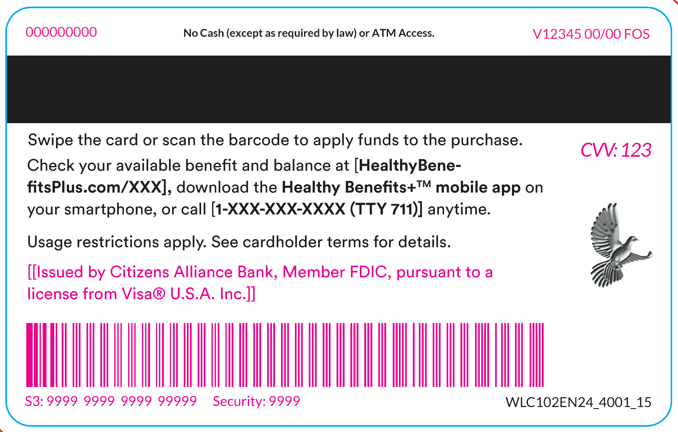
Wellcare Spendables™ Debit Cards
Category level: Healthy food items are managed at a category level. Categories allow members to purchase brand name/generic items, and we have the ability to limit approved categories to ensure members purchase approved items.
Healthy Foods
Beans and legumes
Canned fruits and vegetables
Dairy products
Fresh fruit and vegetables
Fresh salad kits
Frozen produce and meals
Healthy grains - bread, cereals, pastas, etc.
Meat and seafood
Nutritional shakes and bars
Pantry staples - flour, sugar, spices, etc.
Soups
Water/vitamin water
OTC
Allergy and sinus
Cold and flu
Dental and oral health
Diabetes care
Digestive health
Eye and ear care
First aid
Foot care
Home health care and daily living
Incontinence products
Pain relief
Skin care
Sleep aids
Smoking cessation products
Supports, braces, and wraps
Notes:
_6/21/2023: Included images of Wellcare and Wellcare By Health Net /CalViva Health Spendables Debit Cards.

Slide 34
Solutran Network Coverage
Merchant Group Coverage Across 37 Markets | Availability | Highlight
Ahold | Giant Eagle | Publix
Albertsons Companies | Hmart | RiteAid
Butera | HyVee | Southeastern Grocers Inc
Coborn's | Independent Retailers | Walgreens
Cub Corporate | Kroger | Walmart Store
CVS | Miners Super One | Western Beef
Delhaize - Food Lion - Hannaford | Niemann Foods | Woodman's
Dollar General | Piggly Wiggly Midwest
Network as of July 2023. Network build ongoing.

Slide 35
2024 MAPD Benefit Highlights
Benefit | Availability | Highlight
Wellcare Spendables™ Card | Many plans | D-SNPs include OTC, gas (pay-at-the-pump), utilities assistance, rent assistance, healthy food, and depending on the plan, additional Dental, Vision, and Hearing cost-sharing assistance, in one purse. Non-D-SNP plans can include OTC, and depending on the plan, additional Dental, Vision, and Hearing cost-sharing assistance, in one purse. Some plans may also include SSBCI utility assistance in a separate purse. Dental, Vision, and Hearing cost-sharing assistance is separate from routine benefits.
Routine Dental | Most Plans | In 2024, Wellcare will offer dental packages as lean as limited preventive services, to packages with preventive and comprehensive coverage, with various allowances depending on the plan. Allowance amounts for comprehensive services are up to $5,000.
Routine Vision | Most Plans | Wellcare will offer packages in 2024 ranging from a routine exam only to routine exam plus an eyewear (glasses/contacts) allowance. Eyewear allowances range from $100 to $600. Members can get unlimited contacts and glasses with upgrades, up to the allowance maximum on their plan.
Routine Hearing | Most Plans | Wellcare will offer packages in 2024 ranging from coverage for routine exam only to packages with routine exam and hearing aid coverage. Hearing aid allowances range from $350 per ear up to $2,500 per ear.

Slide 36
2024 MAPD Benefit Highlights
Benefit | Availability | Highlight
Non-Emergency Medical Transportation (NEMT) | Most plans | Wellcare will offer packages in 2024 ranging from coverage of 12 one-way trips to unlimited one-way trips. Trips can be used for non-emergency medically necessary reasons such as going to a doctor’s appointment or a pharmacy.
Fitness | Most plans | Wellcare will cover a fitness membership on almost every Medicare Advantage plan being offered in 2024. Members can manage their health through online courses, in-home fitness kits, memory kits, and/or fitness trackers.
Personal Emergency Response System (PERS) | Some Plans | A Personal Emergency Response System (PERS) is a medical monitoring system that provides a safety net for people who might need immediate medical assistance when nobody is there to help. Options include in-home and mobile solutions.
Meals | Most plans | With this benefit, the member has access to meal programs for chronic, post-acute, and/or nutritional shakes.
In-Home Support | Some plans | With this benefit, members can qualify to receive a range of services to assist with chores or personal care services, depending on plan offerings (6-24 visits per year).

Slide 37
2024 MAPD Benefit Highlights
Benefit | Availability | Highlight
Telehealth | All plans | Telehealth allows healthcare professionals to evaluate, diagnose, and treat members in remote locations using telecommunications technology. This benefit is covered on all Wellcare plans.
Nursing Hotline | All plans | This benefit provides telephonic access to nurse assistance 24 hours a day, 7 days a week.
CAM | Some plans | The CAM offers members access to routine chiropractic, routine acupuncture, and therapeutic massage/naturopathy – OR only benefits.
Routine Acupuncture | Some plans | Acupuncture is the procedure of inserting and manipulating needles into various points on the body to relieve pain or for therapeutic purposes.
Routine Chiropractic | Some plans | This benefit provides coverage for members to have access to routine chiropractic services. Original Medicare offers coverage for Medicare-covered chiropractic as well.
Routine Podiatry | Some plans | Routine podiatry services include routine foot care such as cutting or removing corns or calluses, trimming or cutting nails, and hygienic or other preventive maintenance.

Slide 38
PY2024 VBID D-SNP Benefit Changes
One Purse | Healthy Food (VBID) | Allowance-based benefit; non-rolling month-to-month Allowance will be available via Wellcare Spendables™ card Members are not required to take action to receive the benefit
 | Utility & Rent Assistance (VBID) | Allowance-based benefit Allowance will be available via Wellcare Spendables™ card Inclusion of rent assistance
 | Over-the-Counter (OTC) | Part of Wellcare Spendables™ card Purchase methods will include in-store, mobile app, phone, and web orders Solutran offers significantly expanded in-store footprint with multiple retailers Catalog will be available and sent to all members
 | Gas (Pay-at-the-Pump) (VBID) | Allowance-based benefit Allowance will be available via Wellcare Spendables™ card Allowance issued monthly; rolling throughout the year Members are only allowed to use the debit card at the pump
 | Rx $0 Cost-Sharing – All Tiers (VBID) | No change to benefit Administered at point of purchase at any network pharmacy
*PY2024 VBID Participation: New Jersey D-SNP currently outlier for VBID, as there is no Rx; however, will offer the Wellcare Spendables™ debit card.
All information on this slide is subject to change until bids are submitted and approved by CMS.

Slide 39
PY2024 SSBCI –
Approved Vendors and Key Changes
Chronic Conditions
Supplemental benefit not primarily health-related
Offered non-uniformly to chronically ill enrollees
The SSBCI must have a “reasonable expectation of improving or maintaining the health or overall function of the enrollee” as it relates to the chronic disease.
UPDATED
In order to qualify for the SSBCI benefits, a member must meet ALL THREE of the following requirements:
Require intensive care management, based on provider assessment of patient having had two or more inpatient admissions in the last 60 days OR having had three or more emergency room visits in the last 60 days.
Be at high risk for hospitalization, based on provider assessment of patient being at high risk for unplanned hospitalization in the next 60 days.
Have a documented and active diagnosis for one or more of the qualifying comorbid and medically complex conditions. The condition must be life threatening or must significantly limit the overall health or function of the member.
All information on this slide is subject to change until bids are submitted and approved by CMS.

Slide 40
PY2024 SSBCI Benefit Changes
Care Concierge (SSBCI) – Any Plan | 200 quarterly credits to be used for a la carte services National Vendor – healthAlign
Utility Assistance (SSBCI) Non-D-SNP Only | Allowance-based benefit Allowance will be available via Wellcare Spendables™ card Utility assistance will be offered to D-SNP plans through VBID in 2024
How do members become eligible for SSBCI benefits?
Automated Method: Members may be flagged as eligible based on the Hierarchical Condition Category (HCC) reporting from CMS and the member’s risk stratification score indicating them as high risk; or
Manual Method: Members who believe they meet the eligibility criteria may obtain eligibility with a provider’s attestation that members meet condition and clinical criteria.
Eligibility is determined at the discretion of your plan through processes that review claims history, risk classification, and other information. Members who cannot be automatically qualified will be required to schedule a visit with their physician to ensure sufficient documentation (such as claims or qualifying assessment) are available to validate eligibility.
All information on this slide is subject to change until bids are submitted and approved by CMS.
Notes:
_6/12/2023: Updated – note added on benefits not being offered for PY24 (Robotic Companion Pets, NEMT & Assistive Devices)

Slide 41
Part B Diabetic Testing Supplies Strategy
In 2024, all MAPD plans will have the same Part B diabetic testing supply strategy.
Preferred manufacturers:
Traditional diabetic testing supplies: OneTouch covered with quantity limit (1 meter per 365 days; 100 test strips per 25 days)
Continuous blood glucose monitoring: Dexcom or FreeStyle Libre with prior authorization
Non-preferred manufacturers:
Covered with approved prior authorization at the preferred manufacturer copay
The vendor for the benefit is

Slide 42
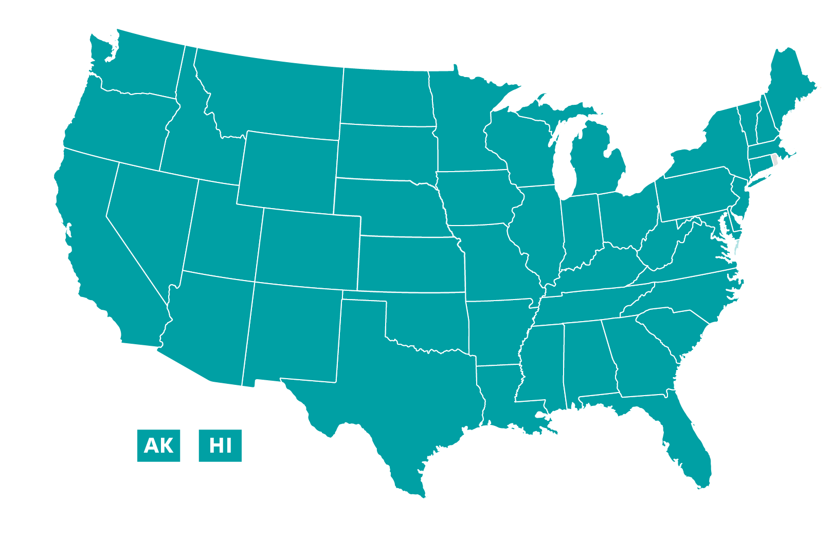
PDP Overview
4.4M members
#2 standalone individual PDP
3-star quality rating
3 unique plans per region

Slide 43
2024 Proposed Product Offerings
 | Duals |  | Low Premium |  | Richest Coverage
Plan Name | Classic |  | Value Script |  | Rx Value Plus
Premium | TBD |  | TBD |  | TBD
Deductible | $545 (applies to all tiers) |  | $545 (applies to tiers 3, 4, 5, and 6) |  | $0
Retail Type | Pref Retail | Std Retail | Pref Retail | Std Retail | Pref Retail | Std Retail
Initial Coverage Stage | T1: $0 T2: $3-$5 T3: 20%-24% T4: 40%-48% T5: 25% T6: $0 | T1: $2-$3 T2: $7-$9 T3: 20%-25% T4: 40%-48% T5: 25% T6: $0 | T1: $0 T2: $5 T3: 25% T4: 50% T5: 25% T6: $11 | T1: $5 T2: $10 T3: 25% T4: 50% T5: 25% T6: $11 | T1: $0 T2: $4 T3: $47 T4: 50% T5: 33% T6: $11 | T1: $5 T2: $10 T3: $47 T4: 50% T5: 33% T6: $11
Initial Coverage Limit | Up to $5,030 in Rx costs |  | Up to $5,030 in Rx costs |  | Up to $5,030 in Rx costs
Network (Preferred Pharmacies) | Walgreens, CVS, and grocers |  | Walgreens, CVS, and grocers |  | Walgreens, CVS, and grocers
Agent use only. Confidential and proprietary. Not to be distributed or shared with Medicare beneficiaries. Distribution to any person or company is prohibited and may be grounds for contract termination. Plan and benefit information contained in this document is pending government approval and subject to change. Final 2024 plan and benefit information may be discussed with beneficiaries on or after October 1.

Slide 44
2024 PBM Migration
ID Cards
All PDP members will receive a new 2024 ID card prior to Jan. 1, 2024, with updated pharmacy processing information (mailed in a teal envelope).
ID cards can also be accessed through the member portal and Wellcare+ app.
It is very important for members to bring their new card to the pharmacy to receive their prescriptions. Claims will not process without the new card.
PDP members typically do not receive a new card annually, so they may not be expecting a new card.
Members will receive several communications throughout AEP about the importance of using their new card:
Educational postcard
ID Card letter
Inbound IVR messaging

Slide 45
Mail Order
Effective Jan. 1, 2024, Express Scripts will replace CVS Caremark as our preferred mail order provider.
CVS Caremark Mail Order will be out-of-network in 2024. If members decide to continue to use mail order, they must switch to Express Scripts effective Jan. 1, 2024.
For existing mail order users, open prescription refills will be transferred to Express Scripts.
For any new mail order prescriptions, members will be able to set up a member profile with Express Scripts beginning Dec. 1, 2023, but will only be able to initiate an order beginning Jan. 1, 2024.
Communications will be sent to members with further information and actions needed to access this benefit.
In a process similar to CVS Caremark, Express Scripts will be managing all mail order operations, including offering a call center to support member inquiries.

Slide 46
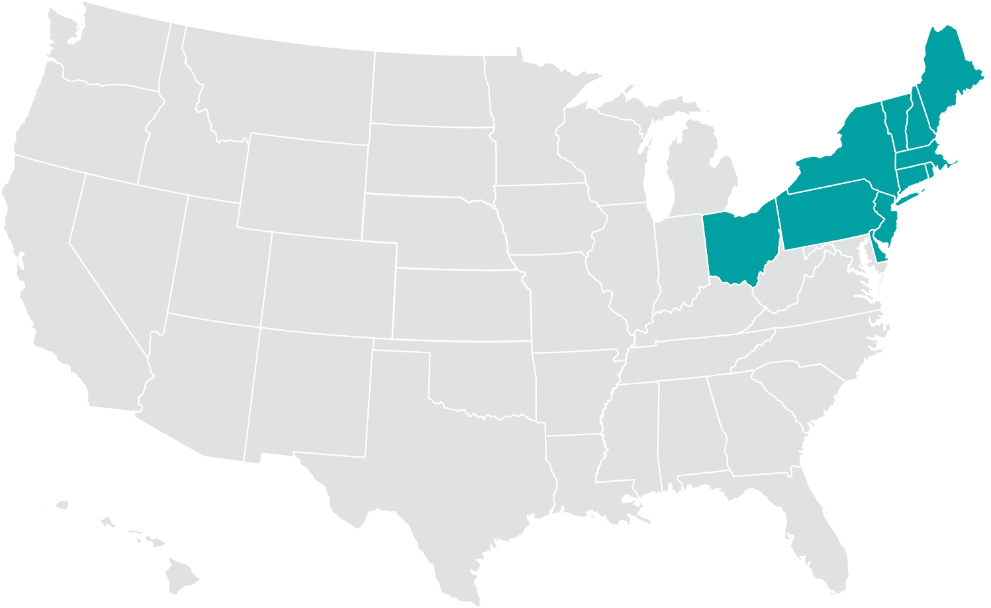
North Region Markets
Existing 2023 markets
Connecticut
Delaware
Maine
Massachusetts
New Hampshire
New Jersey
New York
Ohio
Pennsylvania
Rhode Island
Vermont

Slide 47
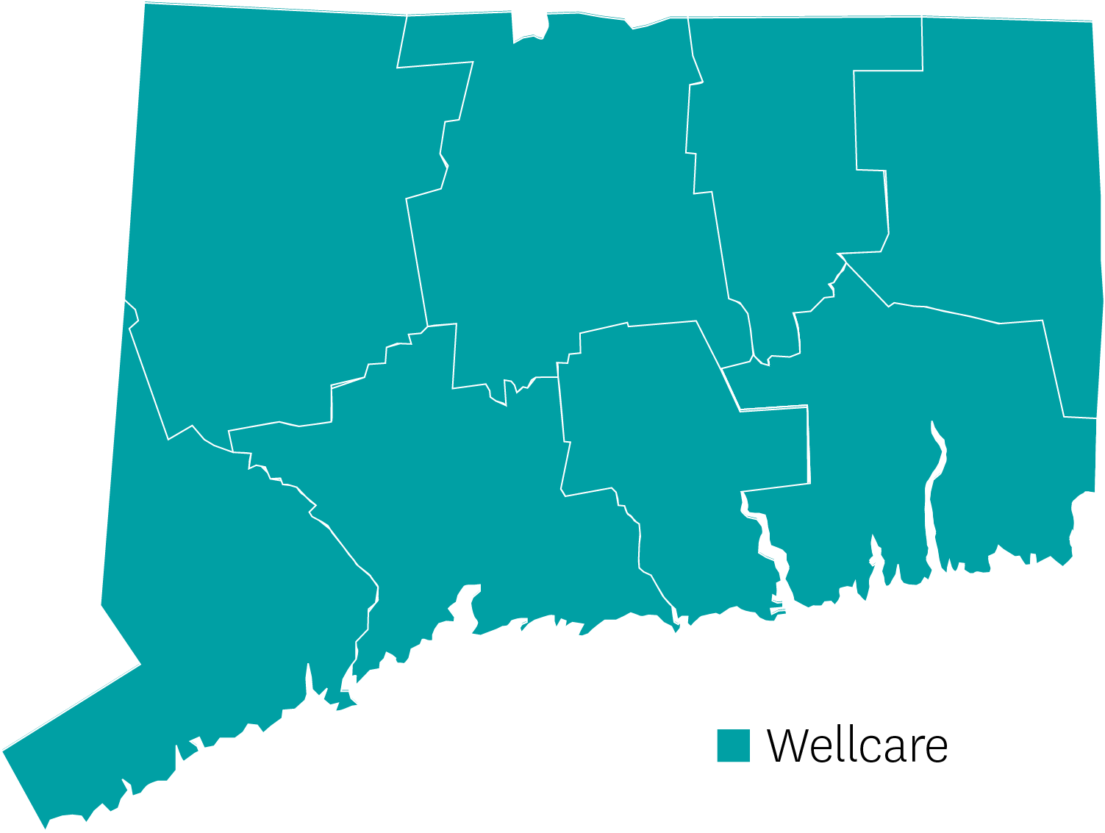
Connecticut | Review
Strong statewide network with all hospitals in network
All plans are available in all eight counties
Very competitive dental and OTC benefits
Strongest network in New Haven and Hartford County
Launched D-SNP PPO 2023 – Doing very well and will be a push plan for us in 2024
Spendables card
Strong DVH
Non-Emergency Transport
UHC, Aetna, Anthem, and Wellcare all offer similar plans on similar networks
Wellcare

Slide 48
Connecticut | At a Glance
Push Plans | Plan Type | Benefit Highlights
Wellcare Access Open | PPO D-SNP | Spendables Card $60 per mo., $1,000 core dental
Wellcare Access | HMO D-SNP | Spendables Card $80 per mo., $1,000 core dental
Wellcare Liberty | HMO D-SNP | Spendables Card $100 per mo., $1,000 core dental

Slide 49
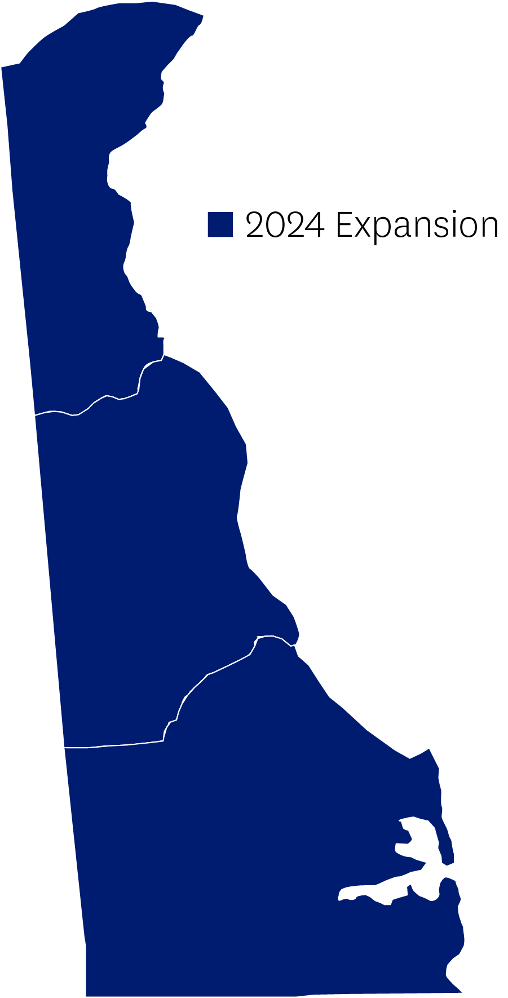
Delaware | Review
Expansion State for 2024!
We will be in three of three counties in Delaware.
There are three major hospitals in the state.
We are expecting to have all three and the following Health Systems:
Christiana Health System, including the two hospitals
Bebbe Hospital and Health System
Bay health Medical Center
Saint Francis Hospital
Tidal Health System
2024 Expansion

Slide 50
Delaware | At a Glance
Push Plans | Plan Type | Benefit Highlights
Wellcare No Premium | HMO-POS | $60 Spendables card per qtr., $1,000 Dental, $750 Hearing (both ears), $100 Vision
Wellcare Dual Liberty | HMO-POS DSNP | $180 Spendables card per mo., $2,000 Dental, $500 Hearing (both ears), $300 Vision
Wellcare Dual Access | HMO-POS DSNP | $140 Spendables card per mo., $2,000 Dental, $500 Hearing (both ears), $300 Vision

Slide 51
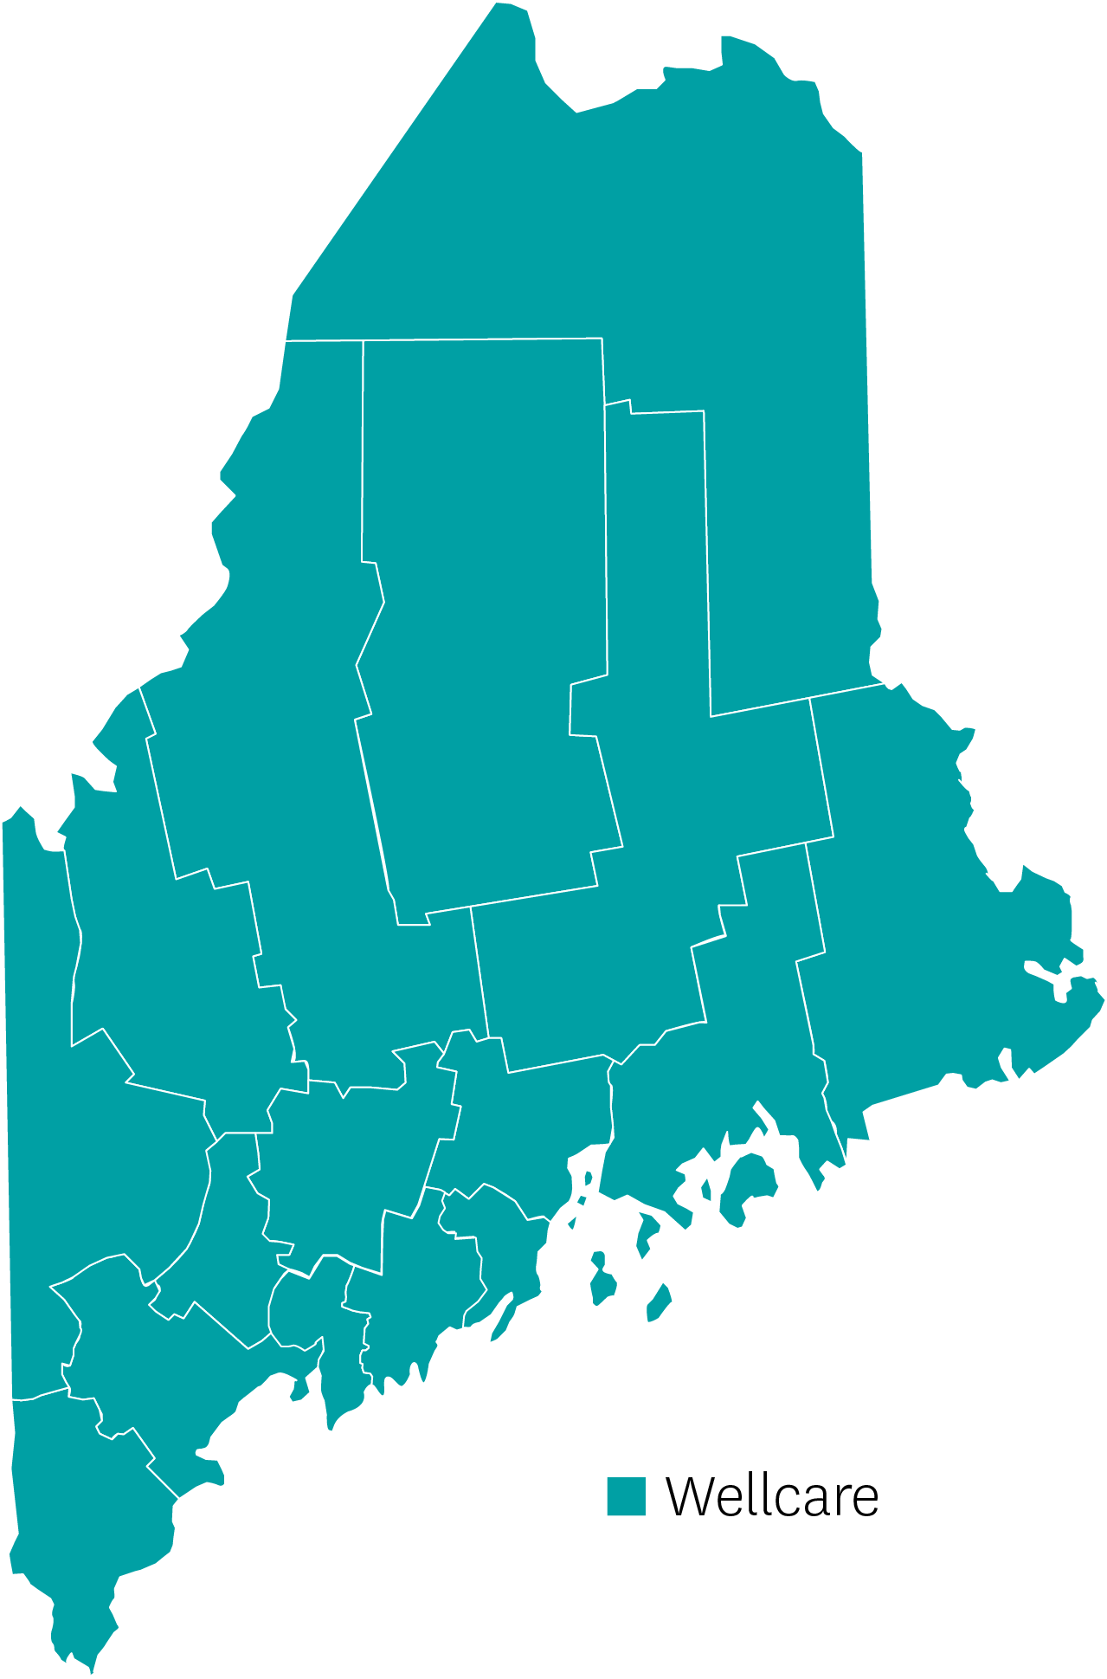
Maine | Review
Geographically Maine is bigger than the other five New England states combined.
The largest population density is in southern Maine.
Maine has a very competitive landscape with Martin’s Point, Aetna, and UHC as major players.
Portfolio consists of HMO, PPO, LIS, Give Back HMO, and 3 D-SNP plans with the drivers being the PPO, LIS, and D-SNP plans.
Strong network with more than 10,000 contracted providers and all 36 hospitals. Maine Health and Northern Lights are the key hospital groups.
Maine has a year-round Special Enrollment Period utilizing the State Pharmaceutical Assistance Program.
Wellcare

Slide 52
Maine | At a Glance
Push Plans | Plan Type | Benefit Highlights
Wellcare No Premium Open | PPO | $85 Spendables card per qtr., $0 Premium, $5,000 MOOP
Wellcare Assist Open | LIS PPO | $50 Spendables card per mo., $0 Premium, $4,500 MOOP, $1,000 Dental
Wellcare Dual Access | HMO D-SNP | $100 Spendables card per mo., $1,000 Hearing, $1,500 Dental
Wellcare Dual Liberty | HMO D-SNP | $110 Spendables card per mo., $1,500 Hearing, $2,000 Dental

Slide 53
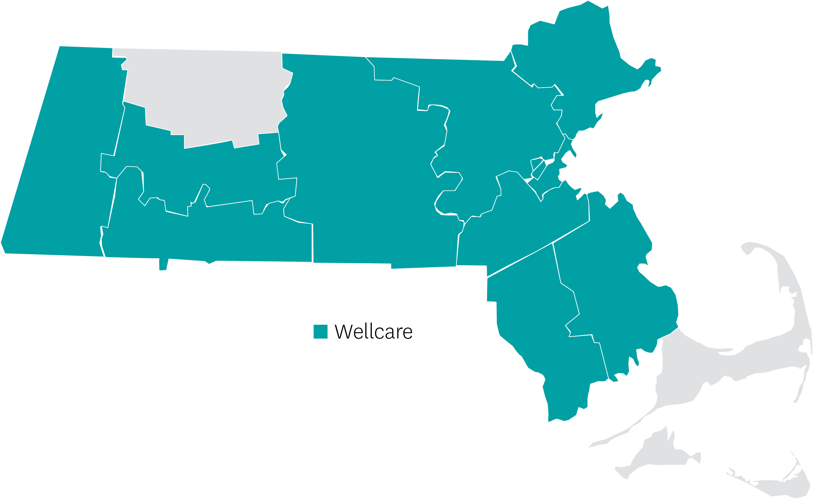
Massachusetts | Review
In 10 of 14 counties
4 total product offerings
Signature Healthcare, Steward Family of Hospitals, BMC in network
Top competitors: UHC, BCBS, Aetna, Humana, Tufts
HMO and PPO products
Wellcare

Slide 54
Massachusetts | At a Glance
Push Plans | Plan Type | Benefit Highlights
Wellcare No Premium | HMO | $19 Spendables card per mo., $1,500 Dental, $200 Vision, $1,000 Hearing (both ears)
Wellcare No Premium Open | PPO | $15 Spendables card per mo., $1,000 Dental, $200 Vision, $1,000 Hearing (both ears)
Wellcare Giveback Open | PPO Giveback | Giveback $70 per mo., PERS benefit, $100 Vision, $350 Hearing (both ears)
Wellcare Premium Enhanced Open | PPO | $75 premium per mo., $37 Spendables card per mo., PERS benefit, $2,000 Dental, $300 Vision, $2,000 Hearing (both ears), No Part D Deductible

Slide 55
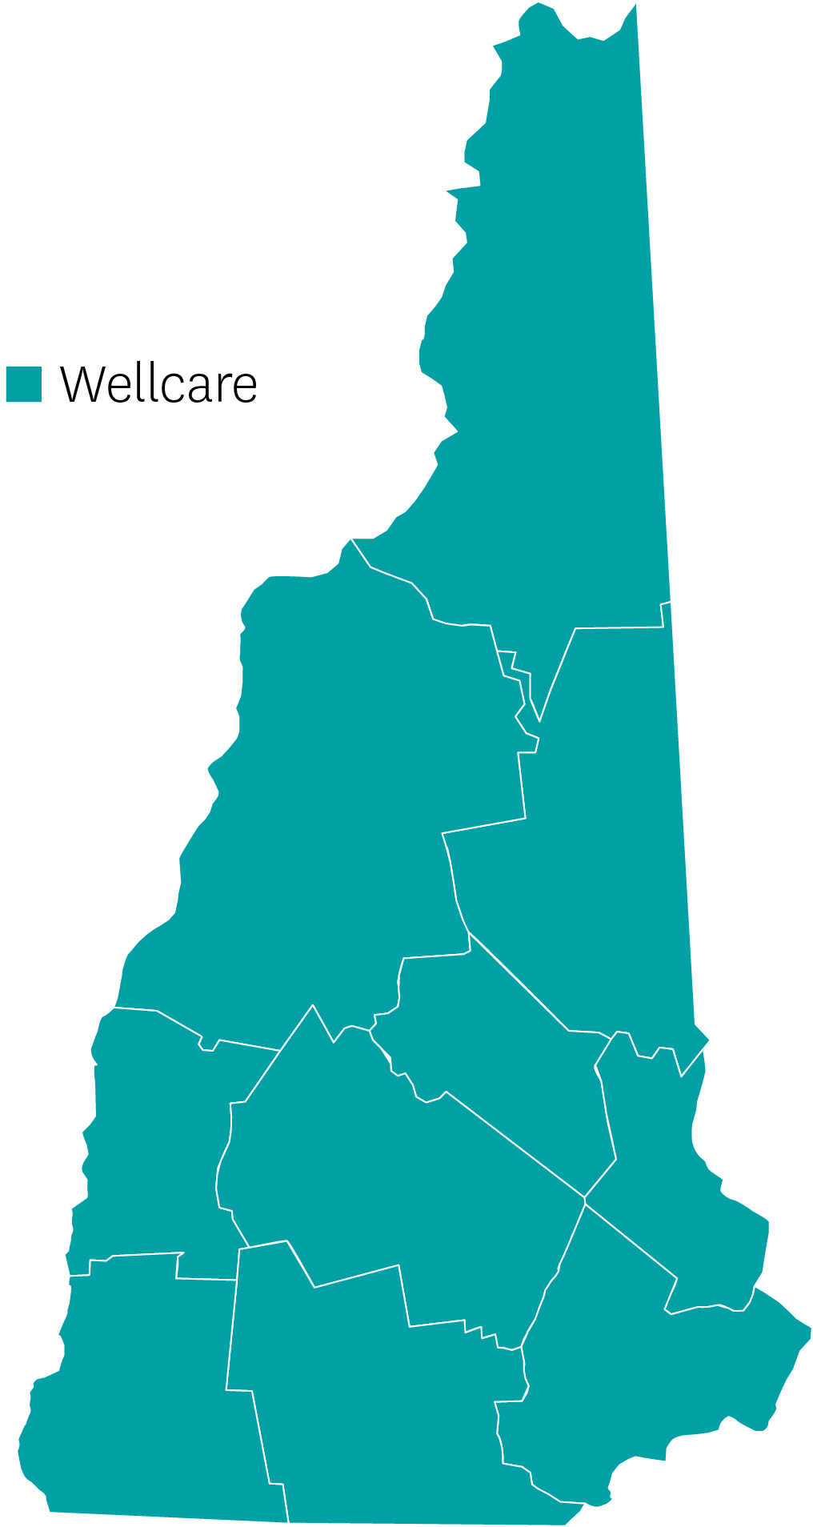
New Hampshire | Review
Southern New Hampshire contains most of the population with the northern part less populated.
Top competitors are Aetna, UHC, Humana, and Martin’s Point.
Portfolio consists of HMO, PPO, Give Back, and D-SNP Lookalike plans.
Network is growing fast with Solutions Health, Frisbee, and Dartmouth Hitchcock being key groups.
The product drivers are the PPO and D-SNP Lookalike plans.
Wellcare

Slide 56
New Hampshire | At a Glance
Push Plans | Plan Type | Benefit Highlights
Wellcare No Premium Open | PPO | $20 Spendables card per mo., $6,300 MOOP, $1,500 Dental, $100 Vision, $500 Hearing (both ears)
Wellcare Plus Open | PPO (D-SNP Look-a-Like) | $90 Spendables card per mo., $2,000 Dental, $300 Vision, $750 Hearing (both ears)

Slide 57
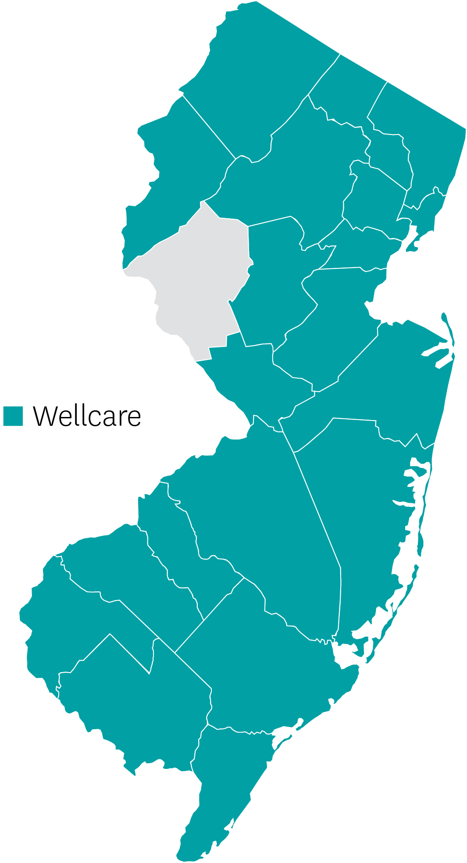
New Jersey | Review
In 20 of 21 counties
Top competitors: Clover, United, Horizon, Aetna, Humana
Key product offerings: D-SNP, HMO
Key provider relationship: SMG
Wellcare

Slide 58
New Jersey | At a Glance
Push Plans | Plan Type | Benefit Highlights
Wellcare Dual Liberty | D-SNP | $194 Spendables card per mo., PERS benefit, 42 post acute meals
Wellcare Assist | HMO | $40 Spendables card per qtr., PERS benefit, $1000 Dental, $100 vision
Wellcare No Premium Focus | HMO | $40 Spendables card per qtr., $1,000 Dental, $100 Vision, $1,000 hearing (both ears), PERS benefit

Slide 59
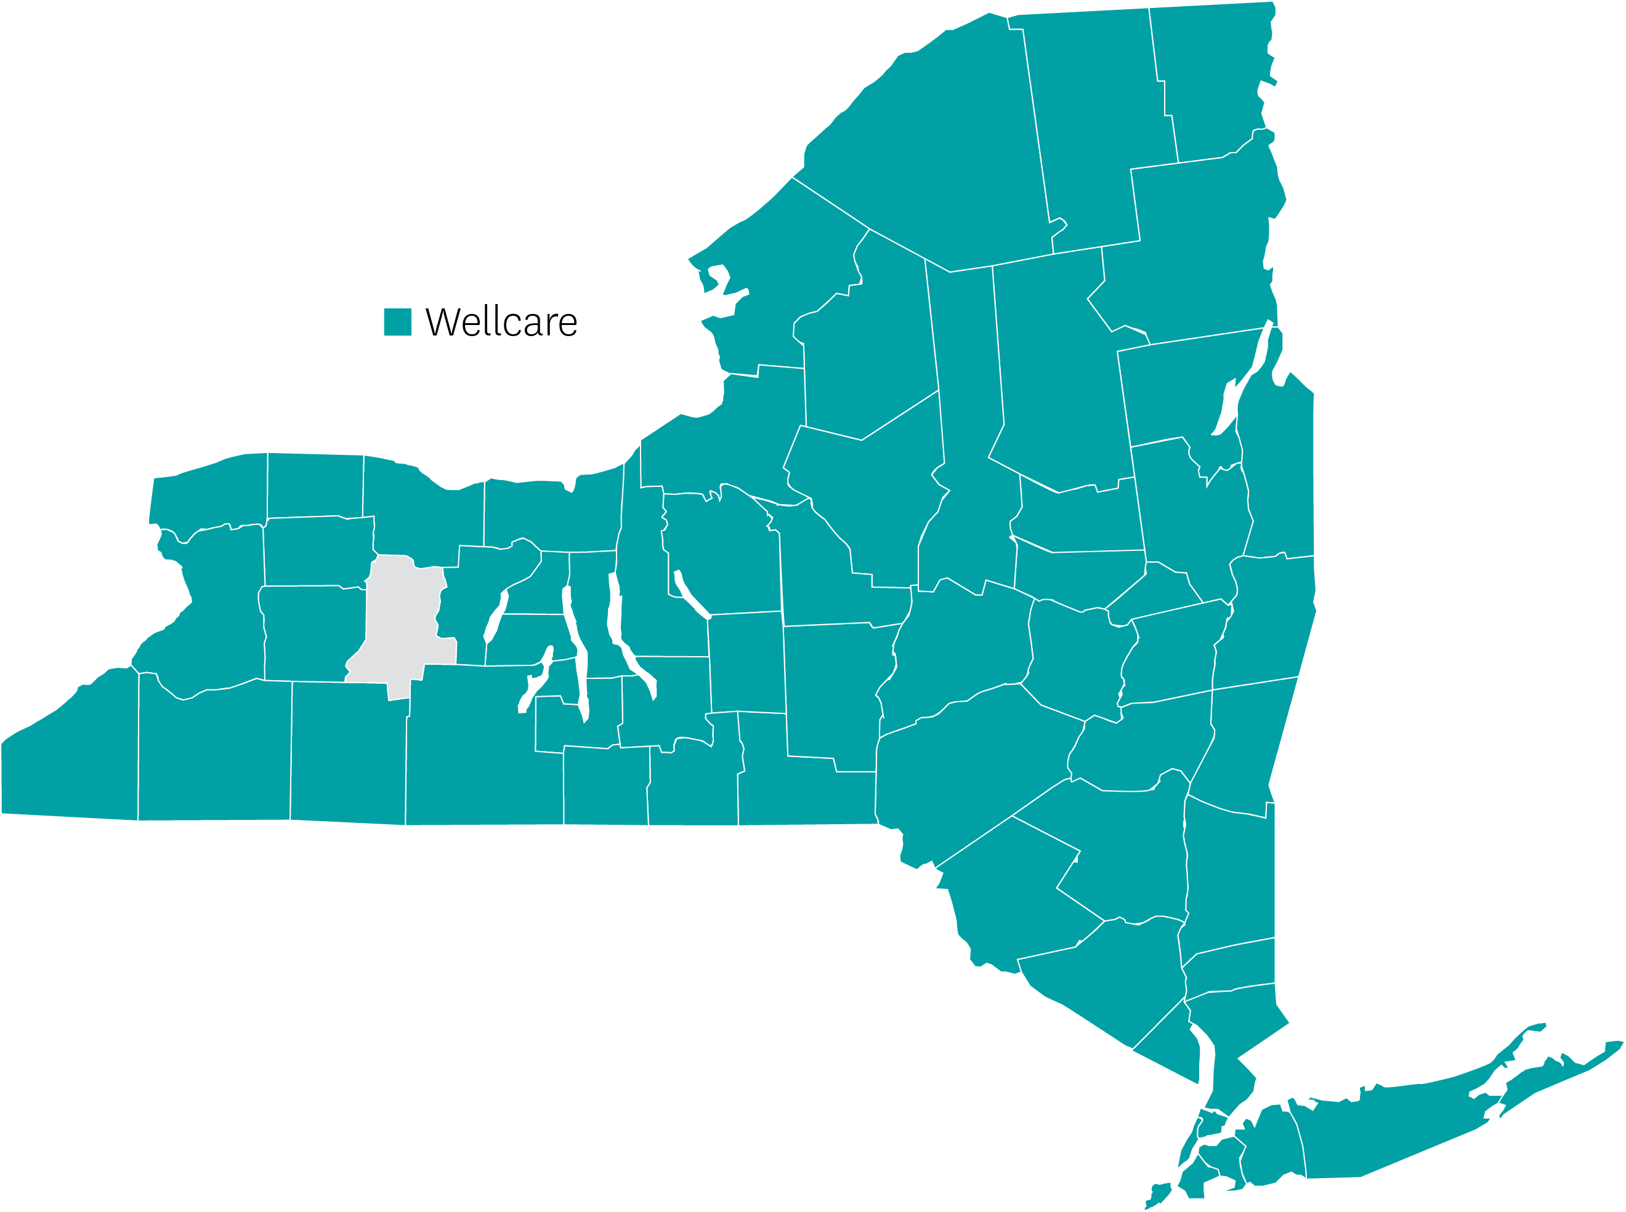
New York | Review
In 61 of 62 counties
Top competitors: United, HealthFirst, Aetna, Humana, Blues
Key provider relationships: SMG, Oak Street, CareMax (NYD)
Downstate New York (NYD) is largest metro area in the entire country.
Due to the population density, we have extensive marketing capabilities.
Strong/rich benefit portfolio
Strong networks in NYC area, Buffalo area, and Central NY
Extremely knowledgeable and tenured local support (Regional Agency Managers) are located across the state.
Wellcare

Slide 60
New York | At a Glance
Push Plans | Plan Type | Benefit Highlights
Wellcare Giveback Open | PPO Giveback | Giveback $74, $0 PCP, $100 Vision, $350 Hearing (both ears)
Wellcare Assist Open | LIS-PPO | $45 Spendables card per mo., $3,000 Dental, $100 Vision, $750 Hearing (both ears)
Wellcare No Premium Open | PPO | $50 Spendables card per qtr. (excluding NY County), $1,000 Dental, $200 Vision, $750 Hearing (both ears)
Wellcare Dual Access Open | PPO D-SNP | $80 Spendables card per mo., $4,000 Dental, $100 Vision, $1,000 Hearing (both ears), $0 Prescription Drugs
Wellcare Dual Access | HMO D-SNP (Downstate) (Bronx, Kings, Nassau, NY, Queens, Richmond) | $200 Spendables card per mo., $3,000 Dental, $200 Vision, $750 Hearing (both ears), $0 Prescription Drugs

Slide 61
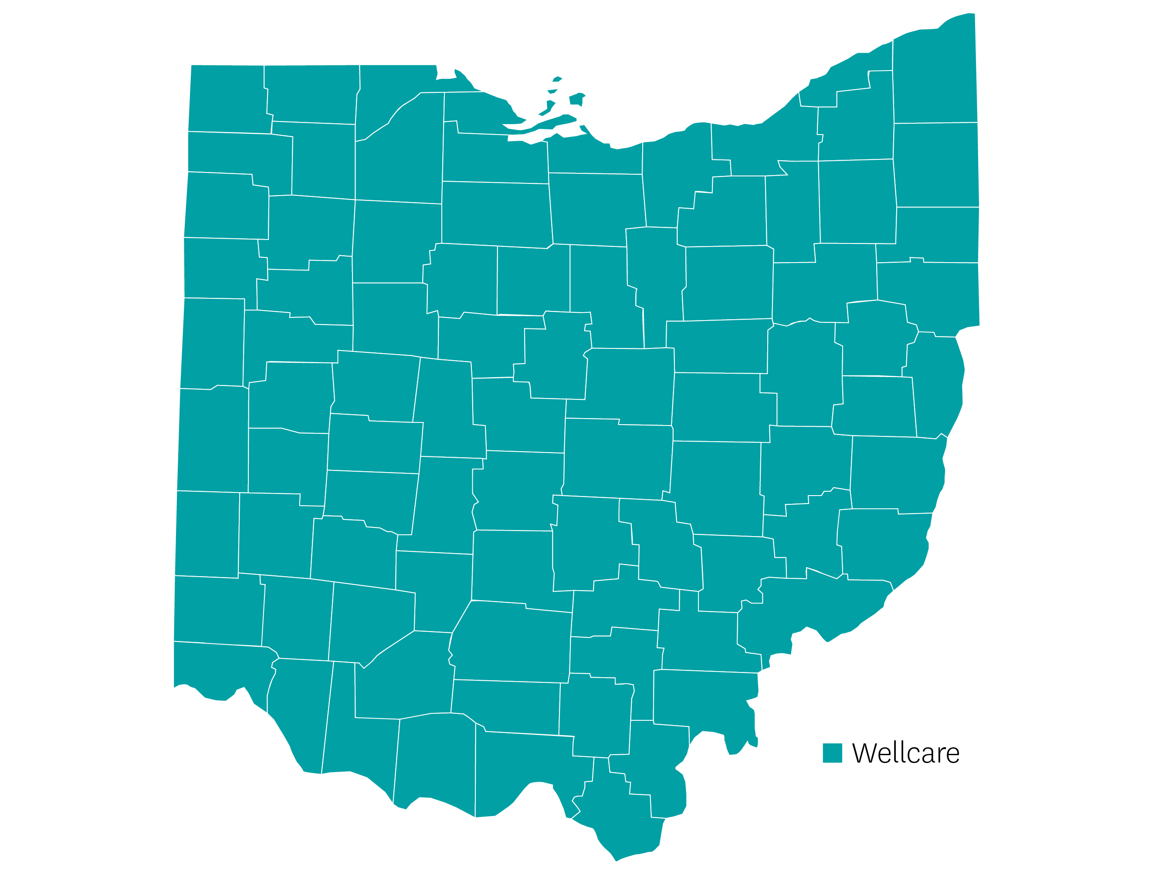
Ohio | Review
Competitive portfolio including HMO, PPO, HMO D-SNP, PPO D-SNP, LIS, and Giveback plans
Two new plans: PPO D-SNP (84 counties) and Giveback PPO MA-only (87 counties)
Plan design innovation
Visa Flex Card on most plans
Strong ancillary on core plans
Healthy Food Card added to HMO and PPO D-SNP plans
D-SNP $0 RX cost-share on all tiers
Wellcare

Slide 62
Ohio | At a Glance
Push Plans | Plan Type | Benefit Highlights
Wellcare by Allwell Dual Access (H0908-001) | HMO D-SNP | $5,000 Dental Spendable Card - $2,076 Monthly OTC - $173, Rolling
Wellcare All Dual Assure (H0980-006) | HMO D-SNP | $1,000 Dental Spendable Card - $2,580 Monthly OTC - $215, Rolling
Wellcare by Allwell No Premium (H0908-003) | HMO | $3,000 Dental Spendable Card - $648 Monthly OTC - $54, Rolling
Wellcare by Allwell Giveback (H0908-005) | HMO | $105 Giveback QTR OTC - $40
Wellcare by Allwell Dual Access Open (H7169-003) | PPO D-SNP | New Plan $3,000 Dental Spendable Card - $1,740 Monthly OTC - $145, Rolling
Wellcare No Premium Open (H7169-001) | PPO | $1,000 Dental Spendable Card - $240 Monthly OTC - $20, Rolling
*Additional eligibility is required to qualify for SSBCI benefits

Slide 63
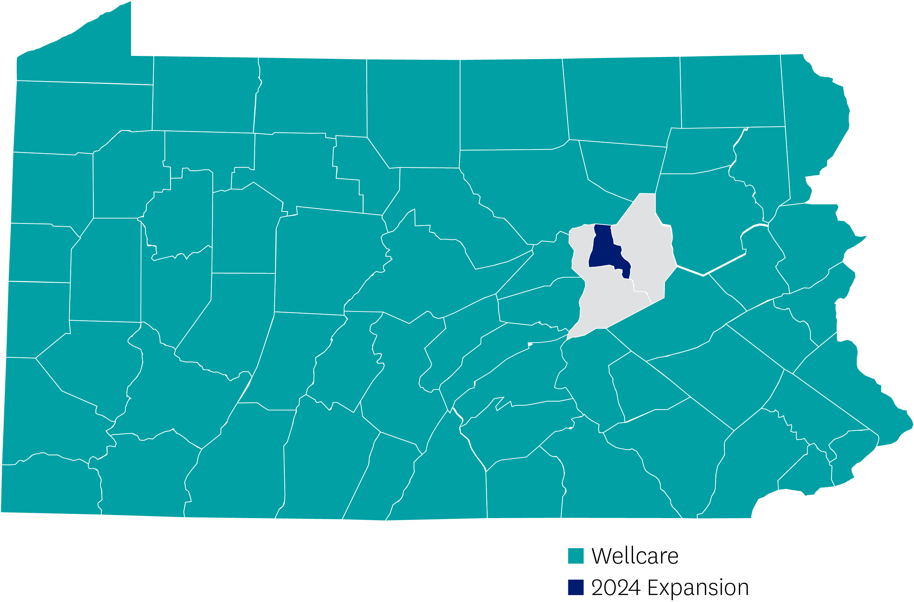
Pennsylvania | Review
In 64 of 67 counties
Strong in five counties in the Philadelphia area (Philadelphia, Chester, Bucks, Montgomery, Delaware)
Top competitors: Cigna, Health Partners, Aetna, Blue Cross, Gateway (D-SNP), Highmark, UPMC
Key product offerings: HMO, PPO, D-SNP,
Wellcare
2024 Expansion

Slide 64
Pennsylvania | At a Glance
Push Plans | Plan Type | Benefit Highlights
Wellcare Dual Access Open | D-SNP PPO | $66 Spendables card per mo., $5,000 Dental, $300 Vision, $1,000 Hearing (both ears)
Wellcare Dual Access (Plan H2915 002 & 007) | D-SNP HMO | $150 Spendables card per mo. (plan 002), $175 spendables card per mo. (plan 007), $500 Vision (plan 002), $300 Vision (plan 007), $1,000 Hearing (both ears) (plan 002), $1,500 Hearing (both ears) (plan 007)
Wellcare Giveback Open | PPO | Giveback $57 per mo., $10 PCP, $45 Specialist, $100 Vision, $350 Hearing (both ears)
Wellcare Patriot Giveback | HMO | Giveback $65 per mo., $65 Spendables card per qtr., $1,000 Dental, $200 Vision, $500 Hearing (both ears)
Wellcare No Premium (Plan H2915 003 & 016) | HMO | $40 Spendables card per qtr., $3,000 Dental (plan 003), $2,000 Dental (plan 016), $200 Vision (plan 003), $100 Vision (plan 016), $500 Hearing (both ears, both plans)

Slide 65
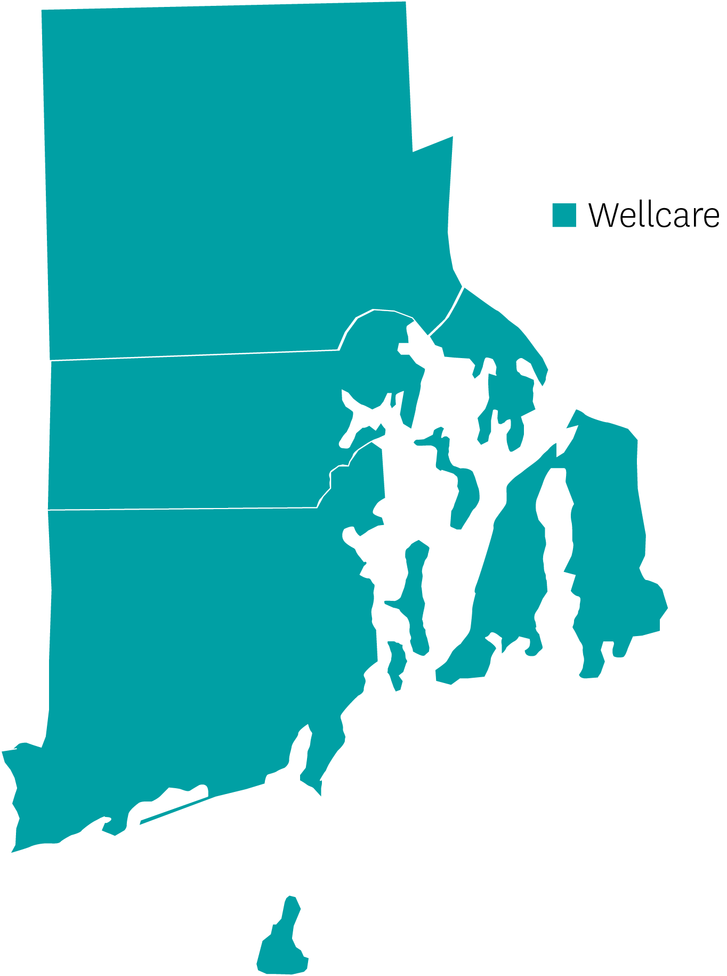
Rhode Island | Review
In five of five counties
Wellcare Dual Liberty Open has most volume
All hospitals in network
Top competitors: BCBS, UHC
Wellcare

Slide 66
Rhode Island | At a Glance
Push Plans | Plan Type | Benefit Highlights
Wellcare No Premium Open | PPO | $35 Spendables card per mo., $1,500 Dental, $400 Vision, $500 Hearing (both ears)
Wellcare Dual Access Open | PPO D-SNP | $66 Spendables card per mo., $2,000 Dental, $400 Vision, $1,000 Hearing (both ears), $0 Prescription Drugs
Wellcare Dual Liberty Open | PPO D-SNP | $158 Spendables card per mo., $3,000 Dental, $500 Vision, $1,500 Hearing (both ears), $0 Prescription Drugs

Slide 67
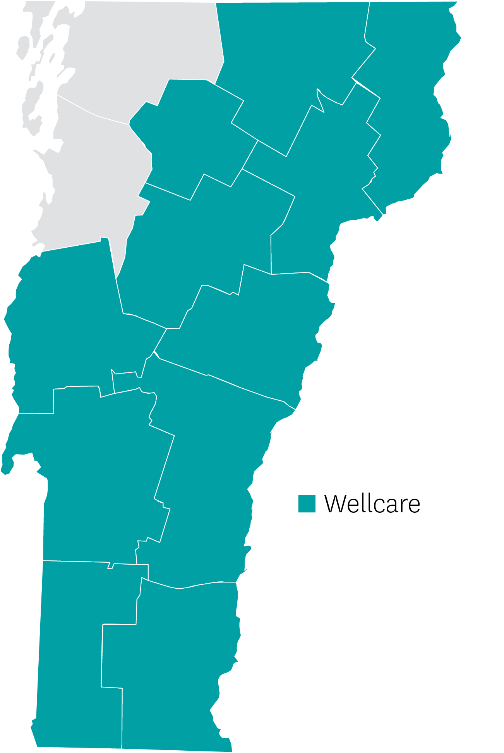
Vermont | Review
Strongest areas: Bennington, Rutland, Windham, Windsor Counties (Southern VT)
Key network partners: Southwest Vermont Medical Center, Rutland Hospital, Community Health Centers of Rutland Region, Brattleboro PC, Grace Cottage/Carlos Otis
Wellcare

Slide 68
Vermont | At a Glance
Push Plans | Plan Type | Benefit Highlights
No Premium Open | PPO | $20 Spendables card per mo., $1,000 Dental, $200 Vision, $750 Hearing (both ears), No Part D Deductible
Wellcare Plus Open | PPO | $100 Spendables card per mo., $300 Vision, $750 Hearing (both ears), PERS benefit
Wellcare Giveback Open | PPO | Giveback $60 per mo., $100 Vision, $350 Hearing (both ears), $0 PCP, $50 Specialist

Slide 69
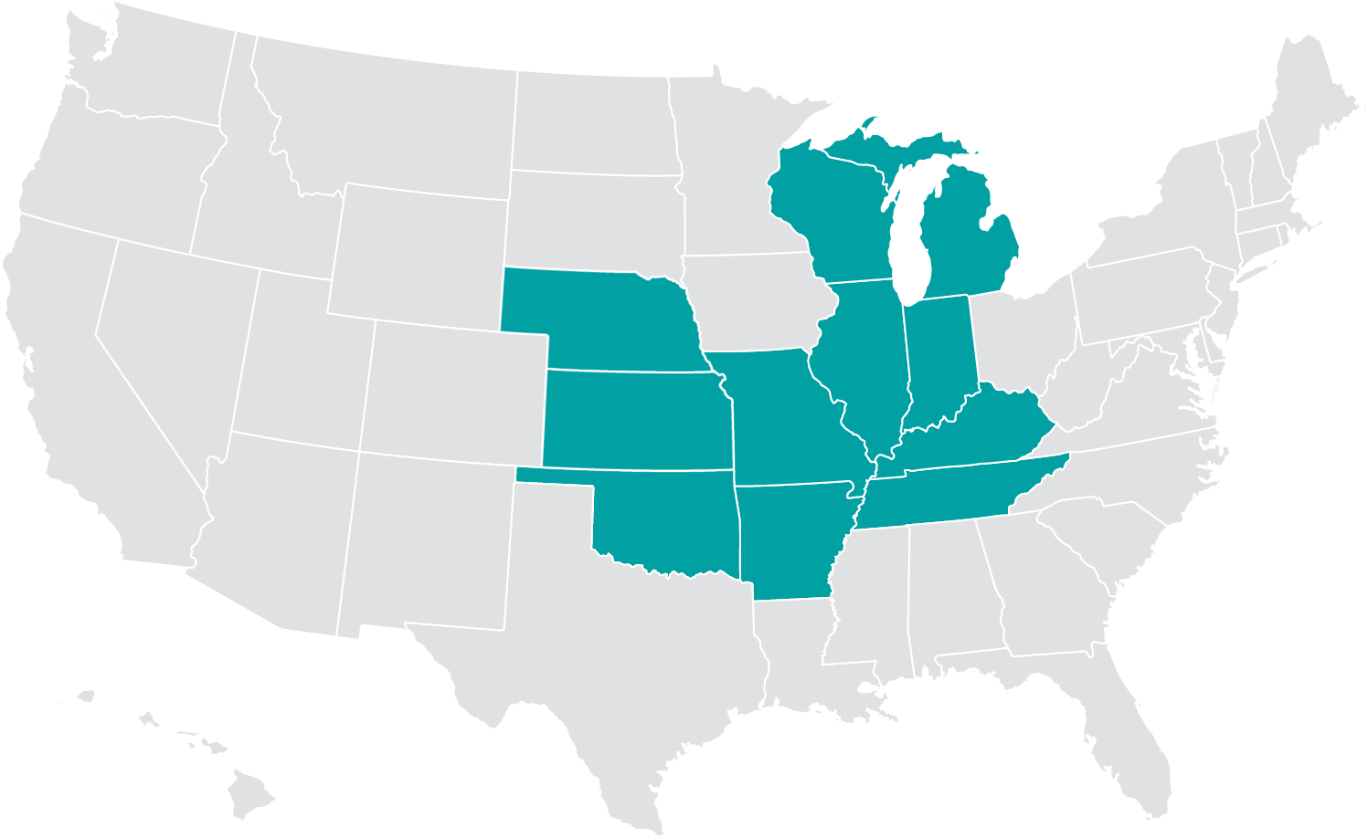
Central Region Markets
Existing 2023 markets
Arkansas
Illinois
Indiana
Kansas
Kentucky
Michigan
Missouri
Nebraska
Oklahoma
Tennessee
Wisconsin

Slide 70
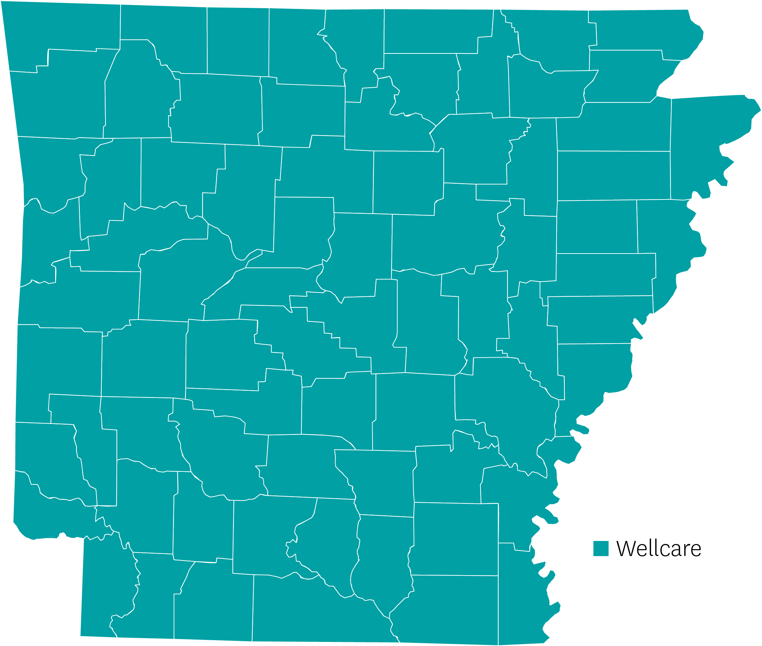
Arkansas | Review
Statewide
Key hospital network outside of state
Memphis, TN – Baptist Memorial
Springfield, MO – Cox Health
Texarkana, TX – Christus St. Michael
Delta Dental
Delta Dental MA network created for Wellcare by Allwell
New Wellcare Spendables Card!
New All Dual plan for partial dual eligibles
Wellcare

Slide 71
Arkansas | At a Glance
Push Plans | Plan Type | Benefit Highlights
Wellcare Dual Access Open (H0270-002) | PPO D-SNP | Spendables Card - $1,920 Monthly Utilities, Rent, Gas, Healthy Food, OTC, DVH - $160, Rolling Dental with dentures - $2,000
Wellcare No Premium (H9630-002) | HMO | Spendables Card - $600 Monthly OTC, DVH - $50, Rolling Dental with dentures - $2,000
Wellcare Dual Access (H9630-010) | HMO D-SNP | Spendables Card - $1,980 Monthly Utilities, Rent, Gas, Healthy Food, OTC, DVH - $165, Rolling Dental with dentures - $3,000
Wellcare Dual Liberty (H9630-011) | HMO D-SNP | Spendables Card - $2,220 Monthly Utilities, Rent, Gas, Healthy Food, OTC, DVH - $185, Rolling Dental with dentures - $4,000
Wellcare All Dual Assure (H9630-014) | HMO D-SNP | New Plan Spendables Card - $960 Monthly Utilities, Rent, Gas, Healthy Food, OTC, DVH - $80, Rolling Dental with dentures - $2,500
*Additional eligibility is required to qualify for SSBCI benefits

Slide 72
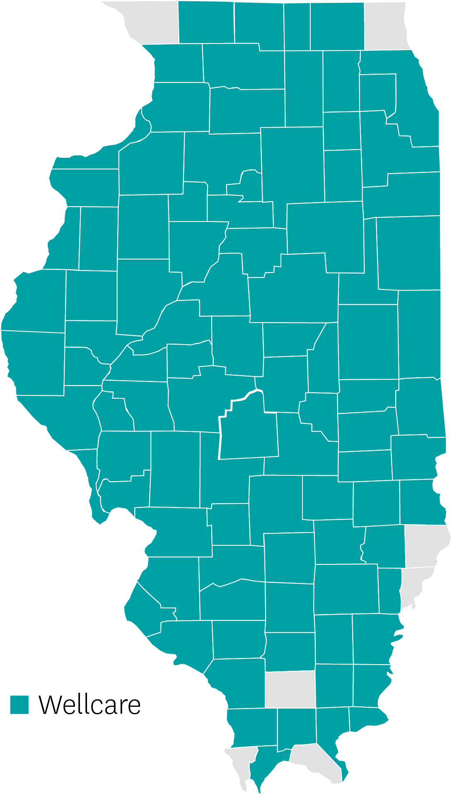
Illinois | Review
95-county service area
Array of products offered
HMO, HMO-POS, PPO
Strong provider network
Oak Street Health
JenCare Senior Medical
Solid supporting partner groups in Advocate Health, Cook County Stronger System, UIC Med., Access Health
New Wellcare Spendables Card!
Wellcare

Slide 73
Illinois | At a Glance
Normal (No Push) Plans | Plan Type | Benefit Highlights
Wellcare No Premium Exclusive (H5779-007) | HMO | Spendables Card - $540 Monthly OTC, DVH - $45, Rolling
Wellcare No Premium Essential (H5779-002) | HMO | Available in 95 counties $3,000 Dental includes dentures
Wellcare No Premium (H1416-009) | HMO-POS | Spendables Card - $660 Monthly OTC, DVH - $55, Rolling $5,000 Dental includes dentures
Wellcare Assist Compass (H1416-023) | HMO | LIS-centric plan Spendables Card - $720 Monthly OTC, DVH - $60 Rolling
Wellcare No Premium Open (H6713-001) | PPO | Spendables Card - $120 Available in 95 counties
*Additional eligibility is required to qualify for SSBCI benefits
Notes:
All IL plans include denture coverage up to plan limit.

Slide 74
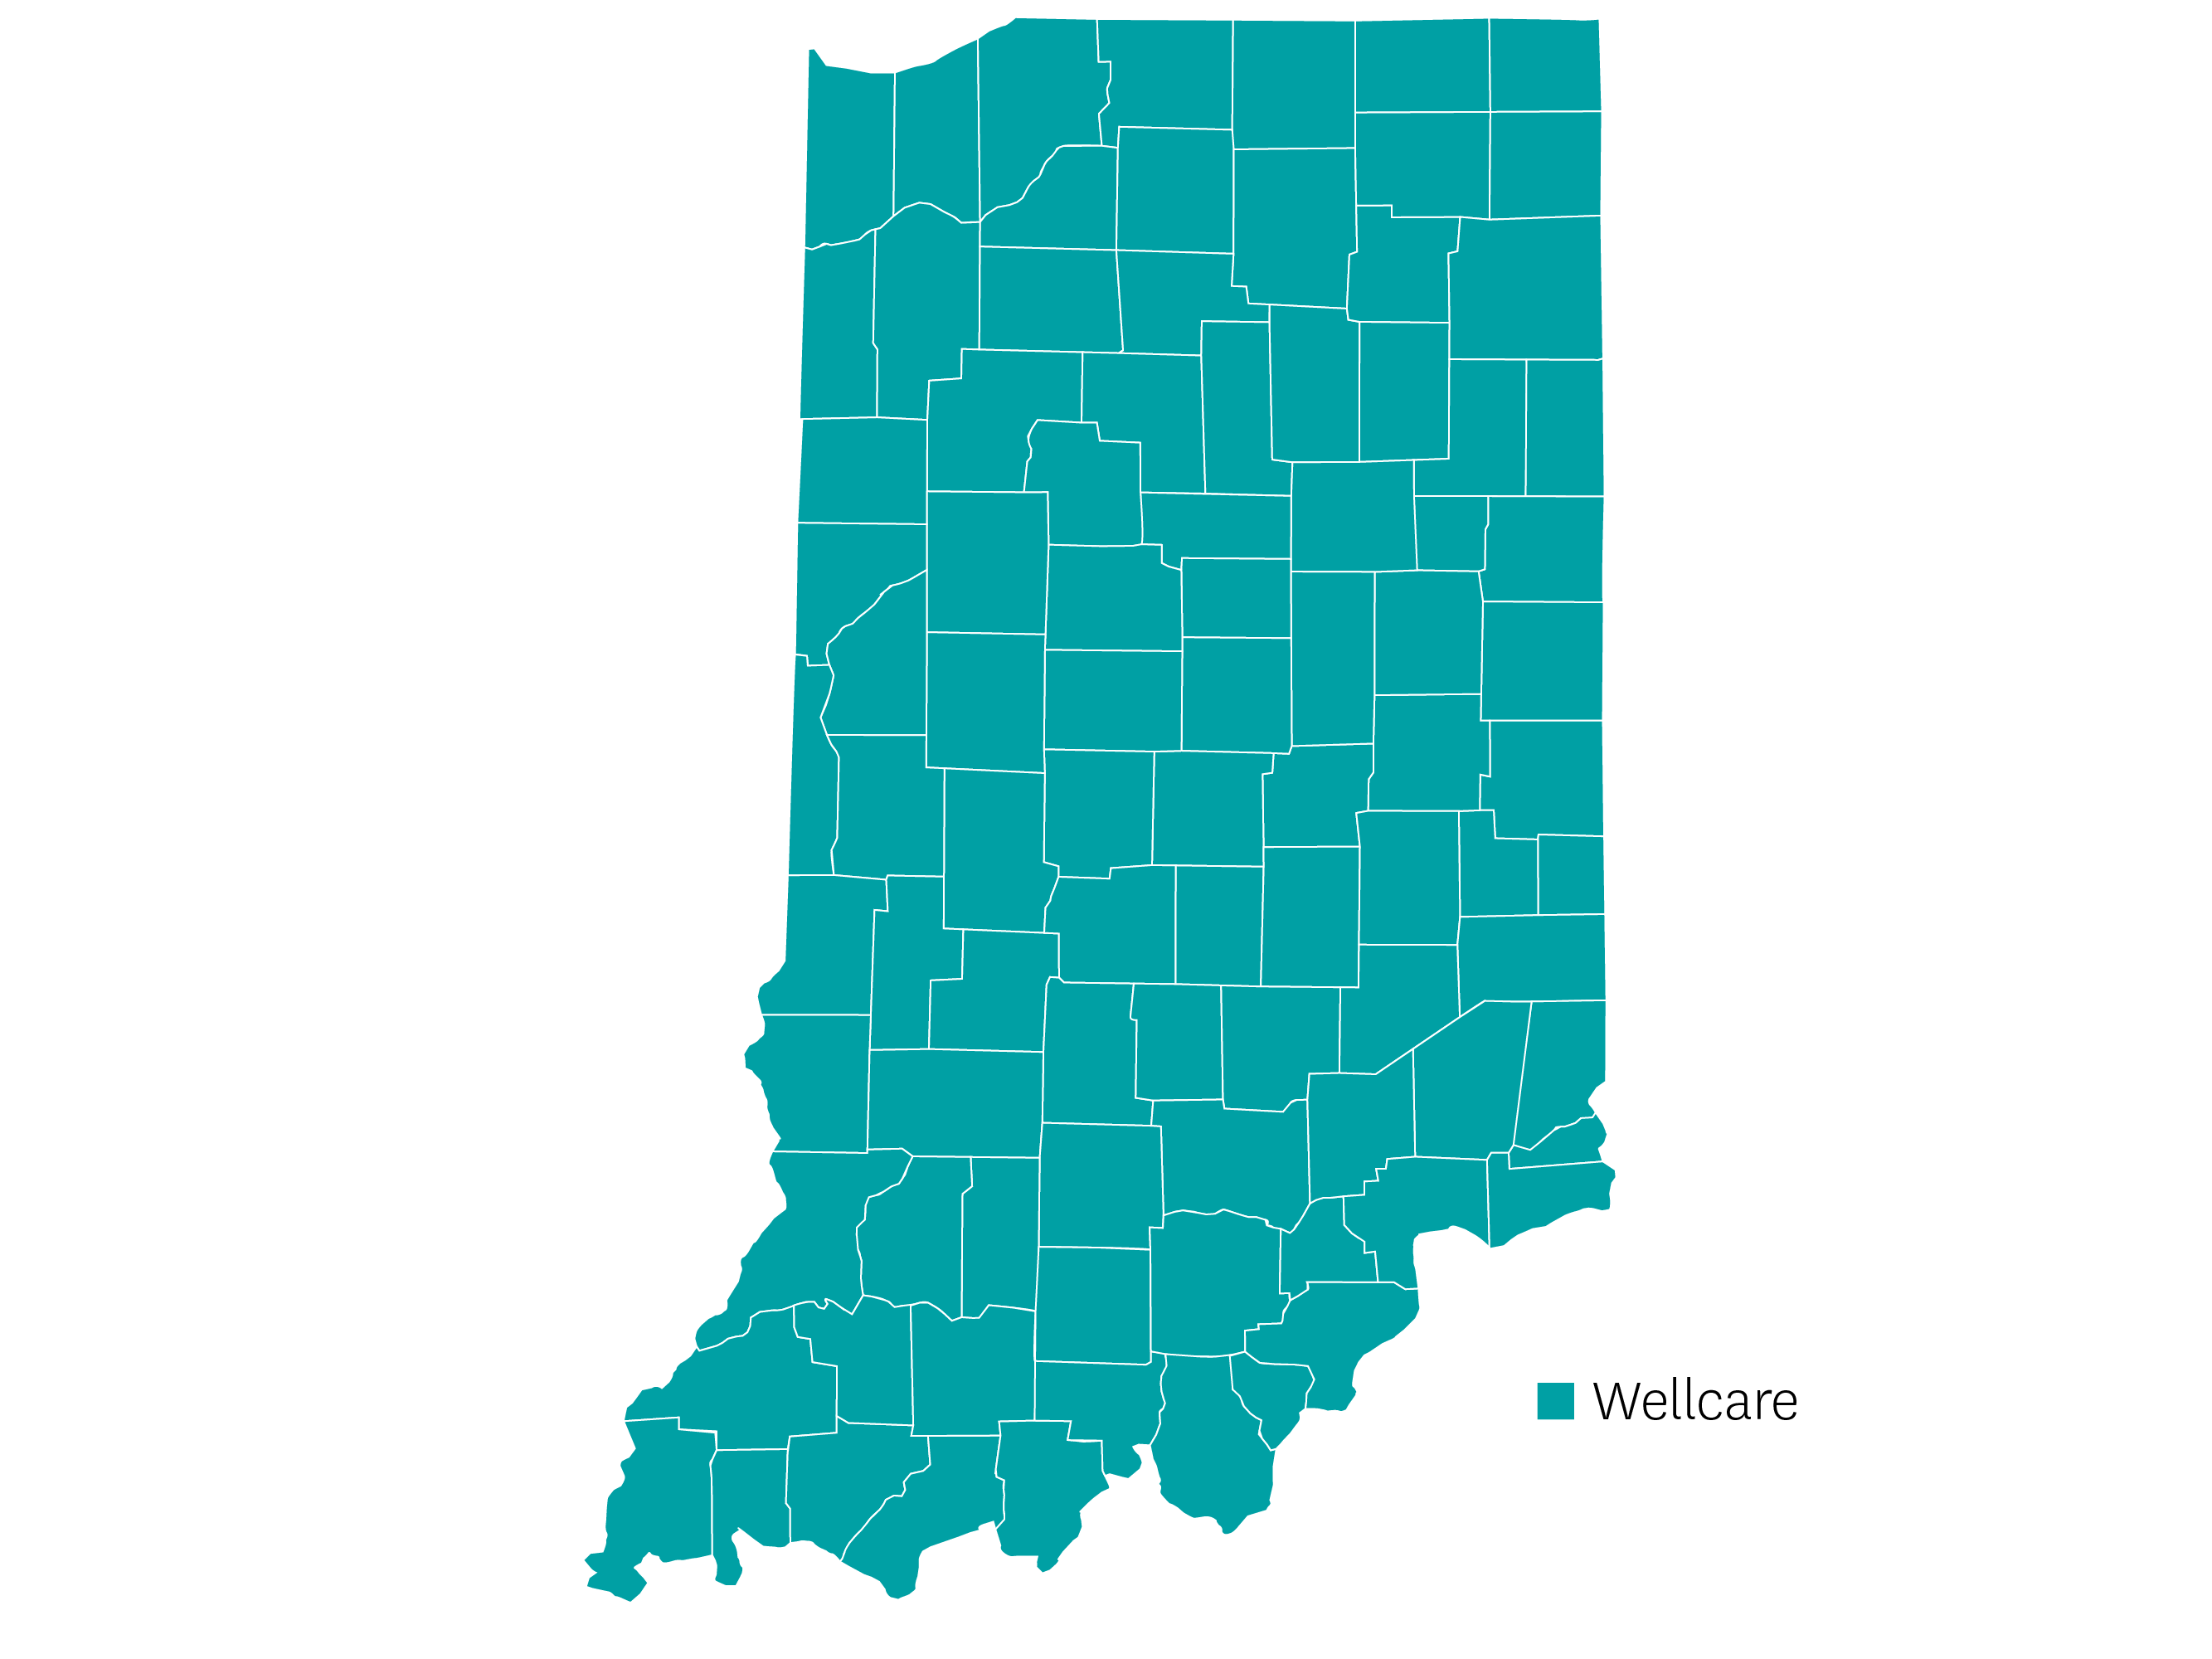
Indiana | Review
Statewide
Strong provider network
Oak Street Health
Ascension
Array of products offered
Multiple PPO and HMO plan options available
New Wellcare Spendables Card!
Wellcare

Slide 75
Indiana | At a Glance
Push Plans | Plan Type | Benefit Highlights
Wellcare No Premium (H3499-002) | HMO | Spendables Card - $600 Monthly OTC + DVH - $50, Rolling $1,500 Dental
Wellcare Assist (H3499-008) | HMO | Quarterly OTC - $64 $4,000 dental
Wellcare No Premium Open (H6348-002) | PPO | $2,000 Dental Quarterly OTC - $60
Wellcare Patriot Giveback Open (H6348-005) | PPO | Spendables Card - $300 Monthly OTC + DVH - $25, Rolling $1,500 Dental
Wellcare Low Premium Open (H6348-007) | PPO | Quarterly OTC - $50 $3,000 Dental
Wellcare Complete No Premium (H7925-002) | HMO | New Plan Spendables Card - $744 Monthly OTC + DVH - $62, Rolling
*Additional eligibility is required to qualify for SSBCI benefits
Notes:
Flex Card all at $500

Slide 76
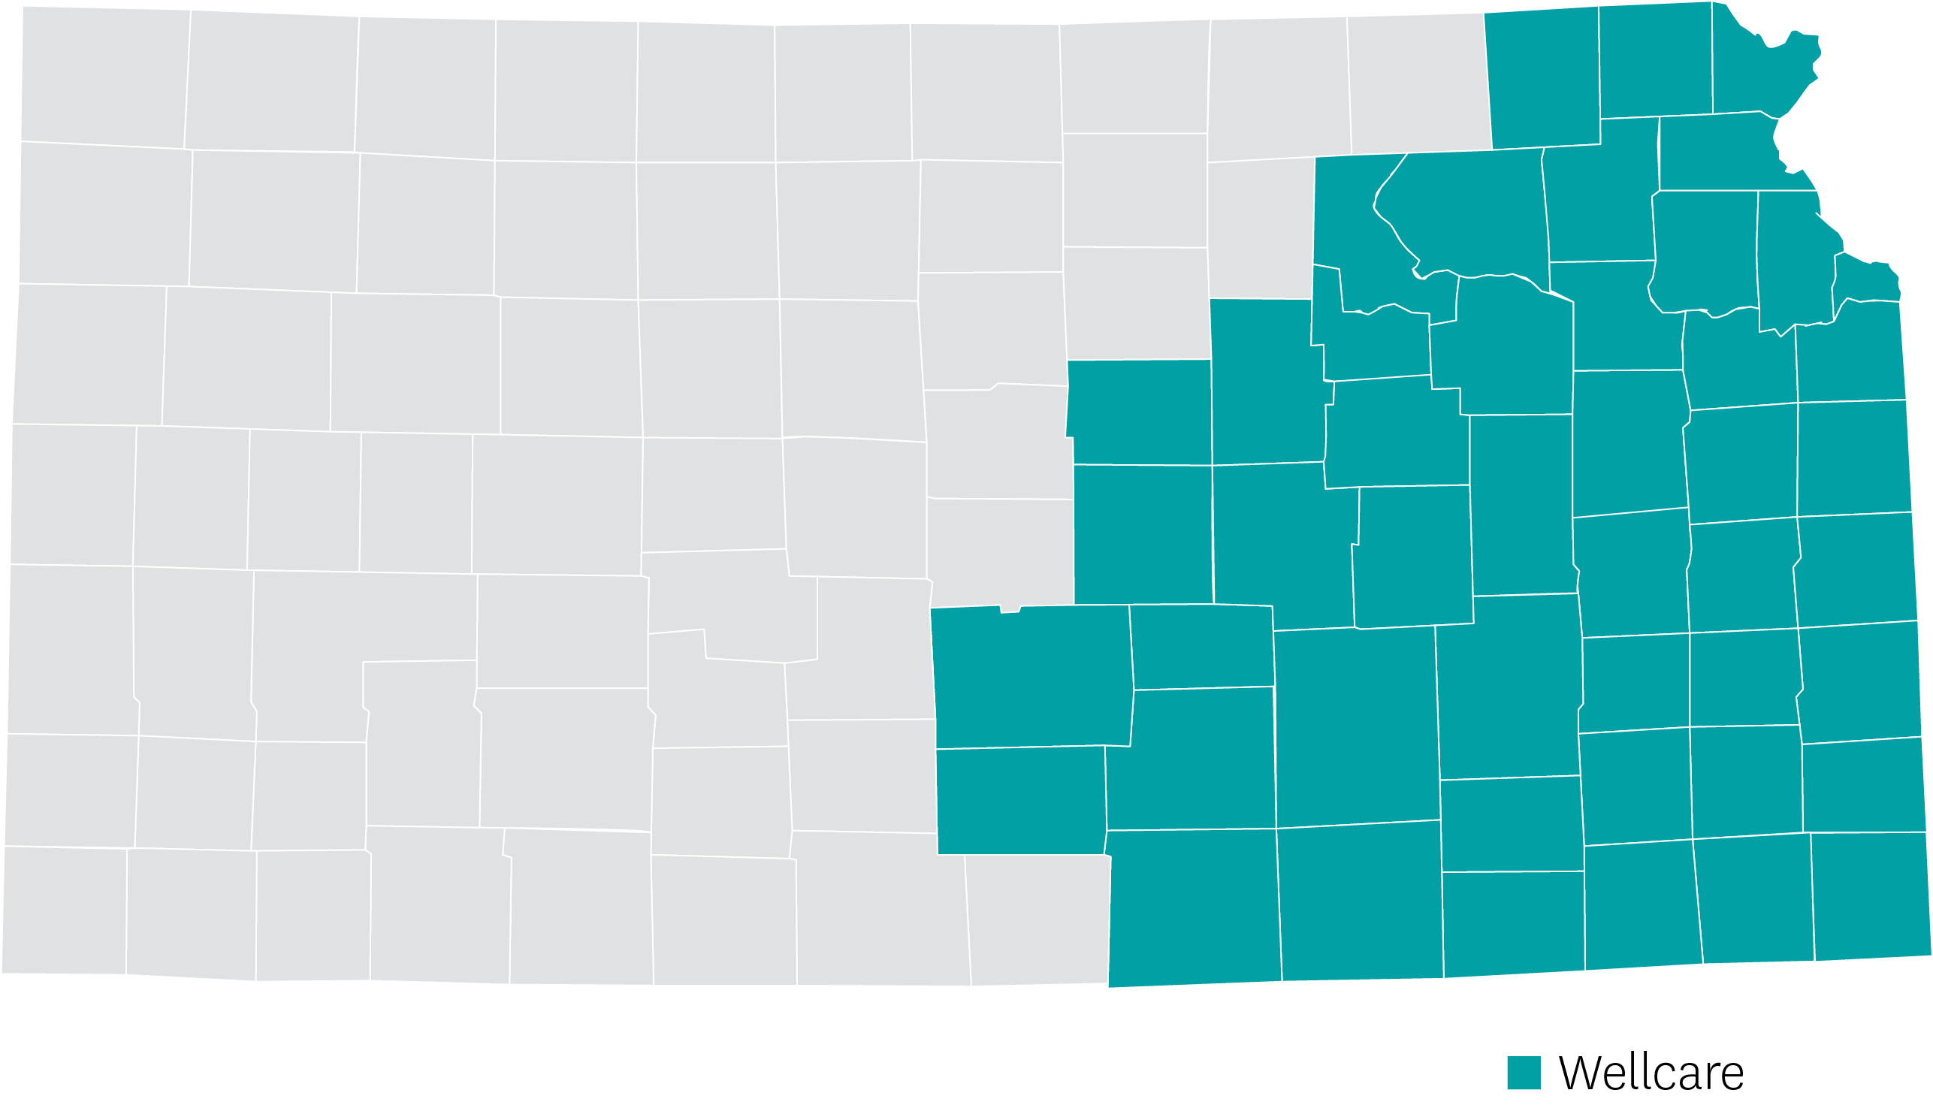
Kansas | Review
47-county service area
Provider network
Hutchinson Regional Medical Center in Reno County has agreed to file our PPO D-SNP and charge Medicaid for the remainder of the cost-share.
No other PPO D-SNPs in the county
Strong D-SNP products
New Wellcare Spendables Card!
Wellcare

Slide 77
Kansas | At a Glance
Push Plans | Plan Type | Benefit Highlights
Wellcare Dual Access (H6550-004) | HMO D-SNP | Spendables Card - $2,100 Monthly Utilities, Rent, Gas, Healthy Food, OTC, DVH - $175, Rolling $5,000 Dental
Wellcare Dual Liberty (H6550-009) | HMO D-SNP | Spendables Card - $2,460 Monthly Utilities, Rent, Gas, Healthy Food, OTC, DVH - $205, Rolling Dental Platinum $0
Wellcare Dual Access Open (H9387-004) | PPO D-SNP | Spendables Card - $2,220 Monthly Utilities, Rent, Gas, Healthy Food, OTC, DVH - $185, Rolling $3,000 Dental
*Additional eligibility is required to qualify for SSBCI benefits

Slide 78
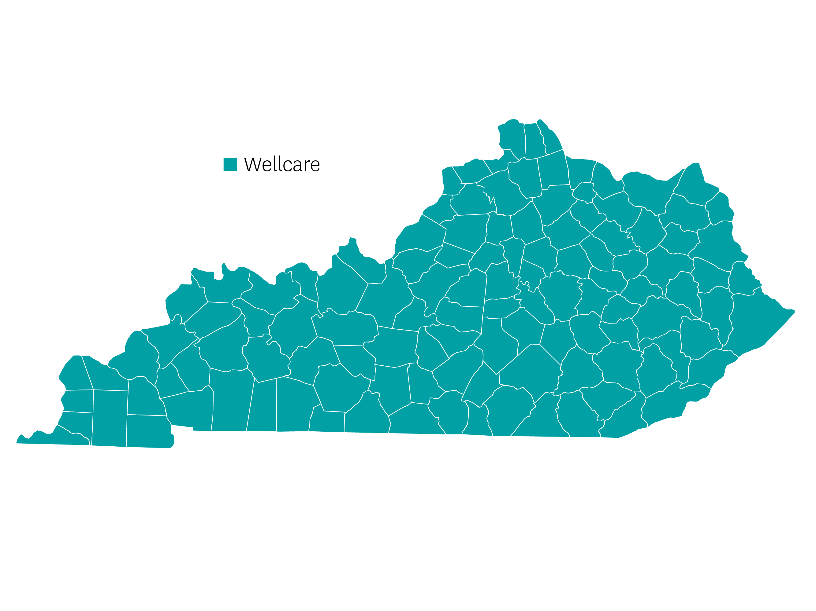
Kentucky | Review
Statewide
Array of products offered
HMO, HMO D-SNP, PPO D-SNP
Strong provider network
Oak Street Health
JenCare Senior Medical
Centerwell
New Wellcare Spendables Card!
New All Dual plan for partial dual eligibles
Wellcare

Slide 79
Kentucky | At a Glance
Push Plans | Plan Type | Benefit Highlights
Wellcare Dual Access Open (H3975-004) | PPO D-SNP | Spendables Card - $1,212 Monthly OTC, DVH - $101, Rolling Dental $2,000
Wellcare Dual Access (H9730-003) | HMO D-SNP | Spendables Card - $1,500 Monthly Utilities, Rent, Gas, Healthy Food, OTC, DVH - $125, Rolling Dental $3,000
Wellcare Dual Liberty (H9730-004) | HMO D-SNP | Spendables Card - $2,100 Month Utilities, Rent, Gas, Healthy Food, OTC, DVH - $175, Rolling Dental $4,000
Wellcare No Premium (H9730-009) | HMO | Spendables Card - $504 Monthly OTC, DVH - $42, Rolling Dental $1,500
Wellcare All Dual Assure (H9730-011) | HMO D-SNP | New Plan Spendables Card - $696 Monthly Utilities, Rent, Gas, Healthy Food, OTC, DVH - $58, Rolling Dental $2,000
*Additional eligibility is required to qualify for SSBCI benefits

Slide 80
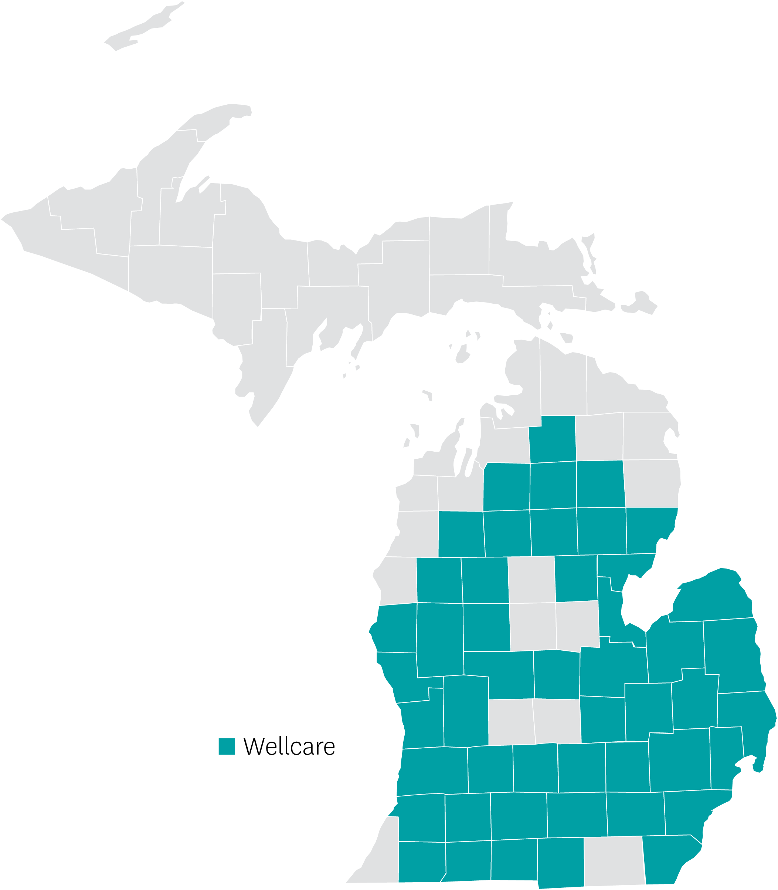
Michigan | Review
48-county service area
Strong provider network
Oak Street Health
Dedicated Senior Medical Center
Rich dental benefits on all D-SNPs
New Wellcare Spendables Card!
New All Dual plan for partial dual eligibles
Wellcare

Slide 81
Michigan | At a Glance
Push Plans | Plan Type | Benefit Highlights
Wellcare Complete Dual Access (H0482-005) | HMO D-SNP | Spendables Card - $2,160 Monthly Utilities, Rent, Gas, Healthy Food, OTC, DVH - $180, Rolling Dental Platinum $0
Wellcare Dual Access Open (H2117-002) | PPO D-SNP | Spendables Card - $1,860 Monthly Utilities, Rent, Gas, Healthy Food, OTC, DVH - $125, Rolling $4,000 Dental
Wellcare Dual Access (H5475-001) | HMO-POS D-SNP | Spendables Card - $1,608 Monthly Utilities, Rent, Gas, Healthy Food, OTC, DVH - $134, Rolling $5,000 Dental
Wellcare All Dual Assure (H5475-039) | HMO D-SNP | New Plan Spendables Card - $612 Monthly Utilities, Rent, Gas, Healthy Food, OTC, DVH - $51, Rolling $4,000 Dental
*Additional eligibility is required to qualify for SSBCI benefits

Slide 82
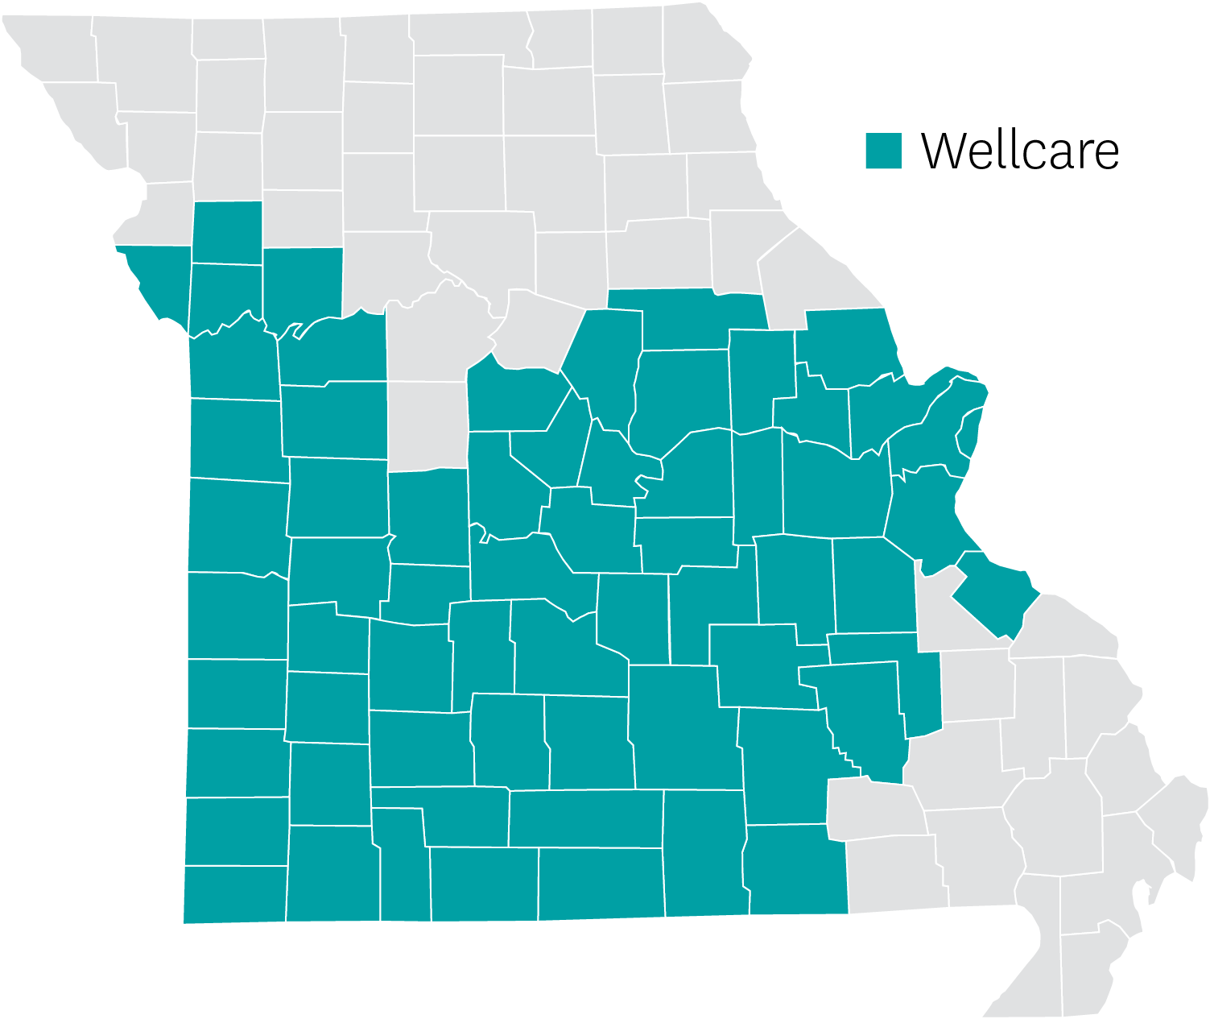
Missouri | Review
66-county service area
Strong provider network
Cox Health
Mercy
University of Missouri
Phelps County Regional
Dedicated
Oak Street
Rich dental benefits on D-SNP offerings
Two new Wellcare Mutual of Omaha plans
New Wellcare Spendables Card!
Wellcare

Slide 83
Missouri | At a Glance
Push Plans | Plan Type | Benefit Highlights
Wellcare Dual Access (H1664-005) | HMO D-SNP | Spendables Card - $2,280 Monthly Utilities, Rent, Gas, Healthy Food, OTC, DVH - $190, Rolling Dental $5,000
Wellcare Mutual of Omaha No Premium Open (H7518-001) | PPO | New Plan Quarterly OTC - $100 Dental Platinum $0
Wellcare Dual Access Open (H7518-003) | PPO D-SNP | Spendables Card - $2,280 Monthly Utilities, Rent, Gas, Healthy Food, OTC, DVH - $205, Rolling Dental $5,000
Wellcare Mutual of Omaha Low Premium (H7518-004) | PPO | New Plan Spendables Card - $900 Monthly OTC, DVH - $75, Rolling
Wellcare Dual Access (H9335-003) | HMO D-SNP | Spendables Card - $2,280 Monthly Utilities, Rent, Gas, Healthy Food, OTC, DVH - $190, Rolling Dental $5,000
*Additional eligibility is required to qualify for SSBCI benefits

Slide 84
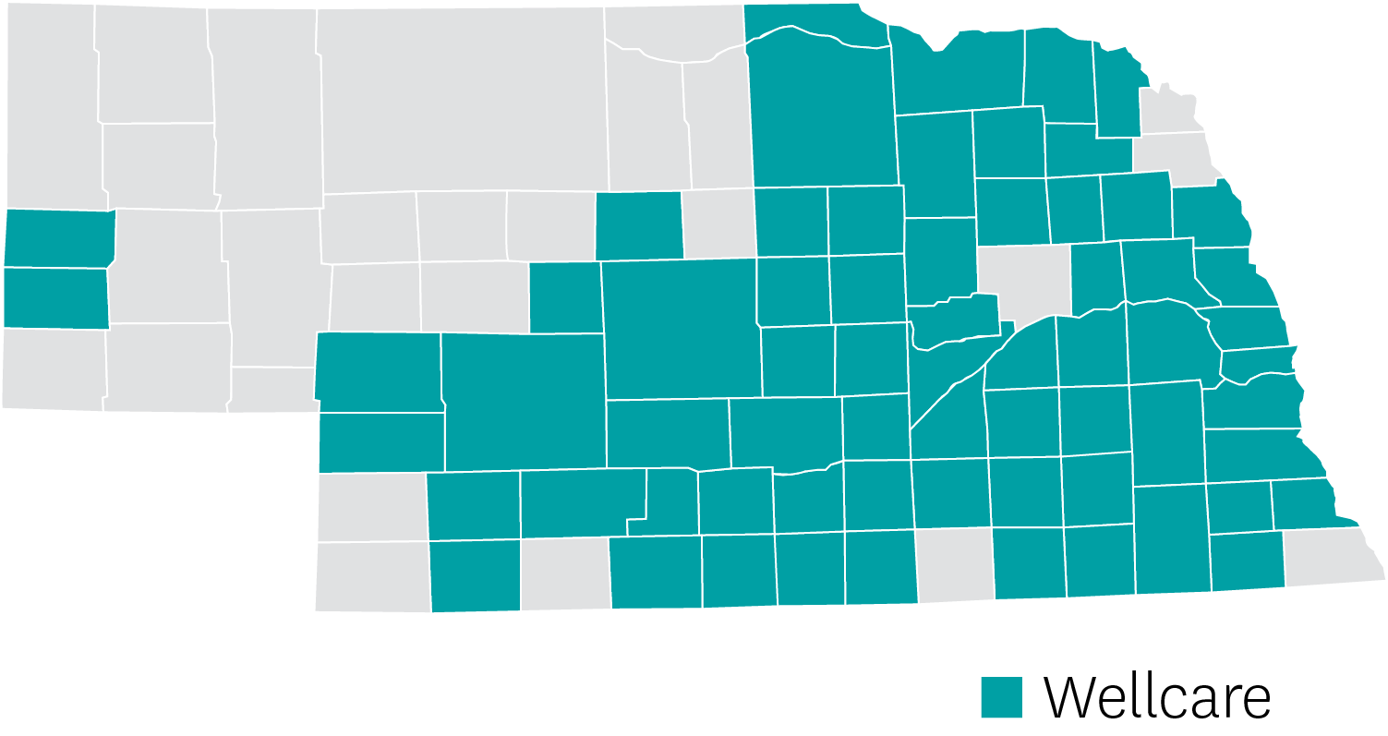
Nebraska | Review
66-county service area
Hospital and provider networks are strong with little to no gaps
2024 focus on D-SNP product offering
New Wellcare Spendables Card!
Wellcare

Slide 85
Nebraska | At a Glance
Push Plans | Plan Type | Benefit Highlights
Wellcare Dual Liberty (H1215-001) | HMO D-SNP | Spendables Card - $2,040 Monthly Utilities, Rent, Gas, Healthy Food, OTC, DVH - $170, Rolling $1,500 Dental
Wellcare Dual Access Open (H1395-001) | PPO D-SNP | Spendables Card - $1,524 Monthly Utilities, Rent, Gas, Healthy Food, OTC, DVH - $127, Rolling $1,000 Dental
*Additional eligibility is required to qualify for SSBCI benefits

Slide 86
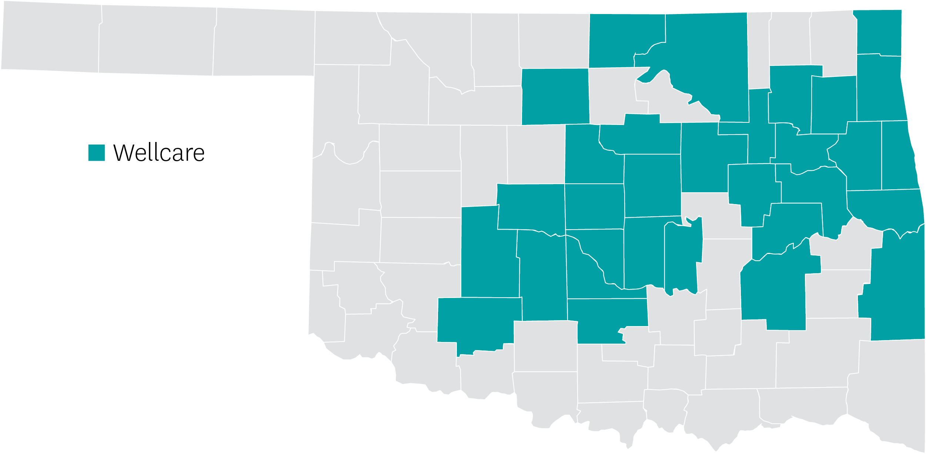
Oklahoma | Review
30-county service area
Array of products offered
HMO, HMO D-SNP, PPO D-SNP, PPO
New Wellcare Spendables Card!
New All Dual plan for partial dual eligibles
Wellcare

Slide 87
Oklahoma | At a Glance
Push Plans | Plan Type | Benefit Highlights
Wellcare No Premium Open (H4537-001) | PPO | Spendables Card - $360 Monthly OTC + DVH - $30, Rolling $2,000 Dental
Wellcare Dual Access Open (H4537-004) | PPO D-SNP | Spendables Card - $1,200 Monthly Utilities, Rent, Gas, Healthy Food, OTC, DVH - $100, Rolling $3,000 Dental
Wellcare Dual Access (H9900-002) | HMO D-SNP | Spendables Card - $1,500 Monthly Utilities, Rent, Gas, Healthy Food, OTC, DVH - $125, Rolling $3,000 Dental
Wellcare Dual Liberty (H9900-003) | HMO D-SNP | Spendables Card - $2,520 Monthly Utilities, Rent, Gas, Healthy Food, OTC, DVH - $210, Rolling $4,000 Dental
Wellcare No Premium (H9900-004) | HMO | Spendables Card - $600 Monthly OTC + DVH - $50, Rolling $2,000 Dental
Wellcare All Dual Assure (H9900-009) | HMO D-SNP | New Plan Spendables Card - $480 Monthly Utilities, Rent, Gas, Healthy Food, OTC, DVH - $40, Rolling $2,000 Dental
*Additional eligibility is required to qualify for SSBCI benefits

Slide 88
Tennessee | Review
Statewide
Array of products offered
HMO, HMO D-SNP, HMO-POS
Robust provider network in Nashville, Memphis, and Knoxville
Methodist, St. Francis, UT Medical, Tri-Star, Vanderbilt, St. Thomas, Tennova, Bristol Regional
New Wellcare Spendables Card!
Wellcare

Slide 89
Tennessee | At a Glance
Push Plans | Plan Type | Benefit Highlights
Wellcare Dual Access (H1416-035) | HMO D-SNP | Spendables Card - $1,692 Monthly Utilities, Rent, Gas, Healthy Food, OTC, DVH - $141, Rolling $5,000 Dental
Wellcare Assist (H1416-042) | HMO | Spendables Card - $600 Monthly OTC, DVH - $50, Rolling $3,000 Dental
Wellcare No Premium (H1416-077) | HMO-POS | Spendables Card - $600 Monthly OTC, DVH - $50, Rolling $1,500 Dental
*Additional eligibility is required to qualify for SSBCI benefits

Slide 90
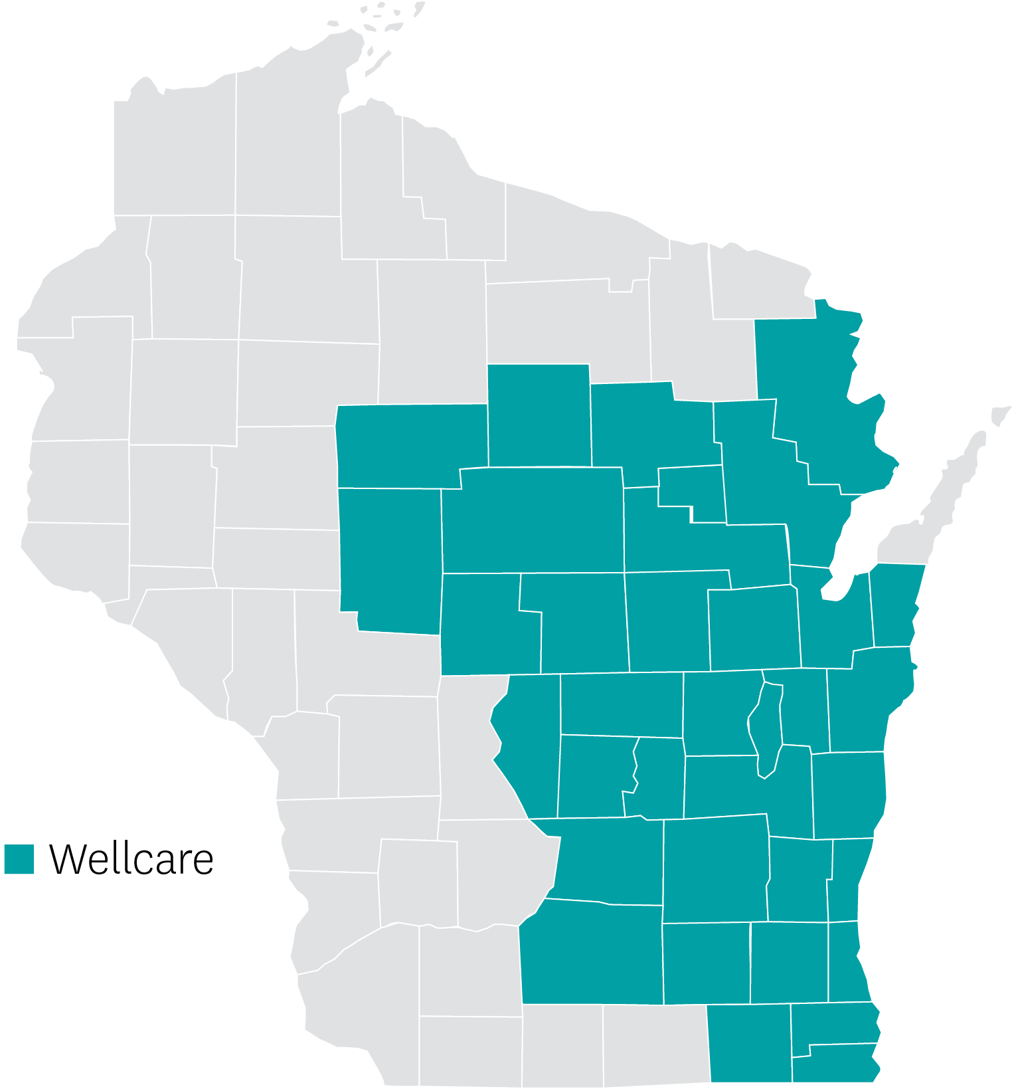
Wisconsin | Review
72-county service area
Strong hospital and provider network
Ascension
Aspirus
Aurora
Bellin
Froedtert
ThedaCare
UW Health
New Wellcare Spendables Card!
New All Dual plan for partial dual eligibles
Wellcare

Slide 91
Wisconsin | At a Glance
Push Plans | Plan Type | Benefit Highlights
Wellcare Dual Access (H8189-001) | D-SNP HMO | Spendables Card - $2640 Monthly Utilities, Rent, Gas, Healthy Food, OTC, DVH - $220, Rolling Dental Platinum $0
Wellcare All Dual Assure (H8189-007) | D-SNP HMO | New Plan Spendables Card - $1380 Monthly Utilities, Rent, Gas, Healthy Food, OTC, DVH - $110, Rolling Dental Platinum $0
*Additional eligibility is required to qualify for SSBCI benefits

Slide 92
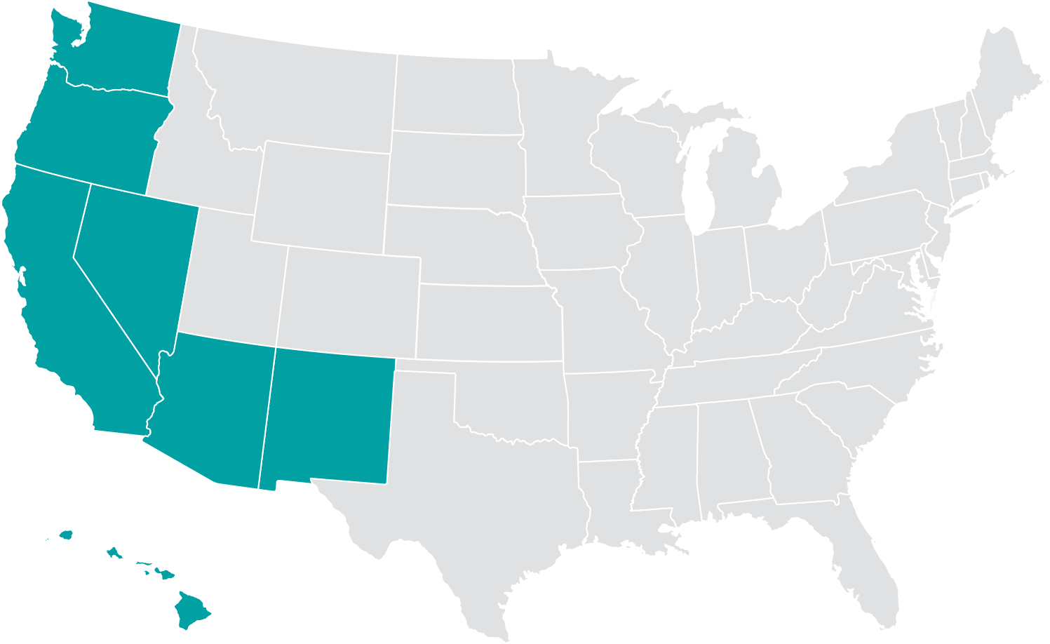
West Region Markets
Existing 2023 markets
Arizona
California
Hawaii
Nevada
New Mexico
Oregon
Washington

Slide 93
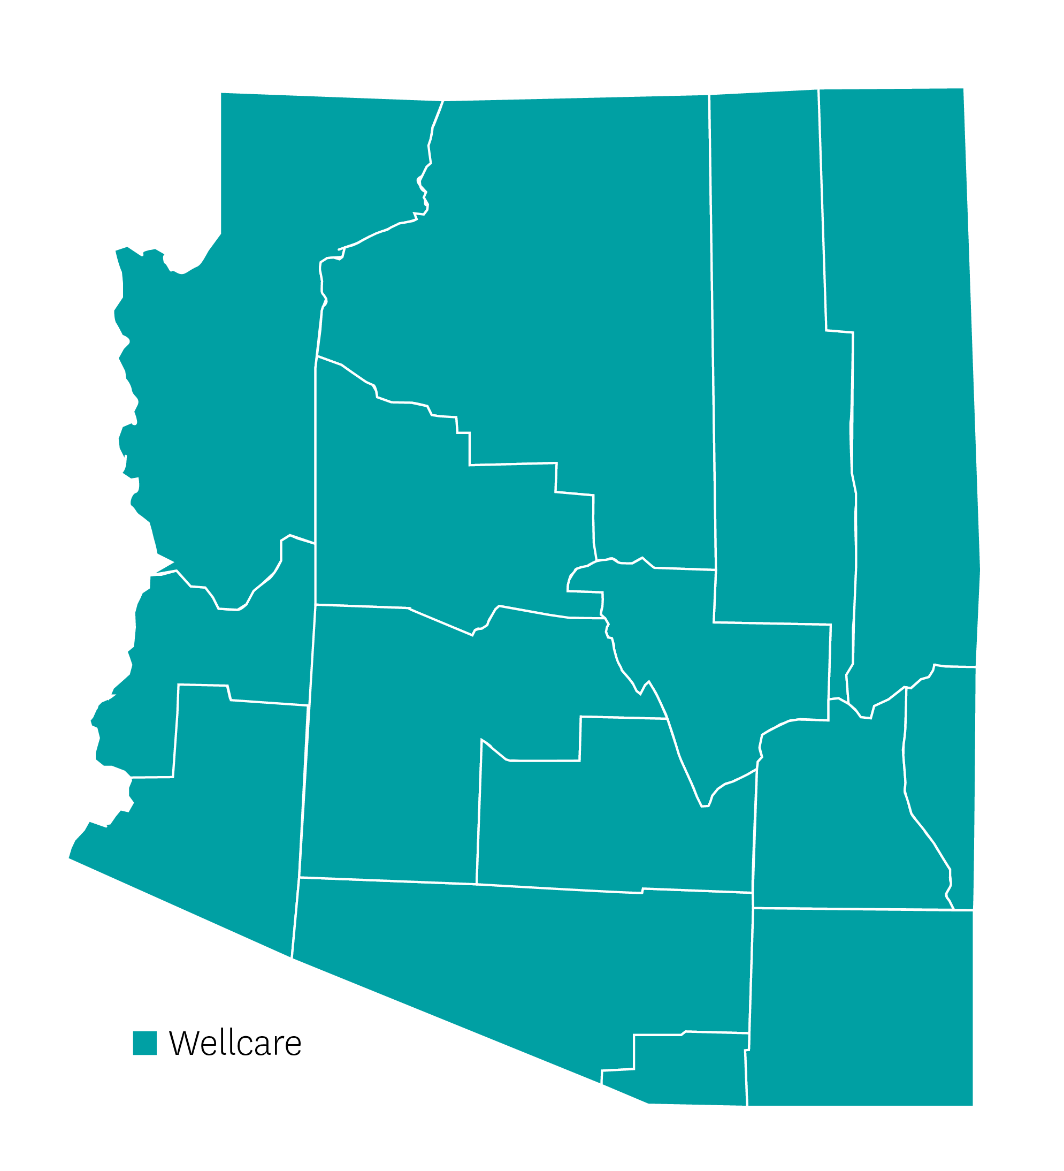
Arizona | Review
#4 in market share – goal to be in top 3
16 total Medicare Advantage products (HMO, PPO, C-SNP, D-SNP, Giveback), 3 PDPs
Products offered in every county
Statewide D-SNP; PDP and county expansion for HMO, PPO, C-SNP
Products designed around urban vs. rural counties
Main competitors: UHC, Humana, and Aetna
Provider network - reciprocity/no referrals required
Strong expanded network for PCP, specialties, dental, etc.
P3 Co-Branded Clinic Opening in Sierra Vista Sept. 2023
Big drivers: enhanced supplemental benefits, network
Current D-SNP exclusive: Centerwell, AZPC, Oak Street, Evernorth
Wellcare

Slide 94
Arizona | At a Glance
Push Plans | Plan Type | Counties | Benefit Highlights
Wellcare No Premium H0351- 063, 053 | $0 HMO –MAPD Members that are not FBDE, QMB+ | Cochise, Coconino, Gila, Graham, Greenlee, La Paz, Maricopa, Pinal, Pima, Mohave, Santa Cruz, Yavapai, Yuma | $2,000- $3000 Comp Dental + Dentures; $125-135 OTC Quarterly $45-$65 per quarter; $100 -$2000 Vision/year; $1500 Hearing Aid, Fitness Benefit; 12 one-way transportation/year ; Post-acute 3 meals per day (max 42 means per year); Hospital Stay 1-10days $175, 1-6days $270; Urgent Care $20-$40, $0 PCP/$15-$20 Specialist; MOOP $2500-$5,000, PT $15-$40
Wellcare Giveback H0351-054, H0351-060, 064 | HMO – Giveback | Cochise, Coconino, Gila, Graham, Greenlee, La Paz, Maricopa, Mohave, Pima, Pinal, Santa Cruz, Yavapai, Yuma | $40-$90 Part B Giveback; $0 PCP, $35-50 Specialist, $1,000-$1,500 Comp Dental; $1000 Hearing (2 Aids); Fitness Benefit, Rural counties include 75miles approved transportation 12-one-way trips every yr.
Wellcare No Premium (PPO) H8553-001/ Wellcare Patriot Giveback Open (PPO) 002 | PPO | Cochise, Coconino, Gila, Graham, La Paz, Maricopa, Mohave, Pima, Pinal, Santa Cruz, Yavapai | $0 PCP, $35 Specialist; $4,500-$5,000 MOOP; $2,000 - $3000 Comp Dental ($INN $OON); $250-$300 Hospital Stay 1-6 days; $50-$90 OTC Per Quarters; $700-$2000 Hearing (1 per year) Hearing Aids; Fitness Benefit; 24 one-way transportation trips every year; $300 RX Deductible Tier 3-5 *Giveback Part B $50

Slide 95
Arizona | At a Glance
Push Plans | Plan Type | Counties | Benefit Highlights
Wellcare Specialty No Premium H0351-038, 057 | C-SNP (CHF, Cardiovascular, Diabetes) | Maricopa, Pima, Pinal, Cochise, Mohave, Santa Cruz, Yavapai, Yuma | $1,000 Comp Dental; $40 OTC Per Quarter; $100 Vision; $1500/2 Hearing Aids; 24 one-way transportation trips every year; Fitness Benefit, Preferred 0-3 Tiers $0-$37
Wellcare Dual Liberty (HMO D-SNP) H5590-008, 009 | HMO D-SNP Medicare FBDE, QMB+ | All Counties | $4,000 Comp Dental; $125 OTC monthly, $300 Vision, $1000 Hearing Aids; (VBID Benefits + OTC + DVH - Single Purse), 24 one-way transportation trips every year, PERS; Fitness Benefit
Wellcare Assist (HMO) H0351-61, 062 | HMO-LIS | Maricopa, Pima, Pinal, Cochise, Coconino, Gila, Graham, Greenlee, La Paz, Mohave, Santa Cruz, Yavapai, Yuma | $2000 Dental, $300 Vision, $1500 Hearing; $175- $225 Days 1-6 Hospital; $0 PCP/; $15-$35 Specialist; $120-$135 WER; $20 LAB, 24 one-way transportation/year; $90 OTC/quarter; 42 Post-acute 3 meal per day; Fitness Benefit

Slide 96
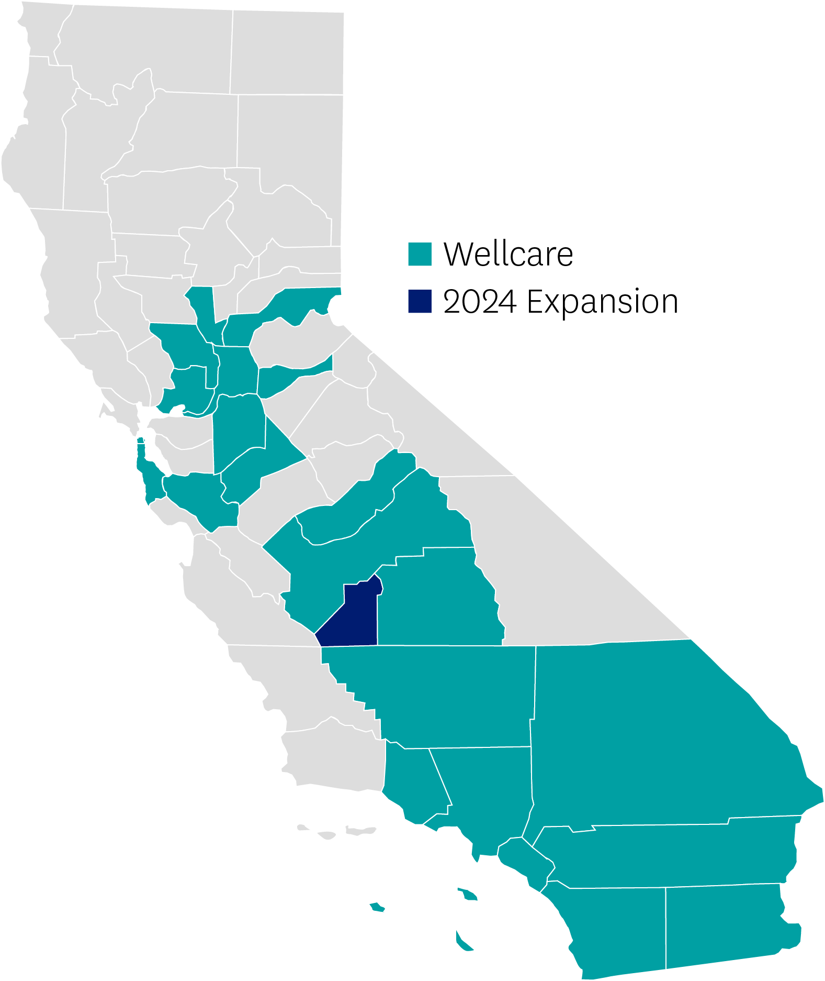
California – South | Review
Geography: urban and rural; multiple metropolitan areas (Los Angeles, Orange, San Bernardino, Riverside). Diversity is the majority in Southern California. State can be viewed in four regions: NorCal; SoCal: Los Angeles; San Diego/OC; and Riverside, San Bernardino, and Imperial Counties
Products: MAPD, D-SNP, C-SNP
Network: Carry both Health Net and Wellcare networks. Extensive provider groups with strong engagement. Continued efforts on network consolidations between the two brands. 56 PPGs (Legacy Wellcare), 85 PPGs (Legacy Health Net/Centene).
Competitors: Kaiser, UHC, Scan, Anthem, Blue Shield, Bright Health, Humana, Alignment, Aetna, IEHP, LA Care, Cal Optima, Molina
Positioned at #5 in market share. Ranked #6 for MAPD HMO plans and #1 D-SNP in the market.
Broker footprint: 7,000 RTS brokers in the market
Wellcare
2024 Expansion

Slide 97
California – South | Service Area
Wellcare Continued Coverage Counties:
Imperial, Los Angeles, Orange, Riverside, San Bernardino, San Diego, Ventura
Wellcare
2024 Expansion

Slide 98
California – South | At a Glance
Push Plans | Plan Type | County | Benefit Highlights
Wellcare Dual Align H3561-008-000 | D-SNP | Los Angeles | Delta Dental Wrap: No Limit Vision: $300; Hearing Aids: $2,000; Transportation: 24 one-way trips (with unlimited Medi-Cal transportation) One Spendable Card (OTC & VBID) $75/month; In-Home Support Services (Chores); Fitness: Peerfit; Personal Emergency Response System
Wellcare Dual Liberty H3561-001-000 | D-SNP | Imperial | Delta Dental Wrap: No Limit Vision: $300; Hearing (2 Aids): $2000; Transportation: 24 one-way trips (with unlimited Medi-Cal transportation) One Spendable Card (OTC & VBID) $75/month; In-Home Support Services (Chores); Fitness: Peerfit; Personal Emergency Response System
Wellcare Specialty No Premium H0562-092-000 | C-SNP | Los Angeles, Orange, San Diego | Preventive & Comprehensive Dental with Copays (Vendor: DBP) Vision: $200; Hearing Aids: $1,000 Transportation: 24 one-way trips; OTC: $60/quarter In-Home Support Services (Chores); Fitness: Peerfit *Select Diabetic Medications and Insulin with $0 copay all year long

Slide 99
California – South | At a Glance
Push Plans | Plan Type | County | Benefit Highlights
Wellcare No Premium H5087-005-000 H5087-024-000 H5087-016-000 | HMO | Los Angeles, Orange, Riverside, San Bernardino, Ventura | Delta Dental No Limit with $0 Copay Vision: $300; Hearing Aids: $2,000; Transportation: 24 one-way trips (with unlimited Medi-Cal transportation) OTC: $60-75/Quarter In-Home Support Services (Chores); Fitness: Peerfit; Personal Emergency Response System
Wellcare Giveback H5087-032-000 H5087-033-000 | HMO | Los Angeles, Orange, Riverside, San Bernardino, Ventura | Part B Giveback: $80 (LA, Orange, SB, Riverside) / $65 (Ventura) Delta Dental No Limit with $0 Copay Vision: $100; Hearing Aids: $1,000 Routine Acupuncture; Fitness: Peerfit
Wellcare No Premium Focus H0562-012-000 H0562-125-000 H0562-126-000 | HMO | Los Angeles, Orange, Imperial, San Diego, San Bernardino, Riverside | Preventive & Comprehensive Dental with Copays (Vendor: DBP) Vision: $300; Hearing Aids: $500 - $1,000 Transportation: 24 one-way trips; OTC: $60-75/Quarter Fitness: Peerfit

Slide 100
California – North | Review
Consolidated into 11 MAPD products (HMO, PPO, C-SNP, D-SNP) offering in 16 counties
Metropolitan geography divided by Northern CA, San Joaquin Valley, Central Valley.
NorCal: Placer, Sacramento, San Francisco, San Mateo, Santa Clara, Solano, Yolo
San Joaquin Valley: Stanislaus and San Joaquin
Central Valley: Fresno, Kern, Kings, Madera, Tulare
Rural geography – Amador and Sutter continue to offer Wellcare No Premium Open PPO.
Competitors: Alignment, Anthem, Bright New Day/Central Health, Humana, UHC
2024 impacted counties:
Kings - expansion
Alameda, Contra Costa – non-renewal
San Joaquin DSNP H5087-027 moving to D-SNP H3561-001
Big drivers: Exclusive Aligned Enrollment opportunity, co-branded with CalViva Health, broad provider networks and enhanced ancillary benefits
Wellcare
2024 Expansion

Slide 101
California – North | Service Area
Wellcare Continued Coverage Counties:
Amador, Fresno, Kern, Madera, Placer, Sacramento, San Francisco, San Joaquin, San Mateo, Santa Clara, Solano, Stanislaus, Sutter, Tulare, Yolo
2024 Expansion Counties:
Kings
2024 Reduction Counties:
Alameda and Contra Costa – Non-Renewal
2024 Reduction Plans:
All NorCal counties – Term Wellcare Patriot Giveback H0562-044
All NorCal counties – Term Wellcare Assist H0562-127
Santa Clara – Term No Premium, added Premium Ultra H0562-009
Fresno, San Francisco – Term Specialty No Premium C-SNP H0562-118.
Sacramento, Placer – Term Wellcare No Premium H0562-124
San Joaquin – D-SNP H5087-027 moving to DSNP H3561-001
Wellcare
2024 Expansion

Slide 102
California – North| At a Glance
Push Plans* | Plan Type | Counties | Benefit Highlights
Wellcare No Premium H0562-128 *Push Plan | HMO -MAPD | Amador, San Mateo, Santa Clara, Solano, Yolo | $0 PCP, $25 Specialist; $8,850 MOOP; $350 Hospital Stay 1-5 days; Unlimited Comp Dental $0-2250; $60 OTC Per Quarters; $200 Vision; $500 Hearing (2 Aids); Fitness with Peerfit; Part D deductible: $545 T3-5.
Wellcare No Premium H5087-024 | HMO -MAPD | San Joaquin, Ventura | $0 PCP, $5 Specialist; $3,850 MOOP; $225 Hospital Stay 1-6 days; $60 OTC/qtr, $100 Vision; No Limit Dental w/Delta Dental; $500 Hearing (2 Aids); no transportation trips; Fitness with Peerfit; Part D deductible: $300 T3-5.
Wellcare No Premium Focus H0562-097 *Push Plan | HMO –MAPD | San Francisco | $0 PCP, $20 Specialist; $6,350 MOOP; $350 Hospital Stay 1-5 days; $40 OTC, $200 Vision; Unlimited Comp Dental $0-2250; $500 Hearing (2 Aids); 12 one-way transportation trips; Fitness with Peerfit; Part D deductible: $150 T3-5
Wellcare No Premium Ruby H0562-079 | HMO -MAPD | Fresno, Kern, Madera, Stanislaus, Tulare | $0 PCP, $0 Specialist; $350 Hospital Stay 1-5 days; $3,850 MOOP; $60 OTC, $100 Vision; Unlimited Comp Dental $0-2250; $500 Hearing (2 Aids); no transportation; Fitness with Peerfit; Part D deductible: $300 T3-5.
Wellcare No Premium Open H7360-001 | PPO | Amador, Sutter | $0 Premium, $5 PCP, $50 Specialist; $8,850 INN/$13,300 OON; $300 Hospital Stay 1-5 days; $35 OTC per quarters; Dental PPO Centene Copper $1,500 (40% INN); $100 Visoin; 12 one-way transportation trips; $1000 Hearing (2 Aids); PERS; Fitness with Peerfit; $300 RX Deductible Tier 3-5
Notes:
OTC / GAS/ Utilities/ RENT/ Health Food

Slide 103
California – North| At a Glance
Push Plans* | Plan Type | Counties | Benefit Highlights
Wellcare Dual Liberty H3561-001 *Push Plan | HMO D-SNP | Amador, Imperial, Kern, Placer, San Francisco, San Joaquin, Stanislaus | $75 OTC/mo†, VBID (gas, utilities, rent assistance, and healthy food), $300 Vision; Dental Wrap No Limit w/Delta Dental; $1,000 Hearing (2 Aids); 24 one-way transportation trips; Fitness with Peerfit; $0 Prescription Drugs.
Wellcare – CalViva Health Dual Align H3561-007 *Push Plan | HMO D-SNP | Fresno, Kings*, Madera | $75 OTC/mo†, VBID (gas, utilities, rent assistance, and healthy food), $300 Vision; Dental Wrap No Limit w/Delta Dental; $1,000 Hearing (2 Aids); 24 one-way transportation trips; Fitness with Peerfit; $0 Prescription Drugs.
Wellcare Dual Align H3561-008 *Push Plan | HMO D-SNP | Los Angeles, Sacramento, Tulare | $75 OTC/mo†, VBID (gas, utilities, rent assistance, and healthy food), $300 Vision; Dental Wrap No Limit w/Delta Dental; $1,000 Hearing (2 Aids); 24 one-way transportation trips; Fitness with Peerfit; $0 Prescription Drugs.
Wellcare Specialty No Premium H0562-092 | C-SNP | Kern | $0 PCP, $0 Specialist; $1,900 MOOP; Unlimited Comp Dental $0-2250; $60 OTC Per Quarter; $200 Vision; $500 Hearing (2 Aids); 24 one-way transportation trips every year; Fitness with Peerfit; 42 Post-Acute Meals; PERS; Part D deductible: $150 T3-5.
*New expansion county
†Unused OTC amounts carry over to the next month. The amount loaded into the card is combined with benefit allowance under VBID (gas, utilities, rent assistance, and healthy food). Member may use the loaded allowance interchangeably between OTC and VBID benefits, as member best sees fit for their needs.
Additional eligibility is required to qualify for SSBCI benefits.
Confidential and Proprietary Information

Slide 104
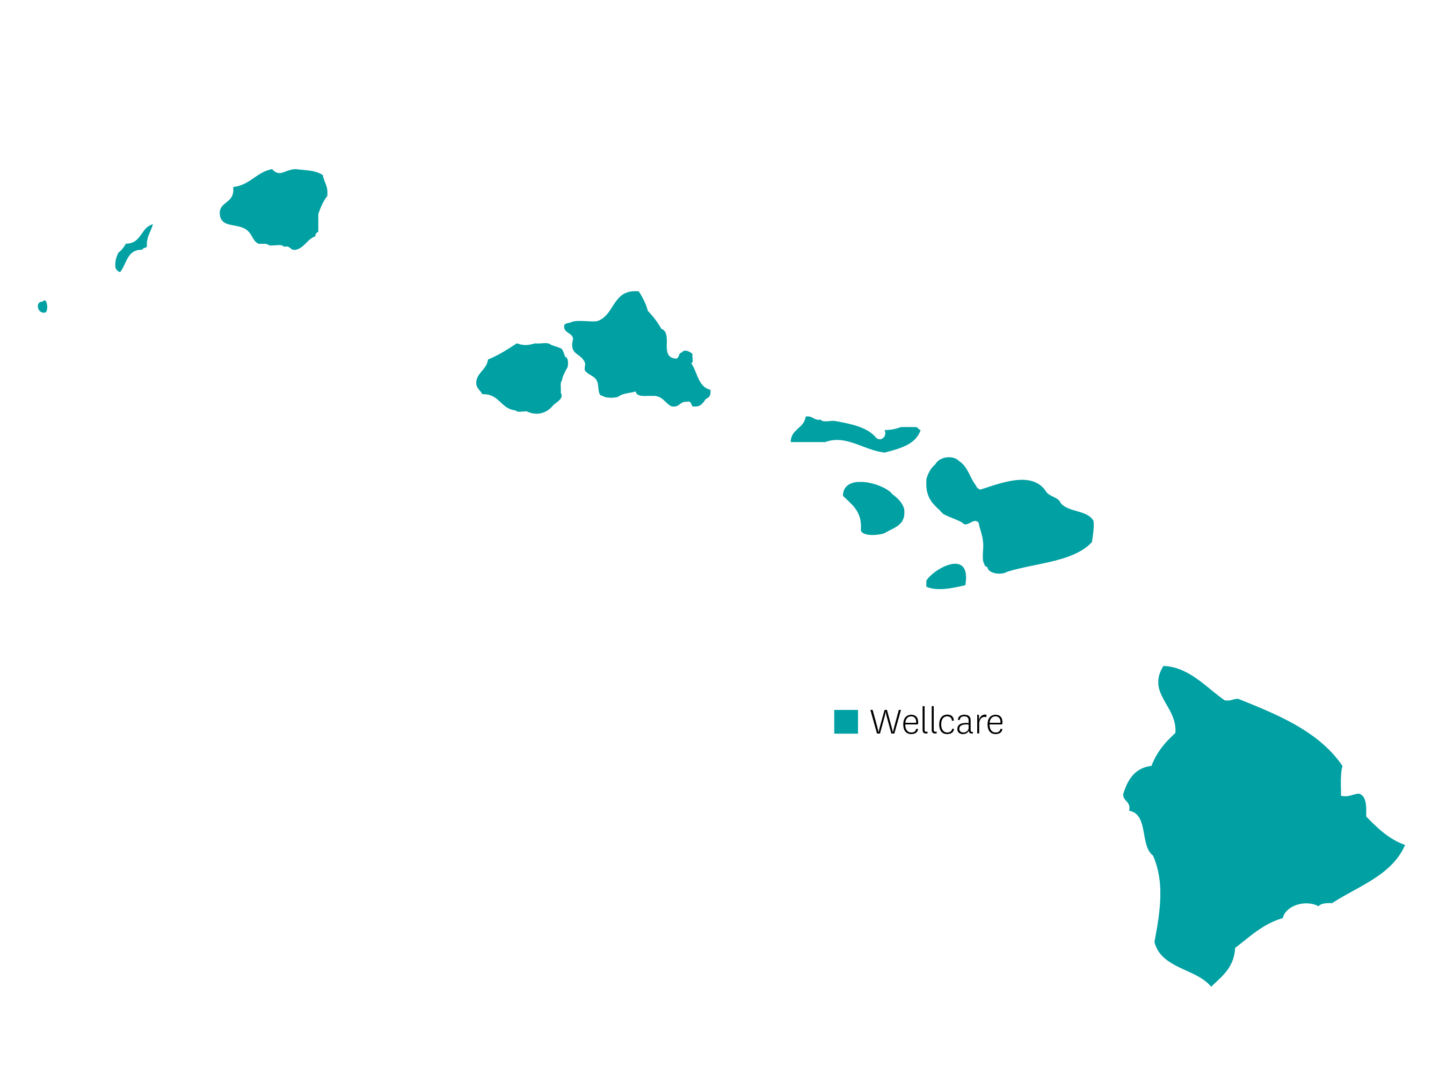
Hawaii | Review
Geography: Hawaii consists of 6 islands but grouped into 4 counties: Honolulu, Hawaii, Kauai, Maui (Maui, Lanai, Molokai); air travel is needed to go between counties
Urban geography: Honolulu
Rural geography: Hawaii, Kauai, and Maui
Top competitors: UHC, Humana, HMSA, Kaiser, Devoted
Network highlights: Hawaii Senior Medical Group, FQHCs (Hawaii Island Community Health Center), QCIPN
Big drivers: NEW spendable card (D/V/H, OTC, Gas, Utilities), fitness, dental with dentures, acupuncture, chiropractic, vision, and hearing
Wellcare

Slide 105
Hawaii | At a Glance
Push Plans | Plan Type | Benefit Highlights
Wellcare 'Ohana No Premium (Honolulu county) | HMO | OTC, Dental $1,500 including Dentures, Vision $200, Hearing Aids, Low professional copays with Tier 1 providers, Acupuncture, Chiropractic, Fitness
Wellcare 'Ohana No Premium (Hawaii county) | HMO | $0 Premium plan, OTC, Dental $1,000 including Dentures, Vision $100, Hearing Aids, Acupuncture, Chiropractic, Fitness
Wellcare 'Ohana Dual Liberty (HIDE) | HMO D-SNP | $85/month spendable card (D/V/H, OTC, Gas, utilities), Dental $3,000 including Dentures, Fitness, Acupuncture, Chiropractic
Wellcare ‘Ohana Dual Align (FIDE) | HMO D-SNP | $90/month spendable card (D/V/H, OTC, Gas, utilities), Dental $3,000 including Dentures, Fitness, Acupuncture, Chiropractic
Wellcare 'Ohana No Premium Open | PPO | OTC, Dental Bronze, Vision $100, Hearing Aids, Fitness, Acupuncture, Chiropractic
Wellcare 'Ohana Patriot Open | PPO | Low PCP, OTC, Dental $2,000 including Dentures, Fitness, Acupuncture, Chiropractic
Wellcare 'Ohana Assist Open Honolulu County Only | PPO | OTC, Dental $2,000 including Dentures, Vision $100, Fitness, Acupuncture, Chiropractic
Wellcare ‘Ohana Low Premium Kaui, Maui, Hawaii County | PPO | OTC, Dental $1,000 including Dentures, Vision $100, Fitness, Acupuncture, Chiropractic

Slide 106
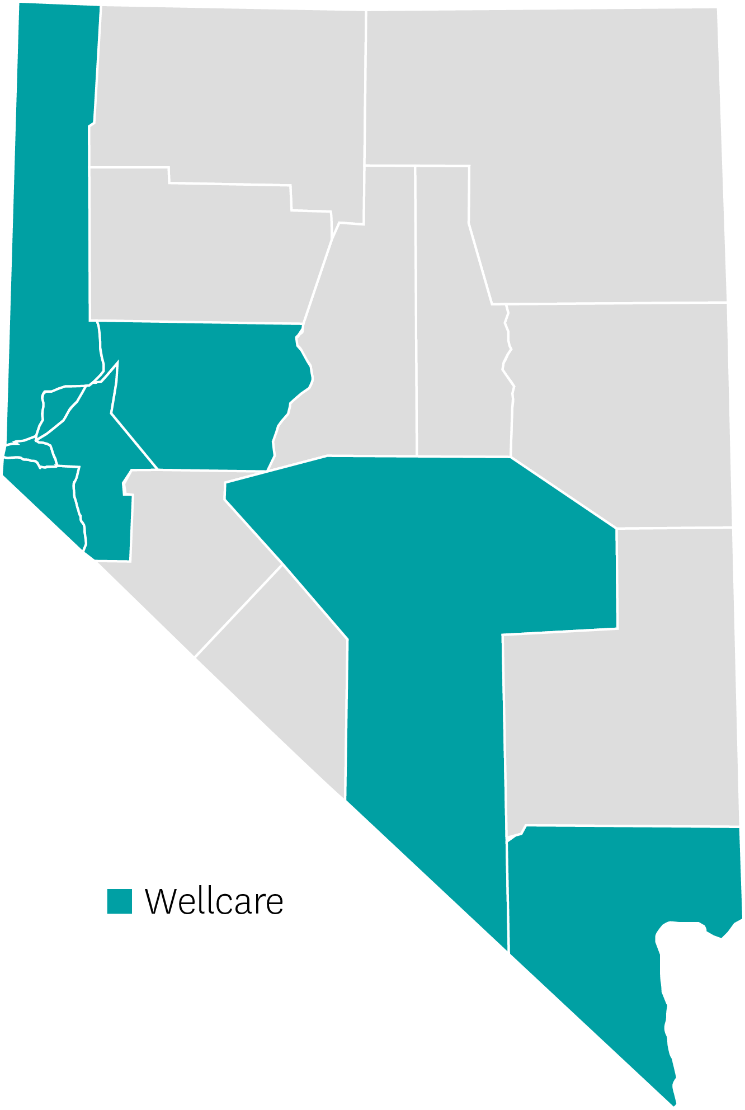
Nevada | Review
6 MAPD products (HMO, PPO, C-SNP, D-SNP), 3 PDP
IPA co-branded products in Clark/Nye counties (P3/Arkos)
Metropolitan geography - Clark, Washoe
Rural geography - Carson City, Lyon, Nye, Churchill, Douglas, Storey
Rural areas are predominately D-SNP
Competitors: UHC, Humana, Aetna
Provider reciprocity/no referrals required
Reciprocity between Carson City, Lyon, Washoe, Douglas, Churchill, Storey
Big drivers: additional supplemental benefits
Wellcare

Slide 107
Nevada | At a Glance
Push Plans | Plan Type | Counties | Benefit Highlights
Wellcare No Premium (P3/Arkos) H6446001 | HMO MAPD | Clark, Nye | $3,000 Preventative Dental/ Comprehensive, $200 OTC every quarter; $200 Vision Benefit; $2,000 Hearing aid benefit; 24 one-way transportation trips, Silver & Fit Benefit- ASH; Post-acute 3 meals per day up to 14 days for a max of 42 meals
Wellcare No Premium H6446010 | HMO MAPD | Carson City, Washoe, Lyon, Churchill, Douglas, Storey | $3,000 Preventative Dental/ Comprehensive; $125 OTC every quarter; $200 Vision Benefit; $2,000 Hearing aid benefit; $3,000 Preventative Dental/ Comprehensive; 24 one-way transportation trips; Silver & Fit Benefit- ASH; Post-acute 3 meals per day up to 14 days for a max of 42 meals
Wellcare No Premium Open H8458003 | PPO | Clark, Nye | $3,000 Preventative Dental/ Comprehensive; $75 OTC every quarter; $300 Vision Benefit; $2,000 Hearing aid benefit; Silver & Fit Benefit - ASH; Post-acute 3 meals per day up to 14 days for a max of 42 meals

Slide 108
Nevada | At a Glance
Push Plans | Plan Type | Counties | Benefit Highlights
Wellcare Dual Access H6446014 | D-SNP Zero Cost Share for: FBDE, QMB+, QMB | Clark, Nye | $4,000 Preventative Dental/ Comprehensive; $100/month Flex Card Benefit W/Rollover for OTC, Utilities, Rent Assistance, Gas, Healthy Food, DVH; $300 Vision Benefit $2,000/year hearing aid benefit; PERS- Emergency Response System; 24 one-way transportation trips; Silver & Fit Benefit - ASH; $0 Prescription Drugs; Post-acute 3 meals per day up to 14 days for a max of 42 meals
Wellcare Dual Access H6446016 | D-SNP Zero Cost Share for: FBDE, QMB+, QMB | Carson City, Washoe, Lyon, Churchill, Douglas, Storey | $4,000 Preventative Dental/ Comprehensive; $90/month Flex Card Benefit W/Rollover for OTC, Utilities, Rent Assistance, Gas, Healthy Food, DVH; $300 Vision Benefit $2,000/year hearing aid benefit; PERS- Emergency Response System; 24 one-way transportation trips; Silver & Fit Benefit - ASH; $0 Prescription Drugs; Post-acute 3 meals per day up to 14 days for a max of 42 meals
Wellcare Specialty No Premium (P3/Arkos) H6446017 | C-SNP - Diabetes, Cardiovascular Disease, Congestive Heart Failure C-SNP | Clark, Nye | $3,000 Preventative Dental/ Comprehensive; $150 OTC every quarter; $200 Vision Benefit; $2,000/yr. hearing aid benefit; PERS- Emergency Response System; 24 one-way transportation trips; Post-acute 3 meals per day up to 14 days for a max of 42 meals; *Participates in SSM
Additional eligibility is required to qualify for SSBCI benefits.

Slide 109
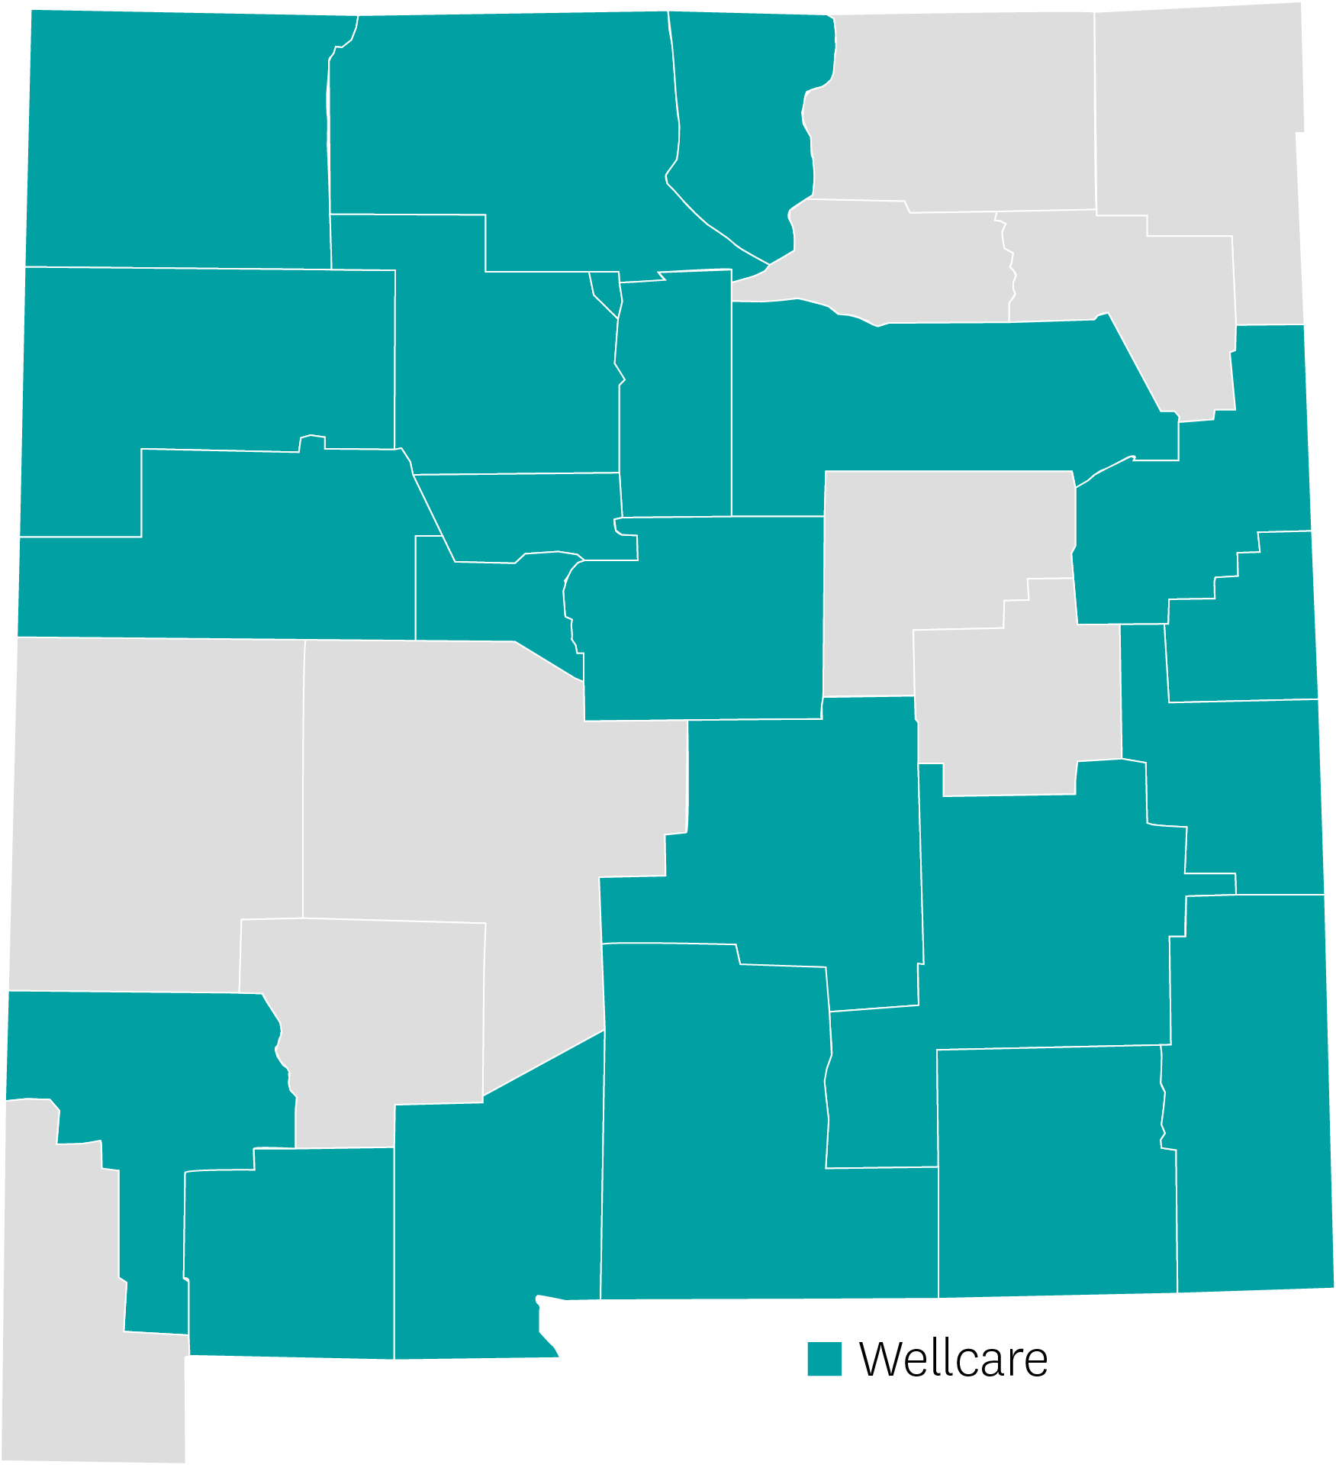
New Mexico | Review
Metropolitan geography: Bernalillo, Dona Ana, Sandoval, Santa Fe
Rural geography: San Juan, Rio Arriba, Taos, McKinley, Torrance, Valencia, Roosevelt, Quay, Luna, Curry, Cibola, Chaves, Eddy, Grant, Lea, Lincoln, Los Alamos, Otero, San Miguel
Competitors: Presbyterian & Humana
Provider reciprocity across states (AZ, CO, TX)
Ongoing provider expansion statewide
Big drivers: additional supplemental benefits (i.e., DVH, D-SNP Grocery Card) and network
PPO options
Wellcare

Slide 110
New Mexico | At a Glance
Push Plans | Plan Type | Counties | Benefit Highlights
Wellcare Dual Liberty H2134-001 | HMO D-SNP Medicare Subset - Zero Cost Share D-SNP FBDE | Bernalillo, Chaves, Cibola, Curry, Dona Ana, Luna, McKinley, Quay, Rio Arriba Roosevelt, San Juan, Sandoval, Santa Fe, Taos, Torrance, Valencia | $4,000 Preventative Dental/Comprehensive; $105 monthly VBID Debit Card (Utilities, Rent, Gas, Health Food, OTC-card/catalog); $300 Vision Benefit; $1,500/year for 2 hearing aids; 24 one-way transportation trips; Silver & Fit Benefit - Includes fitness tracker; Post-acute 3 meals per day up to 14 days for a max of 42 meals.
Wellcare All Dual H2134-003 | HMO D-SNP Medicare Subset - Non-Zero Cost Share D-SNP FBDE, QDWI, QI, QMB, SLMB | Bernalillo, Chaves, Cibola, Curry, Dona Ana, Luna, McKinley, Quay, Rio Arriba, Roosevelt, San Juan, Sandoval, Santa Fe, Taos, Torrance, Valencia | $3,000 Preventative Dental/Comprehensive; $65 monthly VBID Debit Card (Utilities, Rent, Gas, Health Food, OTC-card/catalog); $200 Vision Benefit; $1,500/year for 2 hearing aids; 12 one-way transportation trips; Silver & Fit Benefit - Includes fitness tracker; Post-acute 3 meals per day up to 14 days for a max of 42 meals.

Slide 111
New Mexico | At a Glance
Push Plans | Plan Type | Counties | Benefit Highlights
Wellcare No Premium H2134-005 | HMO | Bernalillo, Dona Ana, Rio Arriba Sandoval, San Juan*, Santa Fe, Torrance, Valencia | $2,000 Preventative Dental/Comprehensive; $60 OTC every quarter Card/Catalog, $100 Vision Benefit, $1,000/year Hearing aid benefit; Silver & Fit Benefit - Includes fitness tracker.
Wellcare No Premium Open H9976-002 | OPEN PPO | Bernalillo, Chaves, Cibola, Curry, Dona Ana, Luna, McKinley, Quay, Rio Arriba, Roosevelt, Sandoval, Santa Fe, Taos, Torrance, Valencia | $1,500 Preventative Dental/Comprehensive; $105 OTC every quarter Card/Catalog; $100 Vision Benefit; $1,000/year Hearing aid benefit; Silver & Fit Benefit - Includes fitness tracker.
*New expansion county

Slide 112
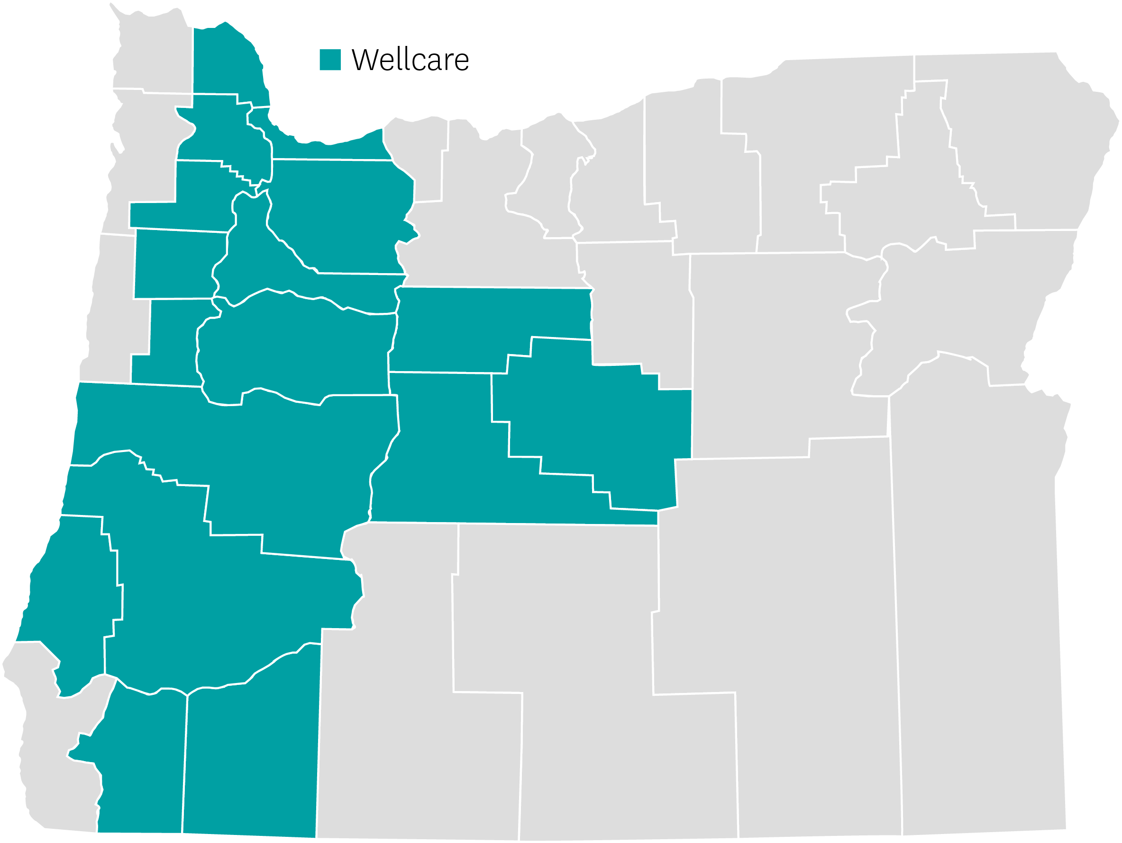
Oregon | Review
Top competitors are UHC, Kaiser, Regence
Broad provider network across the state (24 hospital systems statewide)
Portland metro (including Vancouver in Clark county, WA) is the largest area/population.
Remaining service areas are mainly rural, creating a huge selling opportunity.
Wellcare No Premium PPO Open expanded to all 13 PPO counties
No referrals required on all products.
Wellcare

Slide 113
Oregon | Service Area
Wellcare Continued Coverage Counties:
Benton, Clackamas, Columbia, Coos, Crook, Deschutes, Douglas, Jackson, Jefferson, Josephine, Lane, Linn, Marion, Multnomah, Polk, Washington, Yamhill, Clark County, WA
Branding Bridge by Market:
H5439 (OR, WA); H6815 products
D-SNP only – H2174
Wellcare

Slide 114
Oregon | At a Glance
Push Plan | Plan Type | Counties | Benefit Highlights
Wellcare No Premium Open H5439-017 | PPO | Benton, Clackamas, Lane, Linn, Marion, Multnomah, Polk, Washington, Yamhill; Douglas, Jackson, Josephine, Lane, Clark County, WA | Zero Premium PPO Expanded to all PPO counties Low MOOP – $3,450 INN/OON CAM/Gym/Teladoc One Card: Dental/Vision/Hearing/OTC ($16 mo/$192 annual) Open Access – No referral required
Wellcare No Premium HMO H6815-039 | HMO | Benton, Clackamas, Columbia, Coos, Crook, Deschutes, Douglas, Jackson, Jefferson, Josephine, Lane, Linn, Marion, Multnomah, Polk, Washington, Yamhill | NEW PBP 039 - Zero Premium Low MOOP - $5,600 Gym/Teladoc OTC $40 qtr (no carryover) Open Access – No referral required
Wellcare Dual Select H2174-001 | HMO | Lane | Premium $0-$43.70 Low MOOP - $0-$8,850 CAM/Gym/Teladoc/Transportation/Meals One Card: VBID/Dental/Vision/Hearing/OTC ($85 mo/$1,020 annual) Open Access – No referral required

Slide 115
Oregon | At a Glance
Push Plan | Plan Type | Counties | Benefit Highlights
Wellcare Low Premium Open PPO H5439-019 | PPO | Benton, Clackamas, Lane, Linn, Marion, Multnomah, Polk, Washington, Yamhill; Douglas, Jackson, Josephine, Lane, Clark County, WA | WC Low Prem PPO streamlined to one plan MOOP $5,900 INN/OON Competitive Low premium $30 CAM/Dental/Vision/Gym/Hearing OTC $40 qtr (no carryover) Dental/Vision/Hearing/Gym/Teladoc Open Access – No referral required
Wellcare Assist H6815-037 | HMO | Benton, Clackamas, Columbia, Coos, Crook, Deschutes, Douglas, Jackson, Jefferson, Josephine, Lane, Linn, Marion, Multnomah, Polk, Washington, Yamhill | $0 - $22.70 premium depending on LIS eligibility MOOP $5,600 OTC $40 qtr (no carryover) CAM/Dental/Vision/Hearing/Gym/Teladoc Open Access – No referral required

Slide 116
Oregon | At a Glance
Push Plan | Plan Type | Counties | Benefit Highlights
Wellcare No Premium HMO H6815-038 | HMO | Benton, Clackamas, Columbia, Coos, Crook, Deschutes, Jackson, Jefferson, Josephine, Lane, Linn, Marion, Multnomah, Polk, Washington, Yamhill | Zero Premium Low MOOP - $5,900 CAM/Gym/Teladoc OTC $40 qtr (no carryover) Open Access – No referral required
Wellcare Giveback Open H5439-015 | PPO | Benton, Clackamas, Douglas, Jackson, Josephine, Lane, Linn, Marion, Multnomah, Polk, Washington, Yamhill, Clark County, WA | Zero Premium $22 Monthly Part B Giveback Includes Part D Dental/Vision/Hearing/Gym/Teladoc Open Access – No referral required
Wellcare Patriot Open H5439-010 | PPO | Benton, Clackamas, Douglas, Jackson, Josephine, Lane, Linn, Marion, Multnomah, Polk, Washington, Yamhill, Clark County, WA | Zero Premium Low MOOP $3500 INN / $5100 OON Dental/Vision/Hearing/Gym/Teladoc Open Access – No referral required

Slide 117
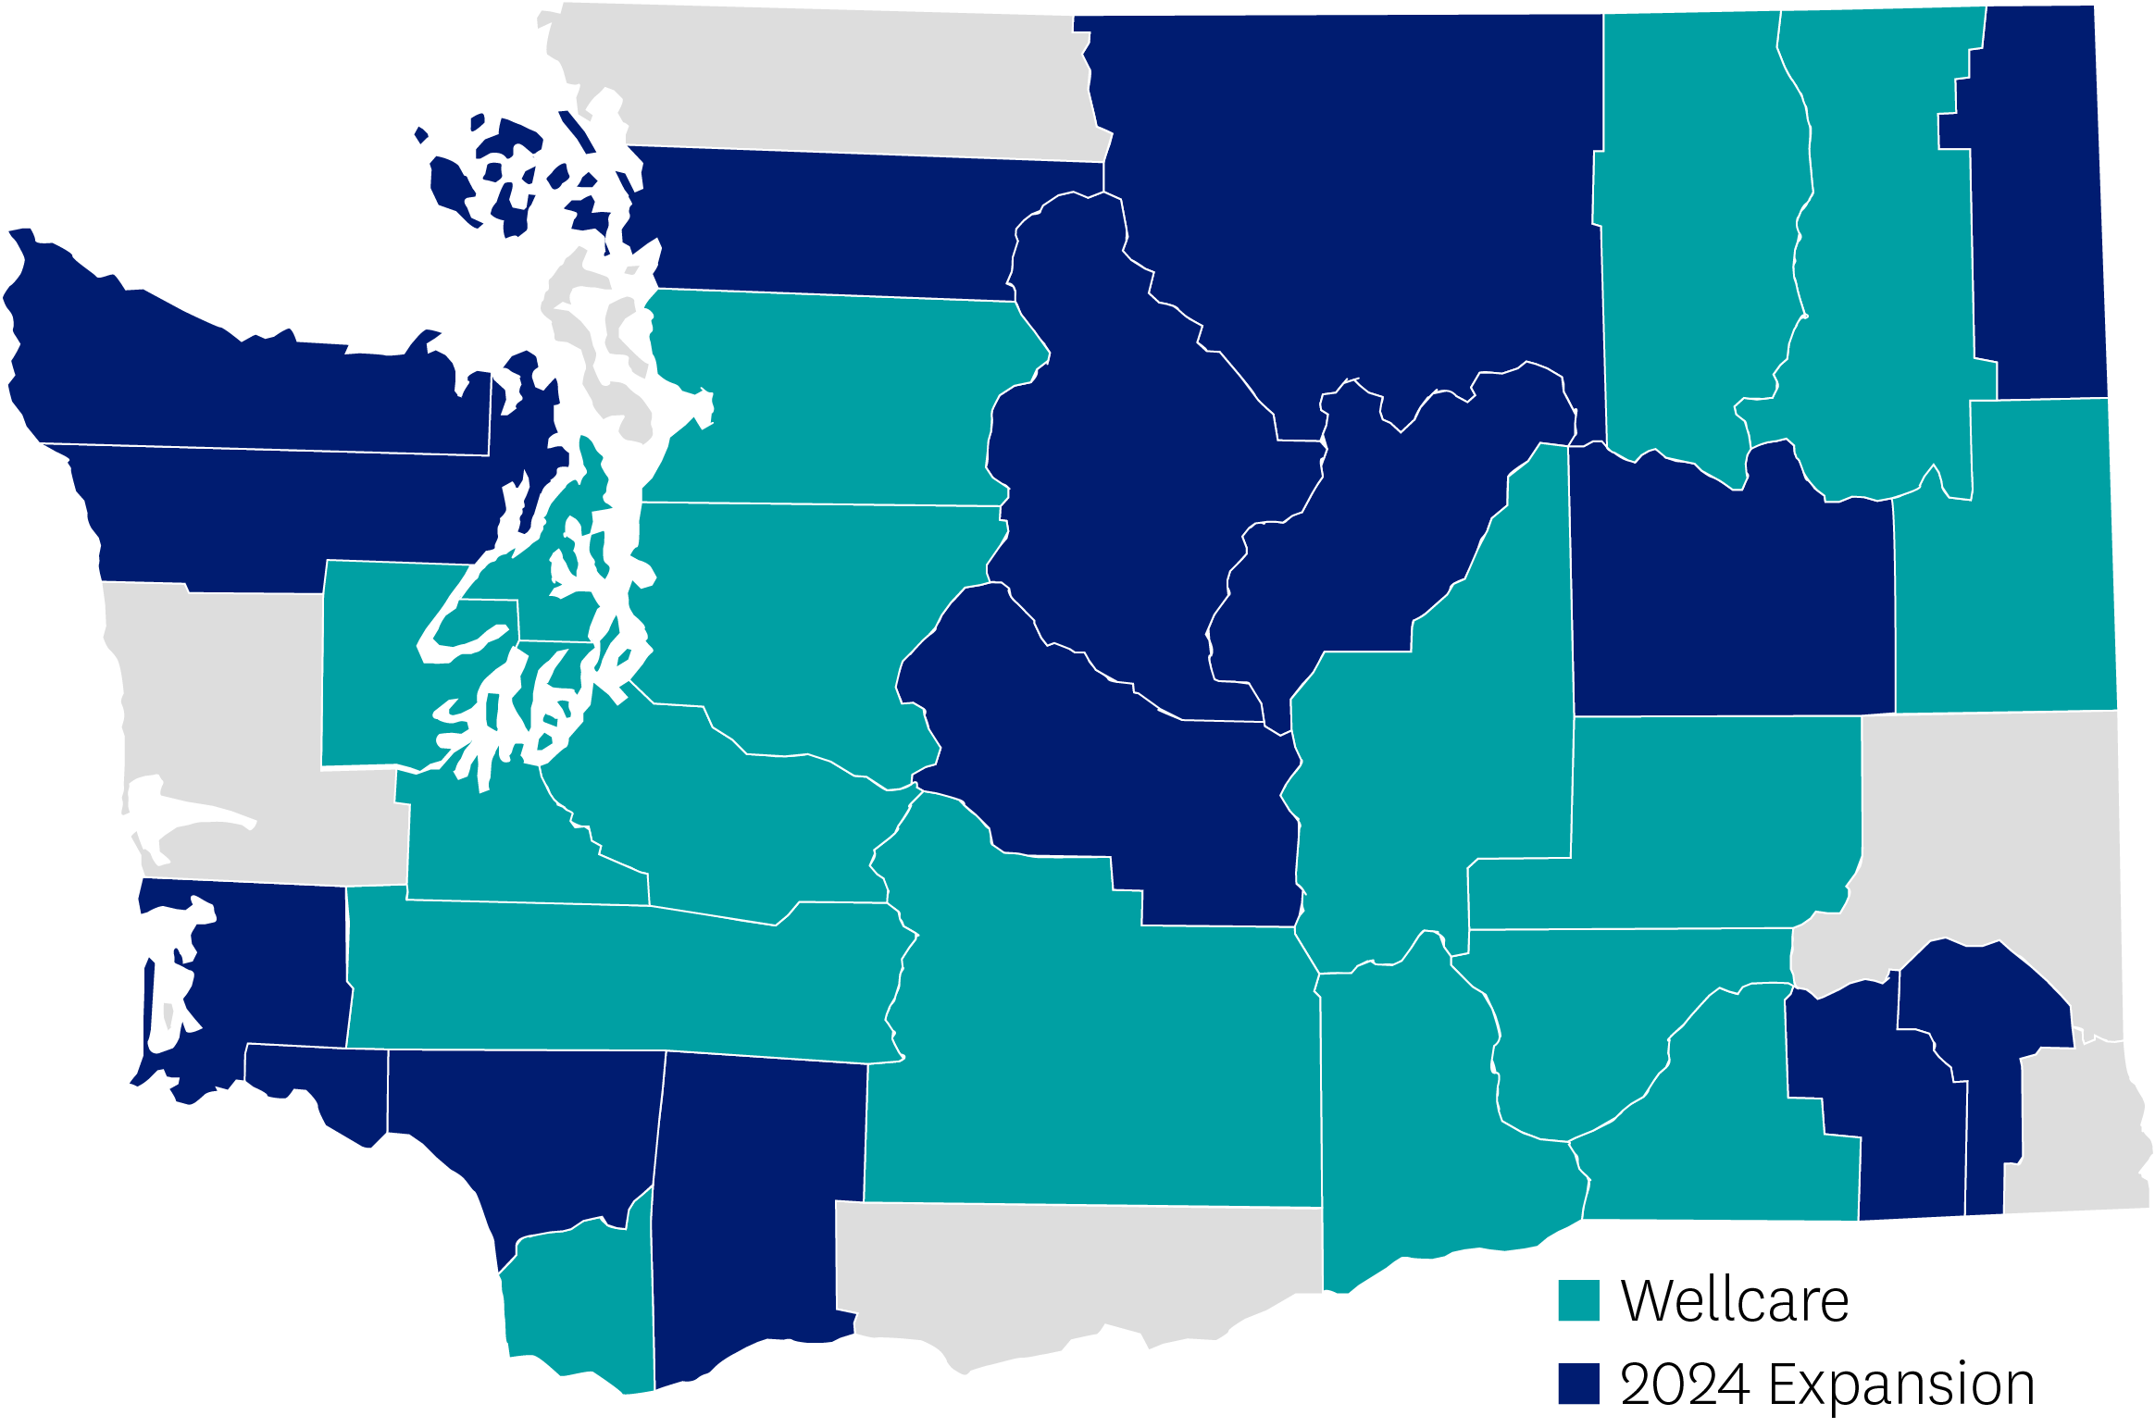
Washington | Review
17-county expansion for 2024
West gets a lot of rain and commerce is mainly tech and manufacturing.
Central and East are more of a dry climate and commerce is agriculture and ranching.
Broad range of products available throughout counties in 2024 – HMO, D-SNP, PPO, including Give Back and PPO D-SNP
Network anchored by key hospital/physician groups; actively contracting with expansion
Top competitors are UHG, Humana, and Aetna
Main differentiation is breadth of ancillary and "extra" benefits: OTC, Dental, Vision, Fitness, and VBID
Wellcare
2024 Expansion

Slide 118
Washington | Service Area
Wellcare Continued Coverage Counties:
Adams, Benton, Ferry, Franklin, Grant, Kitsap, King, Lewis, Mason, Pierce, Snohomish, Spokane, Stevens, Thurston, Walla Walla, Yakima
2024 Expansion Counties:
Chelan, Clallam, Clark, Columbia, Cowlitz, Douglas, Garfield, Jefferson, Kittitas, Lincoln, Okanogan, Pacific, Pend Oreille, San Juan, Skagit, Skamania, Wahkiakum
Branding:
Wellcare
2024 Expansion

Slide 119
Washington | At a Glance
Push Plans | Plan Type | Counties | Benefit Highlights
Wellcare No Premium | HMO | Adams, Benton, Ferry, Franklin, Grant, King, Kitsap, Lewis, Mason, Pierce, Snohomish, Spokane, Stevens, Thurston, Walla Walla, Yakima | $0 PCP copay; $150 Rx Ded T3-T5; $312 annual OTC, DVH, Fitness
Wellcare Giveback | HMO |  | $60 Part B giveback; $10 PCP, Rx Deductible only T3-T5; DVH, OTC, Fitness
Wellcare Dual Liberty | HMO D-SNP |  | $4,000 Dental; $1080 annual VBID Benefits + OTC + DVH - Single Purse, Fitness
Wellcare Dual Access | HMO D-SNP |  | $3,000 Dental; $960 annual VBID Benefits + OTC + DVH - Single Purse, Fitness
Wellcare Mutual of Omaha No Premium Open | PPO | Adams, Benton, Clallam, Clark, Ferry, Franklin, Grant, King, Kitsap, Lewis, Mason, Pierce, Skagit, Snohomish, Spokane, Stevens, Thurston, Walla Walla, Yakima | $0 PCP copay; $25 Specialist copay; $1500 dental; PPO Flexibility
Wellcare Mutual of Omaha Low Premium Open | PPO |  | $0 PCP copay; $20 Specialist copay; $0 Rx Deductible all Tiers

Slide 120
Washington | At a Glance
Push Plans | Plan Type | Counties | Benefit Highlights
Wellcare Dual Access Open | PPO D-SNP | Adams, Benton, Chelan, Clallam, Clark, Columbia, Cowlitz, Douglas, Ferry, Franklin, Garfield, Grant, Jefferson, King, Kitsap, Kittitas, Lewis, Lincoln, Mason, Okanogan, Pacific, Pend Oreille, Pierce, San Juan, Skagit, Skamania, Snohomish, Spokane, Stevens, Thurston, Wahkiakum, Walla Walla, Yakima | PPO Flexibility; $2,000 Dental; $840 annual OTC; Fitness

Slide 121
West Market Summary
Coming together as one brand – Wellcare
Seven markets
20 county expansions
Increased product expansion across existing footprints
Enhanced medical and supplemental benefits across ALL markets
Expanded networks in each market
Strong local sales leadership and sales support teams in each market

Slide 122
South Region Markets
Existing 2023 markets
Alabama
Florida
Georgia
Louisiana
Mississippi
North Carolina
South Carolina
Texas

Slide 123
Alabama | Review
Jason Arbour – Sales Manager AL, LA, MS
Extremely competitive in PPO and D-SNP plans
Up to $187/month Spendables Visa
Key Providers: St. Vincent, Tenant’s Providers (Baptist Hospitals), USA, Providence, Grandview, Crestwood, Huntsville (New), Helen Keller (New)
Advanced Provider Partner relationships:
Oak St Health, Physician Partners, Sage Health (New)
Focus on provider and broker education in existing counties from large 2023 expansion
2024 new product expansion:
Competitive All Duals Plan built for partial duals
Wellcare

Slide 124
Alabama | At A Glance
Push Plans | Plan Type | Benefit Highlights
Wellcare Dual Liberty | HMO D-SNP | $187/mo Wellcare Spendables Visa; Unlimited Dental with dentures; Vision; In-Home Support; Transportation Reimbursement
Wellcare Dual Access Open | PPO D-SNP | $150/mo Wellcare Spendables Visa; 5K Dental with dentures; Vision; In-Home Support; Transportation Reimbursement
Wellcare Dual Access | HMO D-SNP | $150/mo Wellcare Spendables Visa; Unlimited Dental with dentures; Vision; In-Home Support; Transportation Reimbursement
Wellcare No Premium | HMO + PPO | Up to $100/mo OTC/DVH Visa; 252 Chronic Meals; 2k Dental with dentures; Vision; Hearing, Low MOOP
Wellcare Giveback | PPO | $110/mo Giveback; Dental; Vision; Hearing
Wellcare All Dual Assure | HMO D-SNP (partial duals) | $84/mo Wellcare Spendables Visa; 252 Chronic Meals; 5K Dental with dentures; Vision; In-Home Support, Transportation Reimbursement

Slide 125
Louisiana | Review
Jason Arbour – Sales Manager AL, LA, MS
Significant investment in D-SNP plans
Up to $240/mo Spendables Visa
Key health systems:
LCMC Health (New Orleans), FMOL (Baton Rouge), Lourdes (Lafayette), Baton Rouge General, St Tammany Hospital (New), and North Oaks Hospital (New)
Advanced Provider Partner relationships:
Centerwell, Oak Street Health, JenCare
2024 new product expansion:
Competitive All Duals Plan built for partial duals
Wellcare

Slide 126
Louisiana | At A Glance
Push Plans | Plan Type | Benefit Highlights
Wellcare Dual Pinnacle | HMO D-SNP | $240/mo Wellcare Spendables Visa, 4K Dental with dentures; Vision; Hearing; Transportation Reimbursement
Wellcare No Premium | HMO | Up to $50/mo OTC/DVH Visa; 252 Chronic Meals; up to 2k Dental with dentures; Vision; Hearing; Low MOOP
Wellcare All Dual Assure | HMO | $70/mo Wellcare Spendables Visa; 2k Dental with dentures; Vision; Hearing; Transportation Reimbursement
Wellcare Dual Freedom | HMO D-SNP | $200/mo Spendables Visa; 4K Dental with dentures; vision; hearing; Transportation Reimbursement
Wellcare Giveback Open | PPO | $60/mo Giveback; Dental; Vision; Hearing

Slide 127
Mississippi | Review
Jason Arbour – Sales Manager AL, LA, MS
Significant investment in D-SNP (HMO/PPO) plans
Up to $210/month rolling Wellcare Spendables Card
Currently only Giveback plan in MS
All major hospitals in Central and Gulf Coast in network
Baptist, UMC, St. Dominic, Merit, Singing River, and Memorial (recently contracted)
Strong local partnerships with providers, churches, food pantries, non-profits, and senior centers
2024 new product expansion:
Competitive All Duals Plan built for partial duals
Wellcare

Slide 128
Mississippi | At A Glance
Push Plans | Plan Type | Benefit Highlights
Wellcare Dual Liberty | HMO D-SNP | $210/mo Wellcare Spendables Visa; 4k Dental with dentures; Vision; In-Home Support; Transportation Reimbursement
Wellcare Dual Access | HMO D-SNP | $180/mo Wellcare Spendables Visa; 3k Dental with dentures; Vision; In-Home Support; Transportation Reimbursement
Wellcare Dual Access Open | PPO DSNP | $100/mo Wellcare Spendables Visa; 4k Dental with dentures; Vision, Hearing, Transportation Reimbursement
Wellcare All Dual Assure | HMO D-SNP (partial duals) | $40/mo Wellcare Spendables Visa; 2k Dental with dentures; Vision; Hearing; Transportation Reimbursement
Wellcare No Premium | HMO + PPO | Up to $300/yr OTC/DVH Visa; Dental with dentures; Vision, Hearing, Low MOOP
Wellcare Giveback | HMO | $55 Part B Giveback, Dental, Vision, Hearing

Slide 129
Georgia | Review
Ross Miller – Sales Manager GA, NC, SC
Experienced local sales team to support the market
Strong provider network statewide
Key provider relationships:
CenterWell
Seoul Medical Group (Atlanta)
ChenMed
Oak Street Health
Iora Health
New for 2024:
All Duals Plan throughout the footprint
Wellcare Spendables Card up to $140/month, rolling
Wellcare Mutual of Omaha No Premium Open (PPO)
Wellcare

Slide 130
Georgia | At A Glance
Push Plans | Plan Type | Benefit Highlights
Wellcare No Premium | HMO | $2,000 Dental Benefit, $0 PCP, $10 Specialist, 12 one-way trips, $2,000 Hearing Benefit
Wellcare All Dual | HMO D-SNP | $84 Monthly Spendable Card, Platinum Dental, In Home Support Benefit, 48 one-way trips, $4,000 Hearing Benefit
Wellcare Dual Access Open | PPO D-SNP | $3,000 Dental Benefit, In Home Support Benefit, 36 one-way trips, $84 Monthly Spendable Card, $3,000 Hearing Benefit
Wellcare Dual Liberty | HMO D-SNP | $140 Monthly Spendable Card, Platinum (No Limit) Dental, Unlimited Transportation Benefit, $5,000 Hearing Benefit
Wellcare Assist | HMO (LIS Plan) | $3,000 Dental Benefit, $0 PCP, $10 Specialist, 24 one-way trips, $25 Monthly OTC, $2,000 Hearing Benefit
Wellcare Giveback | HMO | $80 Part B Giveback, $700 Hearing Benefit, $100 Vision Benefit

Slide 131
North Carolina | Review
Ross Miller – Sales Manger GA, NC, SC
Plans available in 71 of 100 counties
Key providers:
Atrium, Mission, UNC, First Health
Strong product offerings spanning all socio-economic platforms
PPO D-SNP plan has strong value proposition and rich benefits
All plans offered in current footprint
Wellcare

Slide 132
North Carolina | At a Glance
Push Plans | Plan Type | Benefit Highlights
Wellcare Dual Liberty Open | PPO D-SNP | Spendable Card $141 per month, $3,000 Dental allowance; $3,000 Hearing allowance; 24 one-way trips, $400 Vision allowance, PERS
Wellcare No Premium PPO | PPO $0 | OTC $60 qtr, $2,000 Dental allowance; $3,900 INN MOOP; $200 Vision Allowance, $0 PCP INN, OON $10, Specialist INN $25 OON $35, PERS
Wellcare Giveback Open | PPO Giveback | $85 Giveback; PCP $0; INN & OON; Bronze Dental Preventive
Wellcare Assist Open | PPO LIS Non-SNP | OTC $125 qtr.; $3,000 Dental allowance; $2,000 Hearing allowance; 24 one-way trips; In Home Support Services; PCP $0 INN, $10 ONN, Specialist $25 INN, $35 OON, PERS

Slide 133
South Carolina | Review
Ross Miller – Sales Manager GA, NC, SC
All plans in all counties
Key providers:
PRISMA, ANMED, Lexington, McLeod, MUSC, Roper St. Francis
Full product portfolio: HMO, PPO, Giveback, LIS, Giveback, MA Only, and D-SNP plans
Very competitive D-SNP PPO plan
LIS Assist PPO plan with strong benefits
Wellcare

Slide 134
South Carolina | At a Glance
Push Plans | Plan Type | Benefit Highlights
Wellcare Dual Liberty Open | PPO D-SNP | $150 per month Spendable Card, Platinum Dental with no max allowance; $3,000 Hearing allowance, 36 One-Way Trips, PERS; In Home Support Services, $500 Vision Benefit
Wellcare Giveback Open | Giveback PPO | $80 Giveback, Bronze Preventative Dental, $700 Hearing benefit
Wellcare Mutual of Omaha No Premium Open PPO | $0 PPO | OTC $20 per month rolling, $2,000 Dental allowance; $1,500 Hearing allowance; $200 Vision allowance
Wellcare Assist Open PPO | PPO LIS Non-SNP | OTC $55 per month rolling; $3,000 Dental allowance; 12 trips Transportation; $300 Vision allowance, $700 Hearing benefit, PERS

Slide 135
Florida | Review
Joey Anselmo – Sales Manager
Experienced local sales team to support the market
Strong relationships with:
ChenMed/Dedicated
CenterWell
WellMed/Optum
InnovaCare
Physicians Partners
American Care
Palm Medical
IMA
Shands
CareMax
MaxHealth
MyCare
Wellcare
New for 2024:
Wellcare Spendable Card: D-SNP-OTC, utilities, rent assistance, gas pay-at-pump, healthy food, and dental, vision, hearing allowance, up to $205/month, rolling
Most counties will have higher giveback amounts
All 66 counties will have HMO,PPO, and D-SNP Plans

Slide 136
Florida | At A Glance
Push Plans | Plan Type | Benefit Highlights
Wellcare No Premium | HMO + PPO | Low copays with higher ancillary benefit amounts
Wellcare Dual Liberty | HMO D-SNP | Spendable Card up to $205/monthly, Platinum Dental, Vision – Up to $500, hearing allowance, up to 48 one-way trips
Wellcare All Dual (formerly Wellcare Access) | HMO D-SNP + PPO D-SNP | Spendable Card up to $170/month, $4000 Dental, 36 one-way trips, Vision $400
Wellcare Dual Access Open | PPO D-SNP | Spendable Card up to $89/month, $4000 Dental, $300 Vision, Transportation, Hearing allowance
Wellcare Giveback | HMO | Giveback; Dental, Vision, Hearing, Silver Sneakers, Strong formulary

Slide 137
Texas | Review
Jean Negrete – Sales Manager
Local sales teams supporting the markets of Austin, DFW, El Paso, Houston, Rio Grande Valley, and San Antonio
Strong provider network statewide with key partners:
Oak Street Health, Valora Medical Group, WellMed (Dallas & Houston), Cano Health, ChenMed, Village MD
2024 Product Expansion:
All Duals Plan for 2024!
Spendables card (OTC, Groceries/Healthy Food, Utility/Rent Assistance, Gas)
Wellcare Dual Liberty
Wellcare Dual Access
Wellcare Giveback HMO
Ascension Complete Joint Venture: Wellcare Complete
Wellcare Mutual of Omaha No Premium Open (PPO) (Dallas and Houston)
Wellcare

Slide 138
Texas | At A Glance
Push Plans | Plan Type | Benefit Highlights
Wellcare Giveback | HMO | Giveback up to $150; dental; vision; hearing; $0 premium
Wellcare All Dual Assure | HMO, Partial MSPs (SLMB only, QDWI &QI) | Supplemental benefits will be richer than LIS but not as rich as Access
Wellcare Dual Liberty | HMO D-SNP | Dental with implants; vision; hearing, 1 Tier Formulary $0 copay; VBID Package
Wellcare Dual Access | HMO D-SNP | Dental with dentures; vision; hearing; 1 Tier Formulary $0 copay; VBID Package
Wellcare Assist | HMO | Spendables Card; dental with dentures; vision; hearing; transportation

